Slide 1
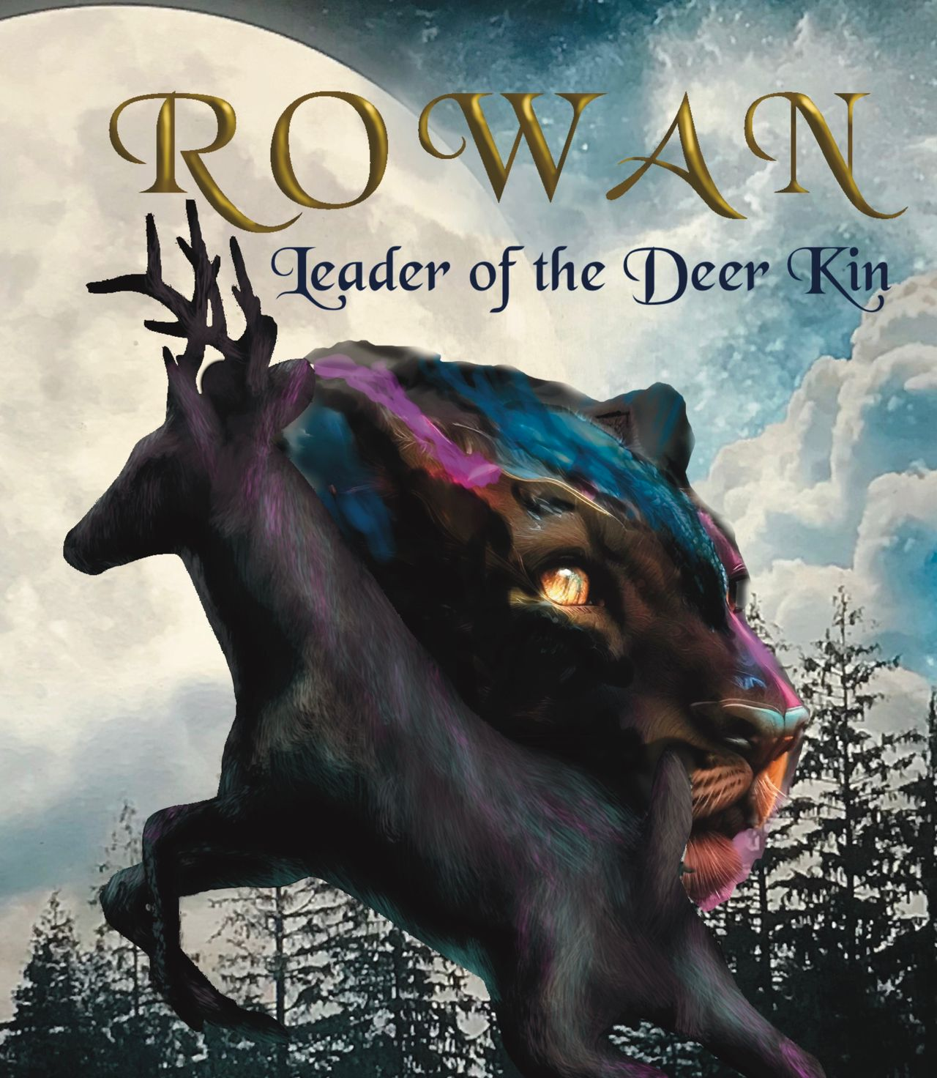
Student Mission Book
Sarah Green

Slide 2
In this unit you will:
Learn about kennings/
compounds
1
Look at examples from the book
Create your own deer kennings
2
Study kennings from Anglo-Saxon poetry
3
Find modern examples
4
Create some of your own
5
Write a dictionary entry for your words
6

Slide 3
Learn the Lingo!
KENNINGS form new words by joining existing ones together.
They are also metaphors
They stem from Anglo-Saxon poetry
COMPOUNDS do the same thing but are not usually metaphors
They are one of the most important ways in which we create new words today.

Slide 4
Revise what you know!
METAPHOR
A figure of speech
Implicitly compares two unrelated things
By stating that one thing IS another.
E.g. “ that chef is a magician.”
SIMILE
A figure of speech
Does much the same thing
BUT uses ‘like’ or ‘as’ to link things.
E.g. ‘ that chef is like a magician.”

Slide 5
Some Ancient Kennings
Beowulf is a Anglo-Saxon poem, famous for its kennings.
Here are a few examples:
“whale-road” [ the sea]
“light-of-battle” [a sword]
“battle-sweat” [blood]
“raven-harvest” [ a corpse]
“ring-giver” [a king]
“sky-candle” the sun]
You can see how much the Saxons liked riddles!

Slide 6
Author’s Note:
Rowan does not understand the world of man.
The author shows that by making up some language for him, such as FANG-CLAW.
This is a KENNING.
It’s characteristic of his language .
It also shows his way of thinking.
For example, ‘kill-stick’ is quite revealing about what he understands. [Those long pointy things kill you, right?}

Slide 7
Rowan’s Kennings
Here are some of Rowan’s kennings. They are like riddles.
Can you work out what they mean?
Fang-claw Cave-trail
Kill-stick Noise-monster
Man-Hive Stone-Tree
Sky-Throb Wing-fire

Slide 8
Create some kennings for Rowan
Invent some kennings for these:
Car
Tractor
City
Gun
Man

Slide 9
Kennings? Compounds? What’s the difference?
Kennings: metaphors
Compounds: literal
e.g.
Compound Kenning
Ice-cream Mouth-chill
Takeoff Sky-soaring
Bookshop Wisdom-hoard
Blackbird Dawn-singer

Slide 10
Working with Compounds The most common way to create new words in English
Find some really up-to-date compounds.
Write a dictionary entry to explain their meaning and how and when to use them.
Tip: see if you can find some that your teacher doesn’t know!
Super-power credit: decide whether the compounds you have found are a noun or a verb or an adjective. Use it in a sentence.
Stuck on writing a dictionary entry? Try this:
1.The compound; 2. noun, verb or adjective? 3. Give an example of a sentence in which it is used.

