Slide 1
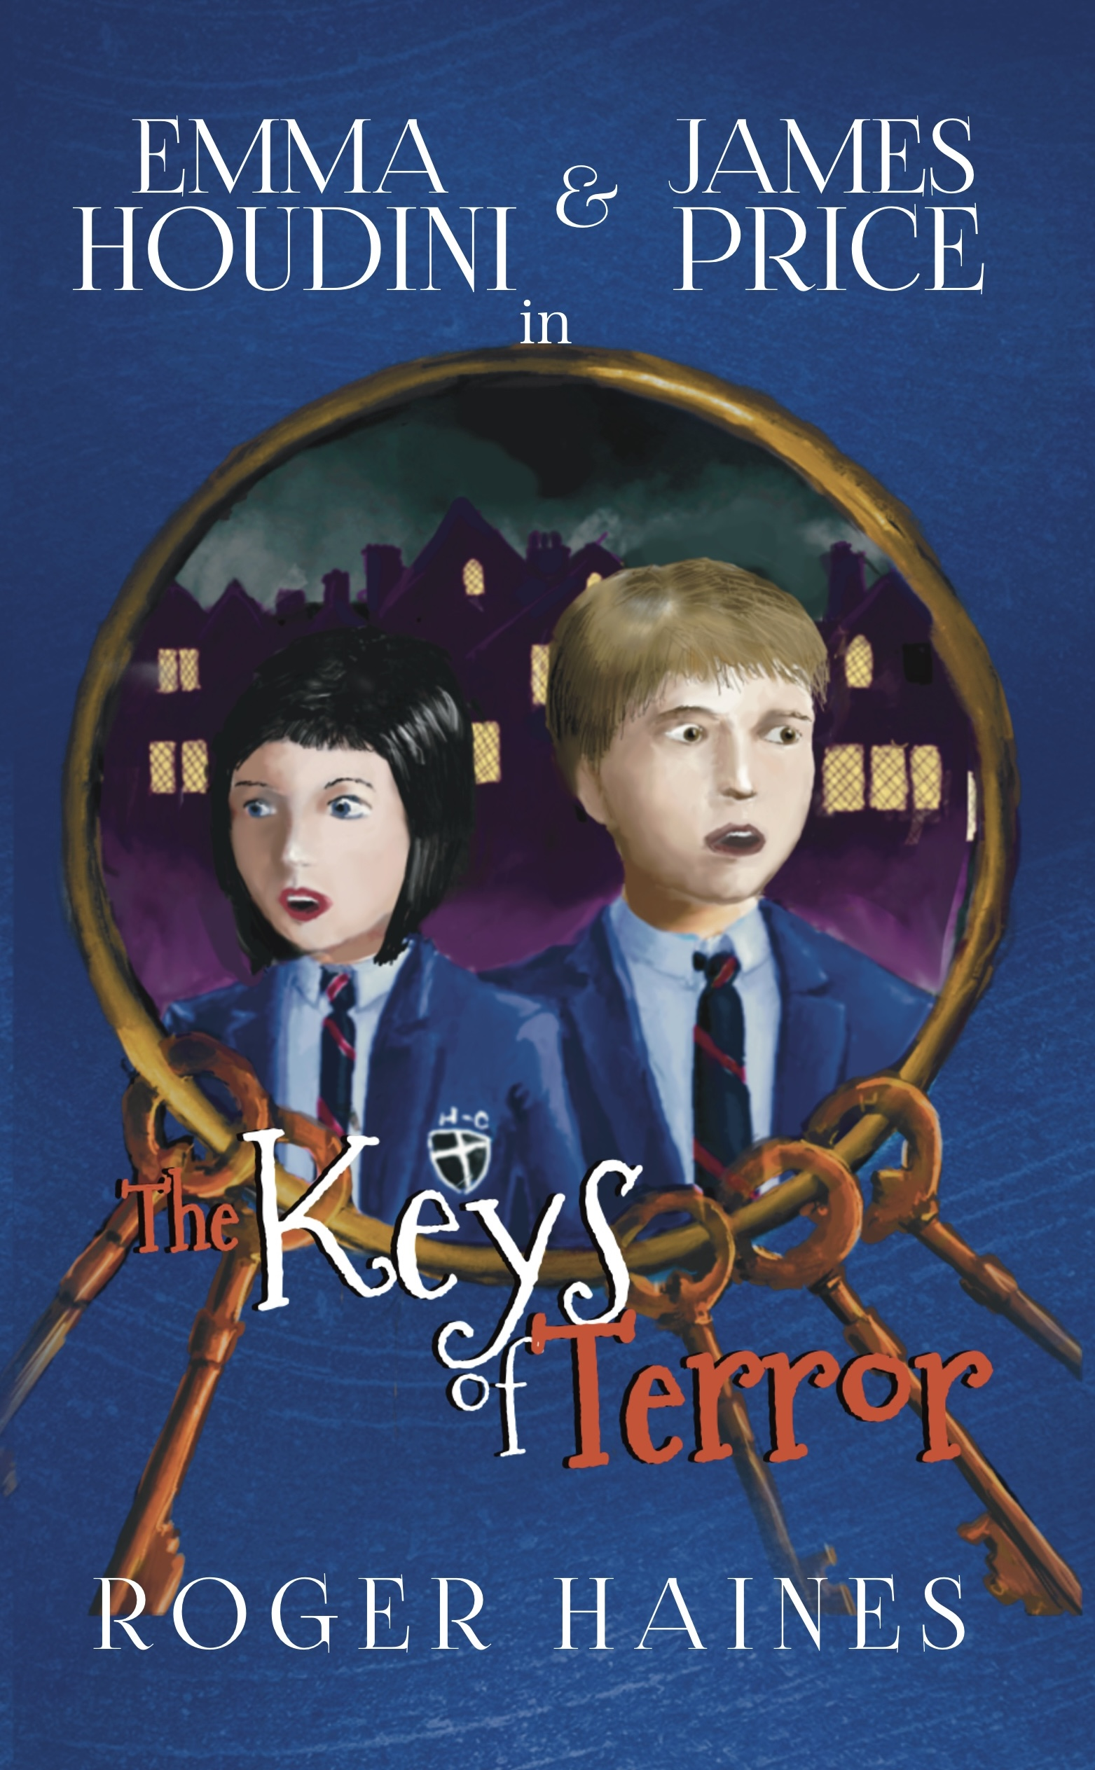
Student Mission Book 7
Roger Haines

Slide 2
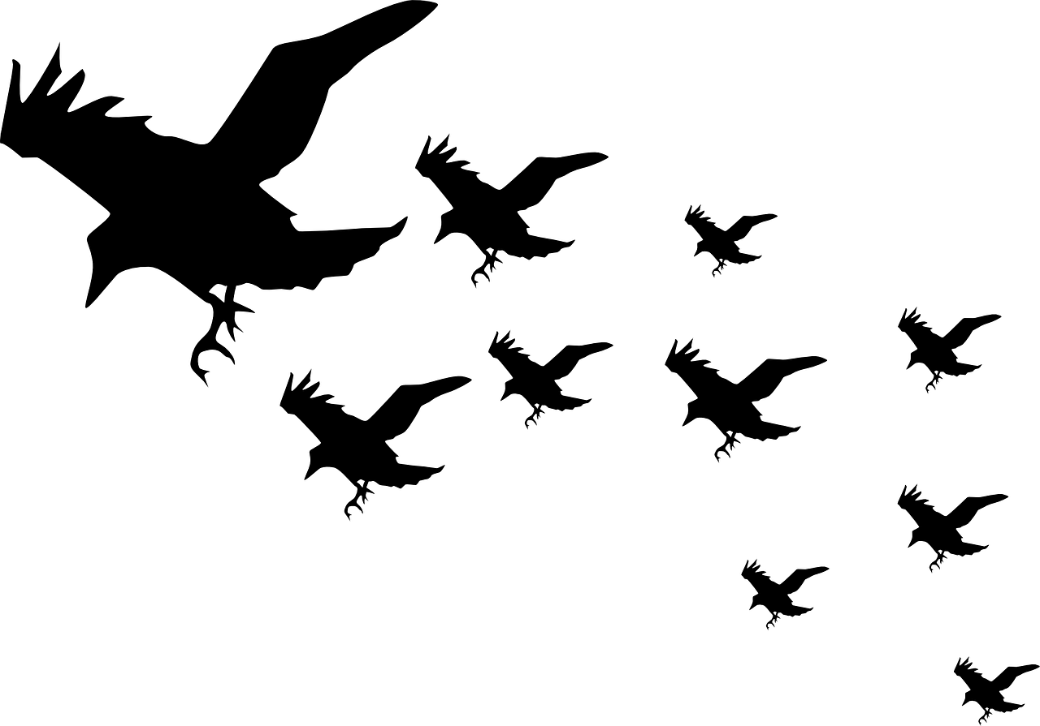
In this unit you will:
Learn about your hero’s CHARACTER ARC
Learn how that works in Keys of Terror
Revisit Freytag’s Pyramid [Story diagram]
Use the diagram to map your hero’s character arc
Produce a storyboard to outline your hero’ s story.

Slide 3
Author’s Note:
Don’t make your hero too perfect.
Give them a flaw or personal issue. E.g they might lack confidence
As they meet the challenges caused by the antagonist [villain] they will need to change
We call this the CHARACTER ARC
Plan your story to develop the way the character changes.
PS. Villains can’t and don’t change. That’s why they’re the villain!

Slide 4
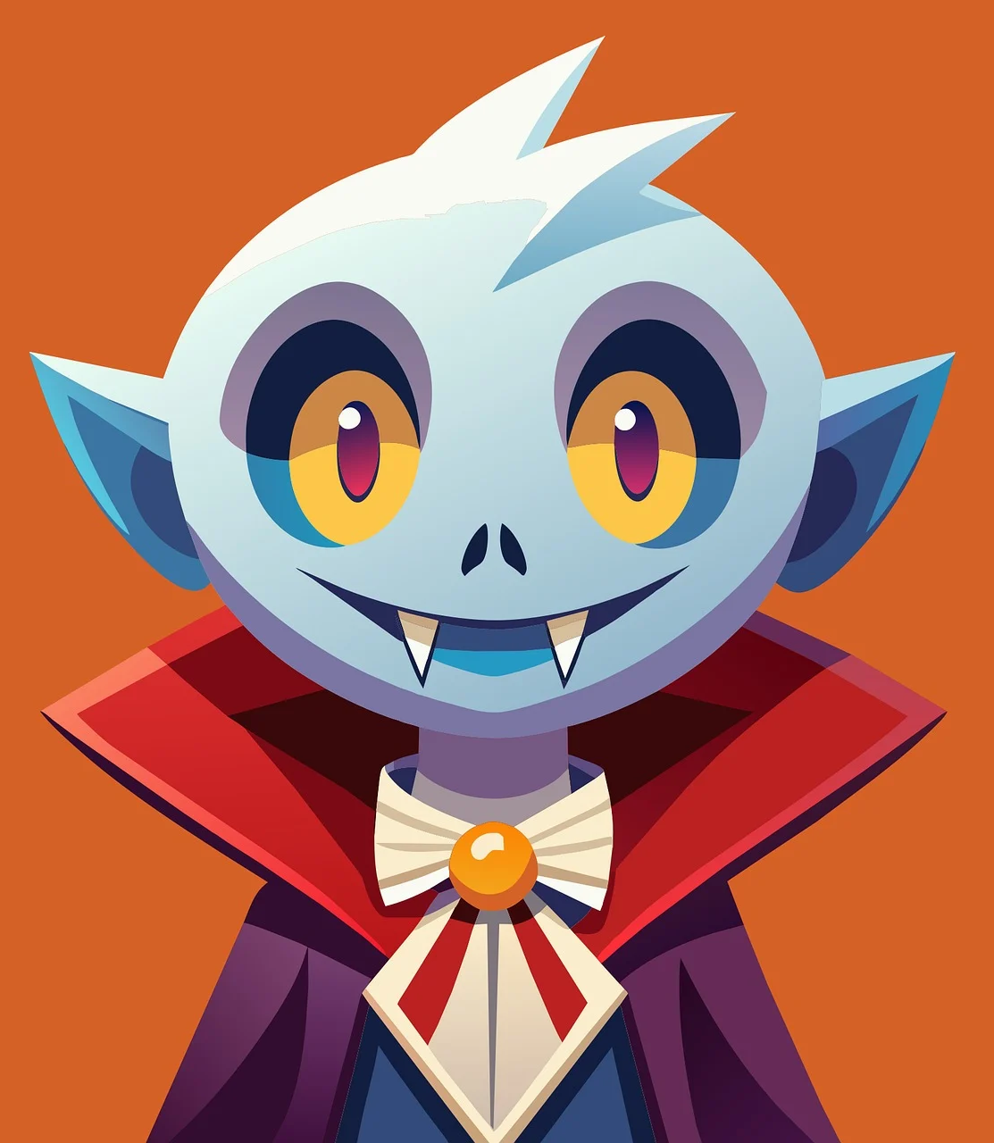
Stories are about character!
Good stories tell us about how the main character changes because of their experiences.
We call this THE CHARACTER ARC.
It’s a good idea to remember this when planning the events of your story.
When you decide what will happen in the story, it’s important to work out how these events will change the main character in some way.
What change could mean:
“Change” doesn’t have to mean a complete transformation, such as becoming a vampire or a werewolf.
It typically means the main character starts the story believing something about themselves or about life generally, but by the end, they’ve discovered that they were wrong.

Slide 5
How does the character arc work in Keys of Terror? [How does the character change?]
At the start of Keys of Terror, James Price thinks he attends a normal comprehensive school.
He doesn’t Believe in ghosts.
He also thinks his annoying younger brother isn’t his responsibility.
The events of the story force James to realise that these beliefs aren’t true!
This changes the person he is at the end of the story.

Slide 6
Remember this diagram?

Slide 7
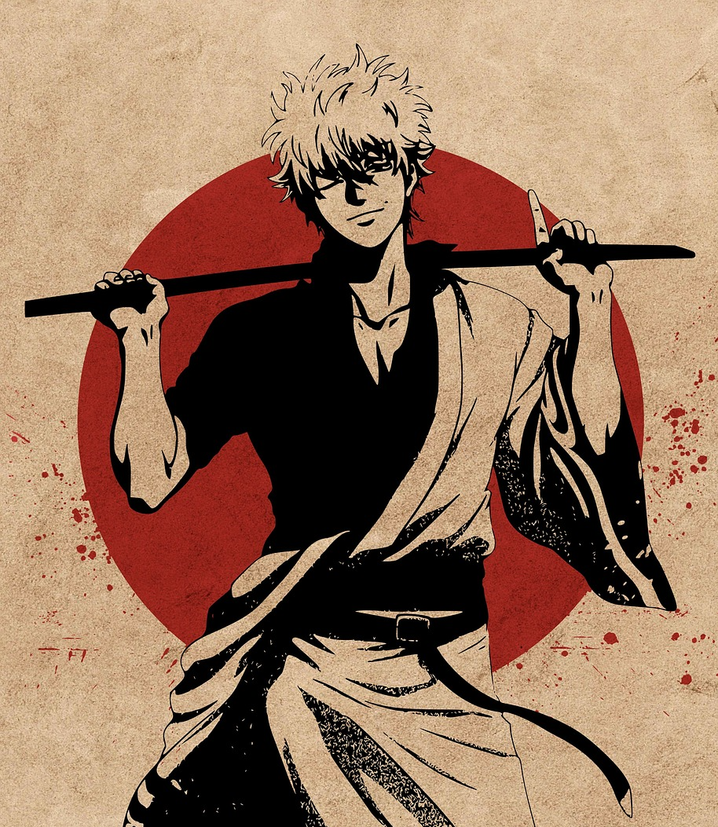
Draw a diagram like the pyramid and map what happens to your hero:
Introduction: what are they like at the start?
Inciting incident: what happens which affects them, so they are called to action?
Rising action: how does the hero find out what to do to beat the villain?
Crisis/climax: what happens when the hero first confronts the villain?
Falling action: what changes for the hero so that he will now beat the villain?
Resolution: how does the hero feel at the end of the story?

Slide 8
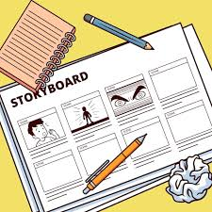
Use your notes to produce a story board [comic strip] for your story.
Begin by drawing some boxes to be your comic strip or filling out the sheet your teacher will give you.
Draw a picture in each box to show what happens.
[Matchstick men are fine! You can label the pictures as well to make them clear to your reader.]
Put a caption underneath each box to briefly outline the story!
Note: they use story boards to plan films!

