Slide 1
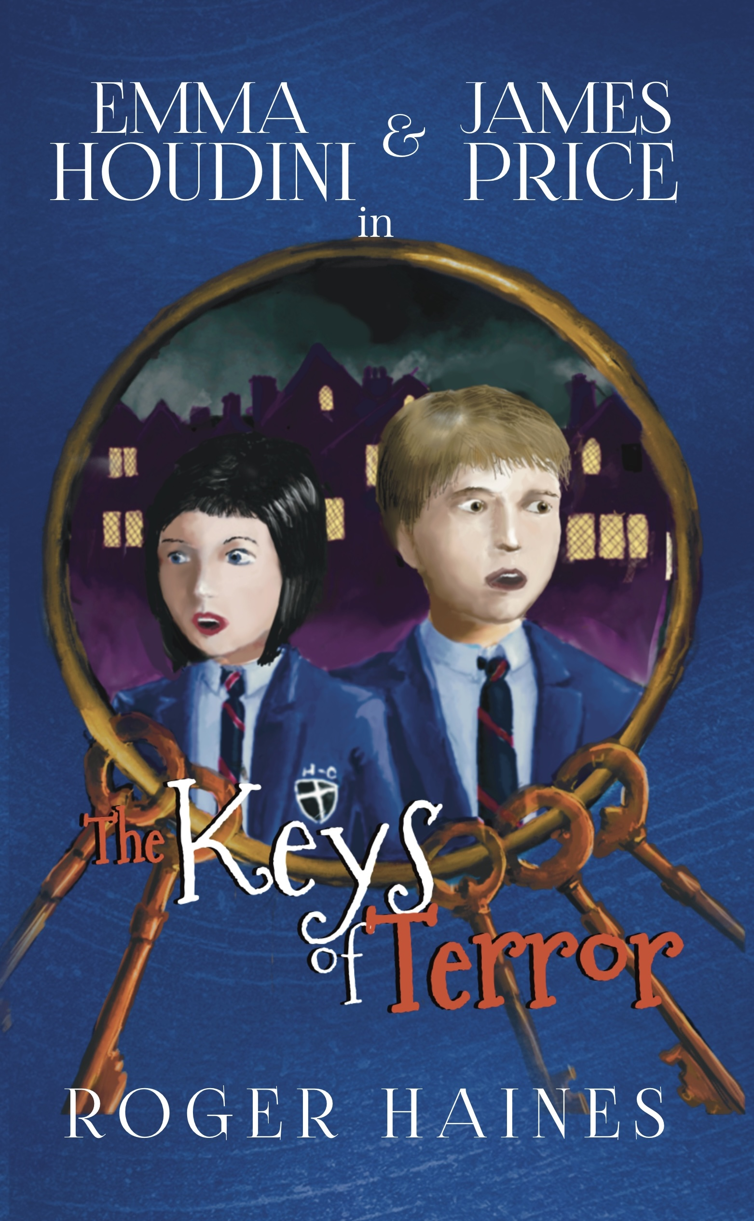
Student Mission Book 2
Roger Haines

Slide 2
Inn this unit you will:
Learn how to edit
1
Build a word bank
2
Revise your knowledge of key terms
3
Do some writing
4

Slide 3
On the next slide you’re going to work on building a Word Bank. But first, a word about EDITING which is a major part of writing.
Draft
Draft> edit> edit some more> get your best work.
Try
-Try putting the Word Bank words in different places and see how the sentence changes.
Don’t be
- Don’t be afraid to cross things out (neatly!)
Make
-Make changes!
Use
-Use different colours to show where you’re making alterations.

Slide 4
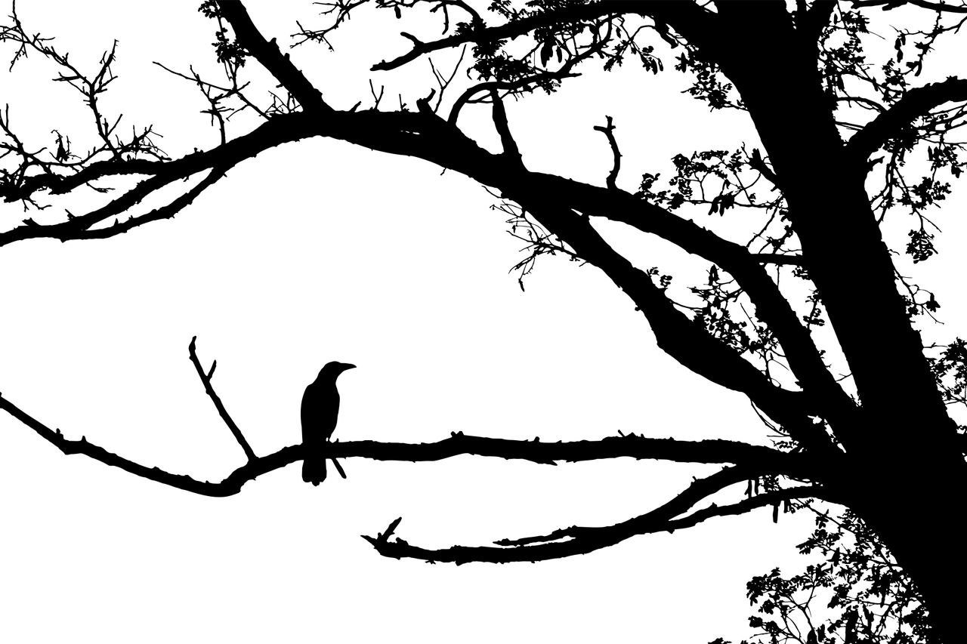
Build a word-bank! Show your reader that they’re reading a Gothic story with your word choices.
Here’s a sentence without much description:
I walked through the door and entered a room with a window.
Here’s a Word Bank with adjectives and adverbs suitable for a Gothic story:
Cautiously dark ruined crumbling rotting stealthily nervously
creaky shadow-filled arched dusty stench-ridden nightmarish
Task: Use some or all of the words to make the sentence sound more Gothic.
Don’t forget to use your editing skills! Try the words in different places!

Slide 5
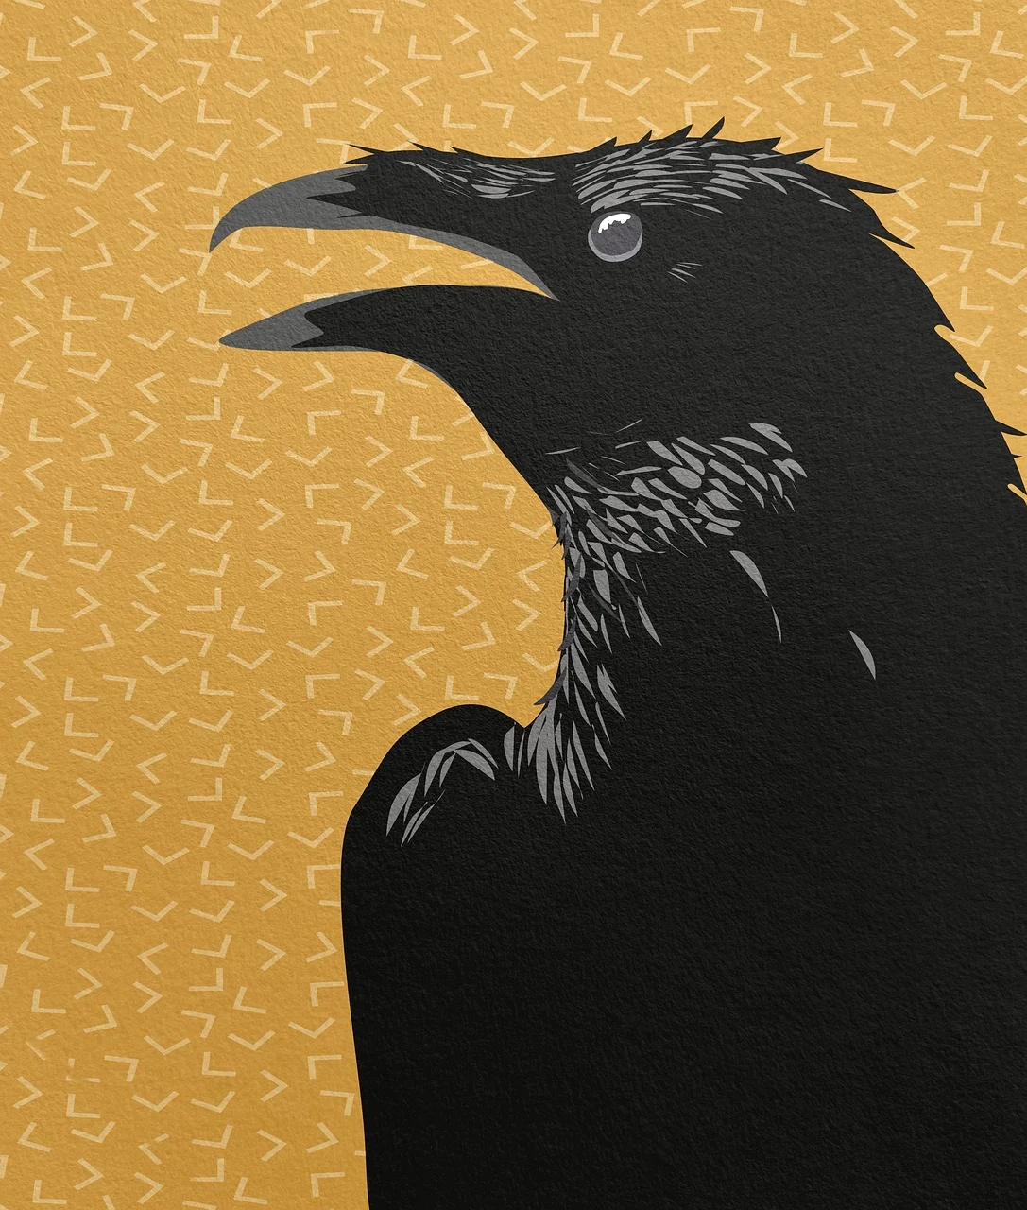
Freestyle your own word bank! So far, the words in the Word Bank have been descriptive: adjectives and adverbs. Time to get creative!
What might you see in a Gothic setting?
Add some NOUNS:
Eg. castle graveyard candle-stick lightning
What actions might you see in a Gothic setting?
Add some VERBS:
Eg. hide bite leap crawl disappear to fear
Tip: the more you have, the easier the next task!

Slide 6
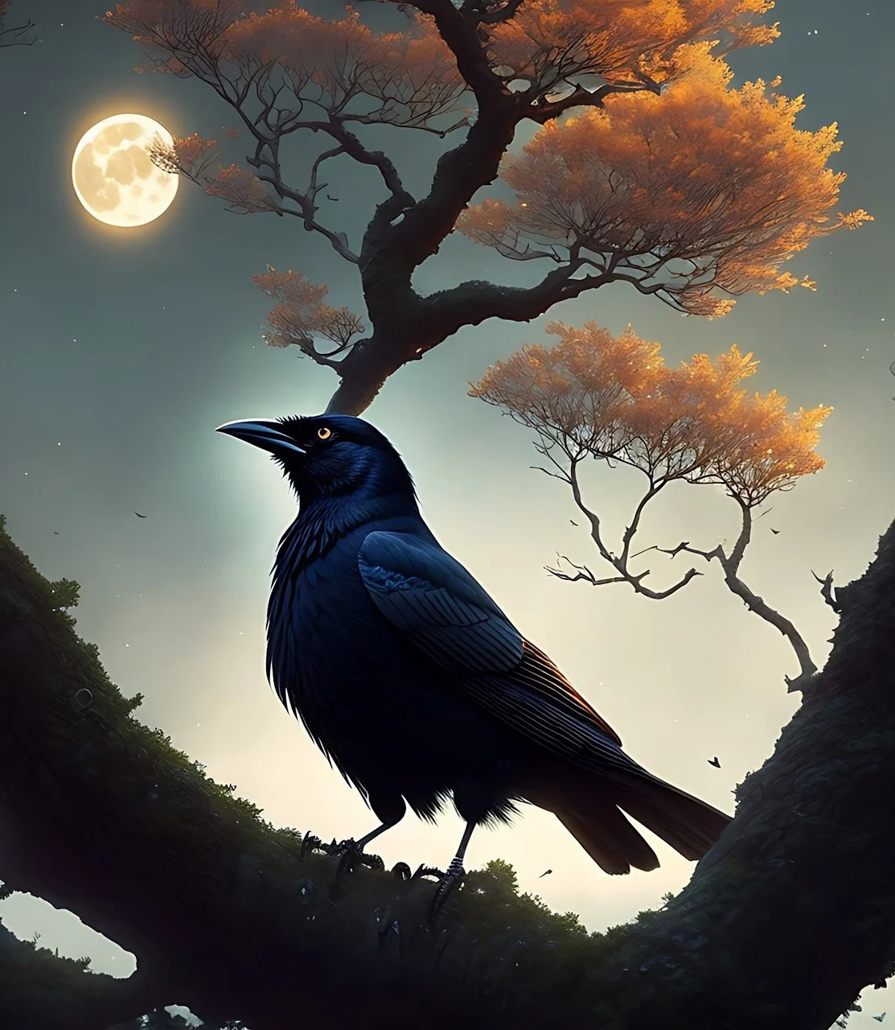
Step up to sentence-building! Use the Word Bank you have created!
Pick words from it (including at least one verb and one noun) and use them to start building a sentence. Add in any other words that you need as you go.
Words from the Word Bank: To hide, shadow-filled, castle, rotting, cautiously, lightning, graveyard
This could become:
As lightning struck the shadow-filled castle, I hid cautiously in the rotting graveyard.
Or
I hid cautiously in the shadow-filled castle graveyard as the lightning struck a rotting tree stump.
Challenge! Build more sentences using the Word Bank. Aim to make a full Gothic paragraph with at least 4 sentences.

Slide 7
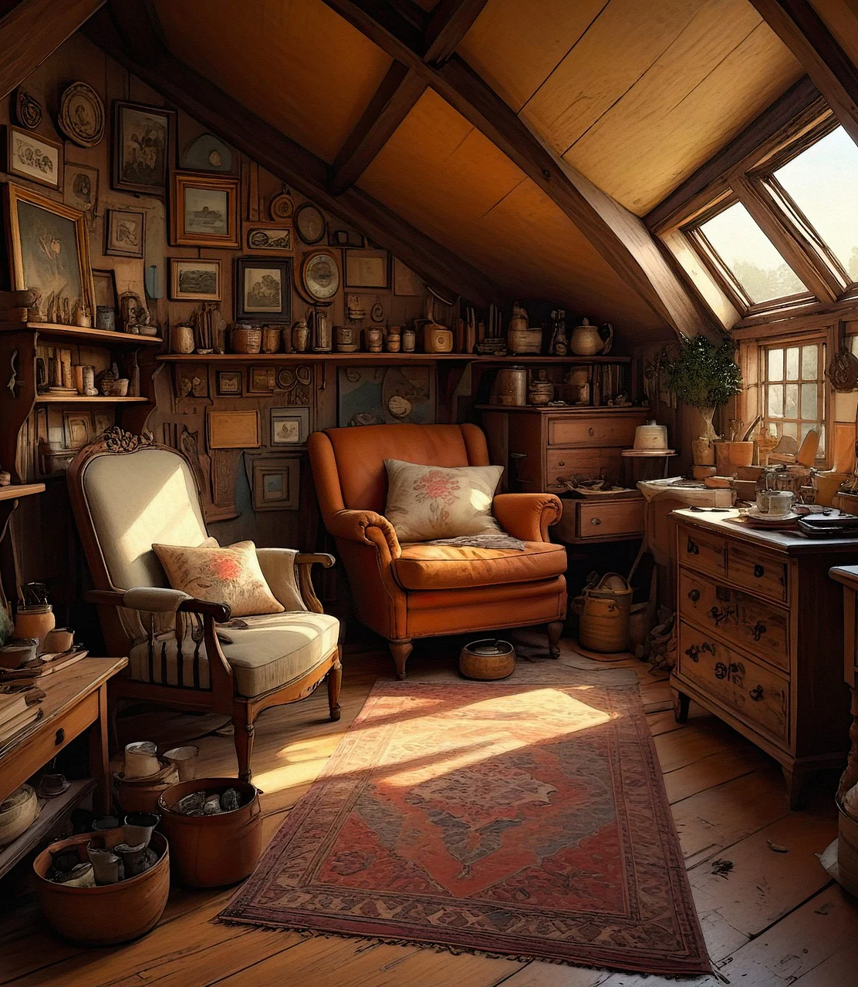
Gothic Writing: Creating a Scene Imagine an old attic full of clutter.
Under the heading Attic Word Bank, write down as may words as you can think of that might be used to describe this location. Include:
Nouns: objects that might be up in the attic
Adjectives: words to describe the attic and the things in it
Verbs: how someone might move around in an attic (crawl, tiptoe, tread)
Verbs: how objects are positioned (stood, balanced, teetered, stuck, hanging)
Adverbs: help verbs - (carefully, slowly, suddenly, frighteningly)
YOU ARE GOING TO USE YOUR AMAZING ATTIC WORD BANK IN THE NEXT TASK. YAY!

Slide 8
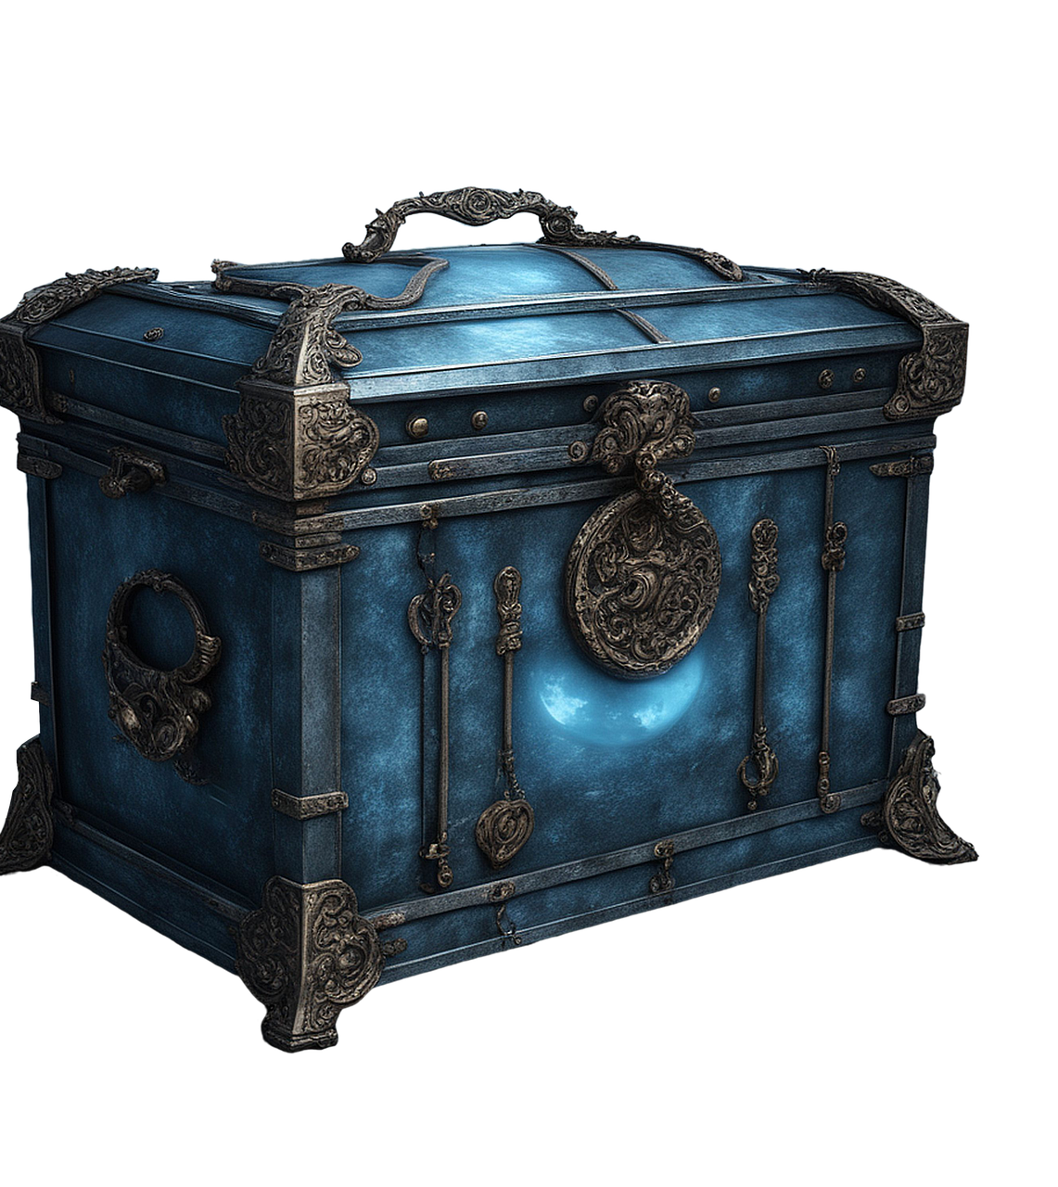
Be a Gothic writer!
Imagine climbing a ladder into the attic. Think about what you can see, hear, smell and touch.
Imagine walking through all the clutter when you discover something in the dark at the far end of the attic - a box.
Challenge!
Write a first-person account of going into the attic. Use words from your Word Bank to help you build sentences and include rich details. Remember to include as many senses as you can.

Slide 9
Follow-up Editing: the rule of five! Make at least 5 improvements to your Attic paragraph. You could:
Improve
Improve your choice of adjectives (words like good, bad, happy, sad, big and small can often be replaced with stronger words)
Make
Make your verbs more interesting, (replace walked with crept, sneaked, strode, sidled... Be interesting!)
Add
Add dialogue - which could just be your character talking to themselves.
Remember
Remember to check how to present speech:
“You need to start a new paragraph when a new person starts speaking,” James said, “and include speech marks before and after the words they say.”
“Like this?” Emma asked.

