Slide 1
Student Mission Book 7
Sarah Green
Roger Haines

Slide 2
In this unit you will:
Take a closer look at characters in the book
Check your understanding
Discuss character arcs
Do some writing of your own.

Slide 3
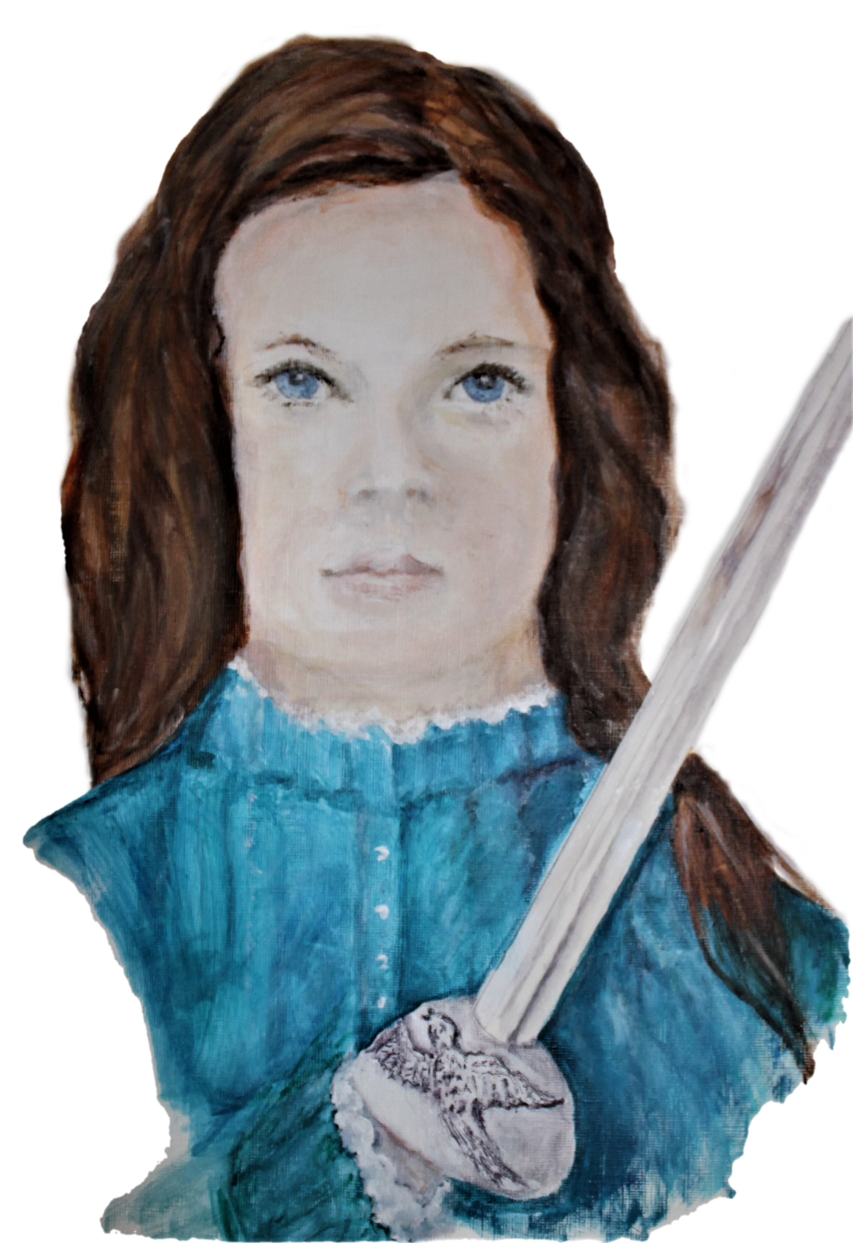
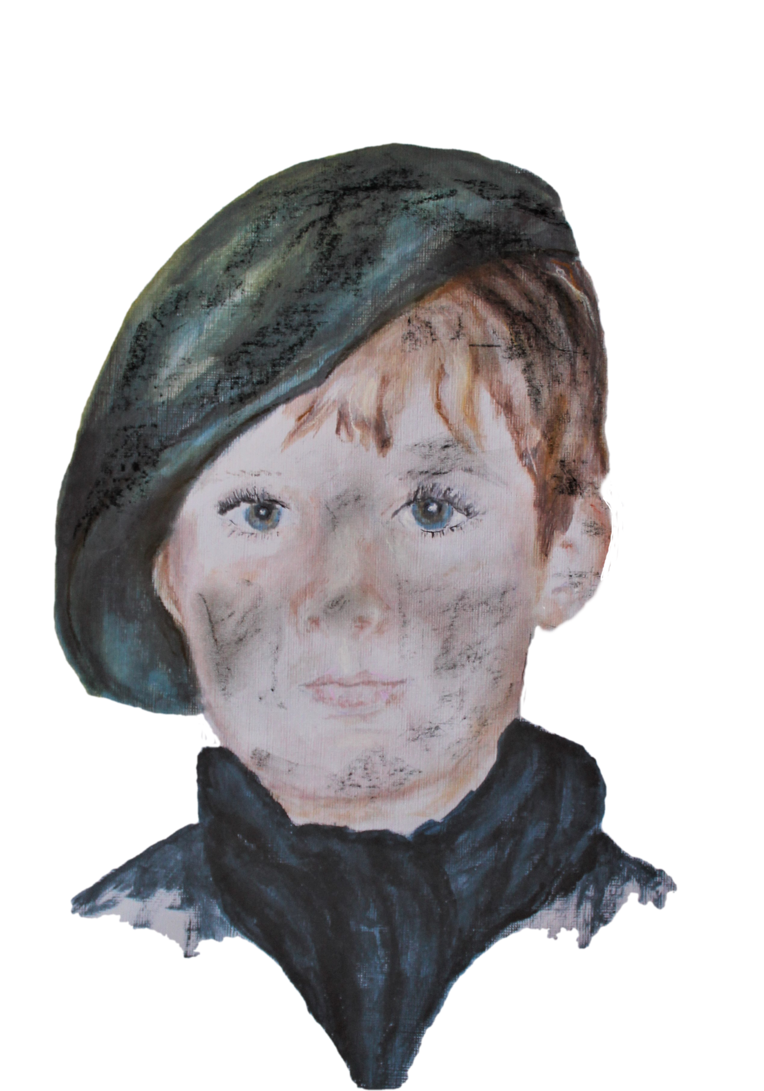
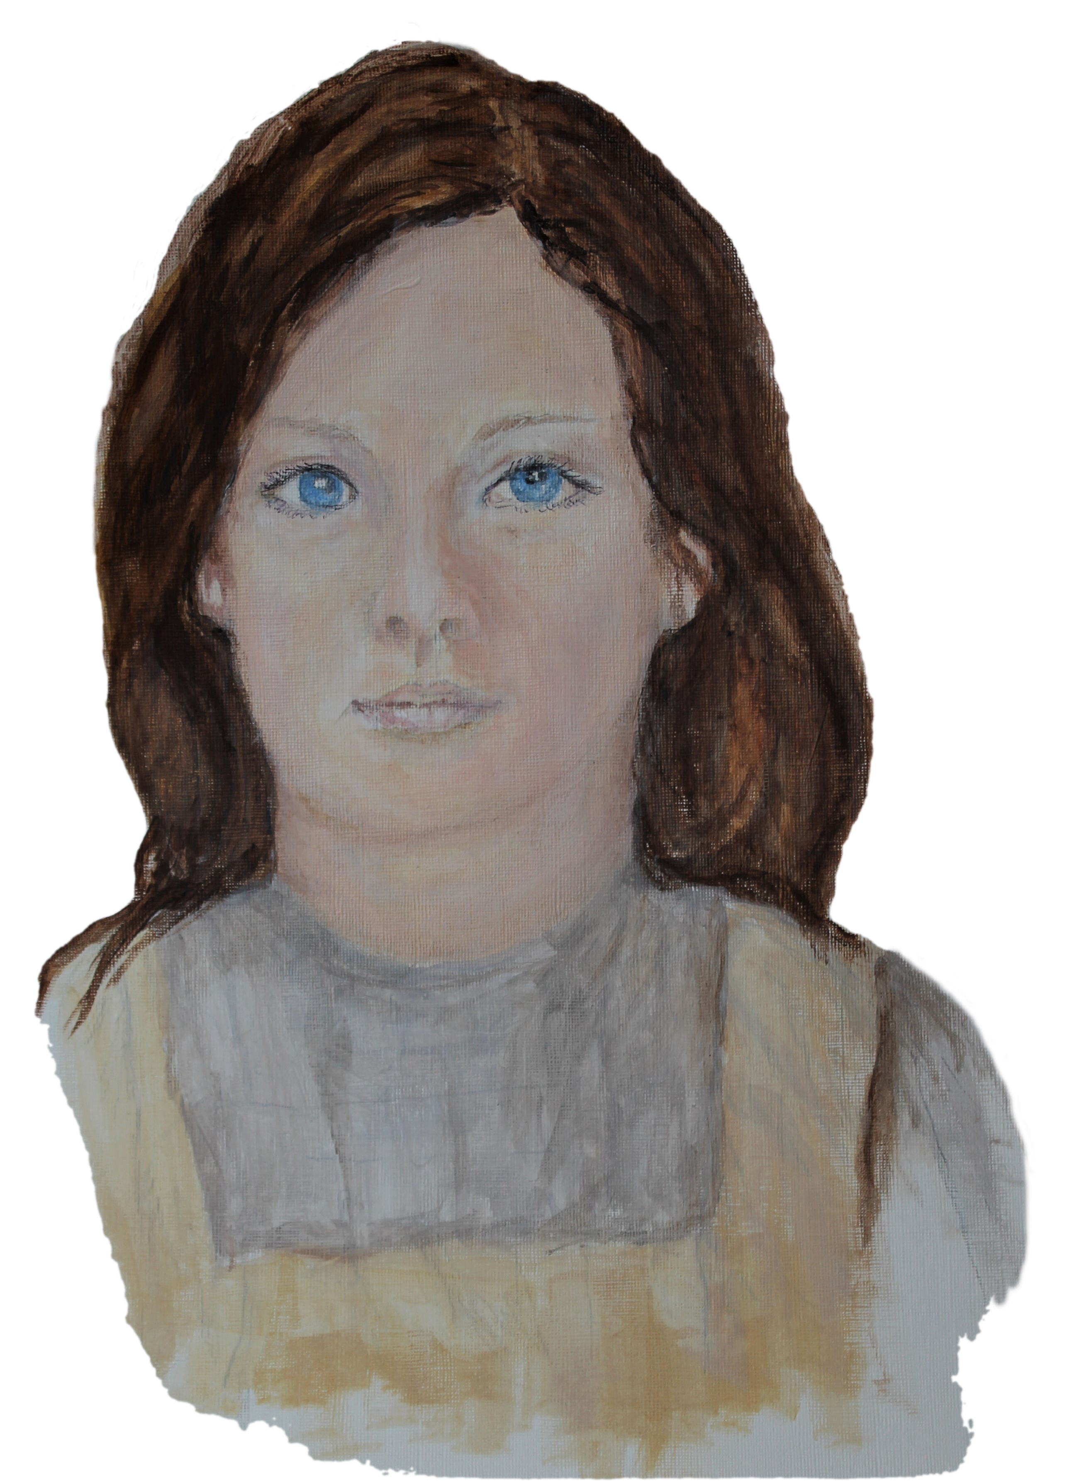
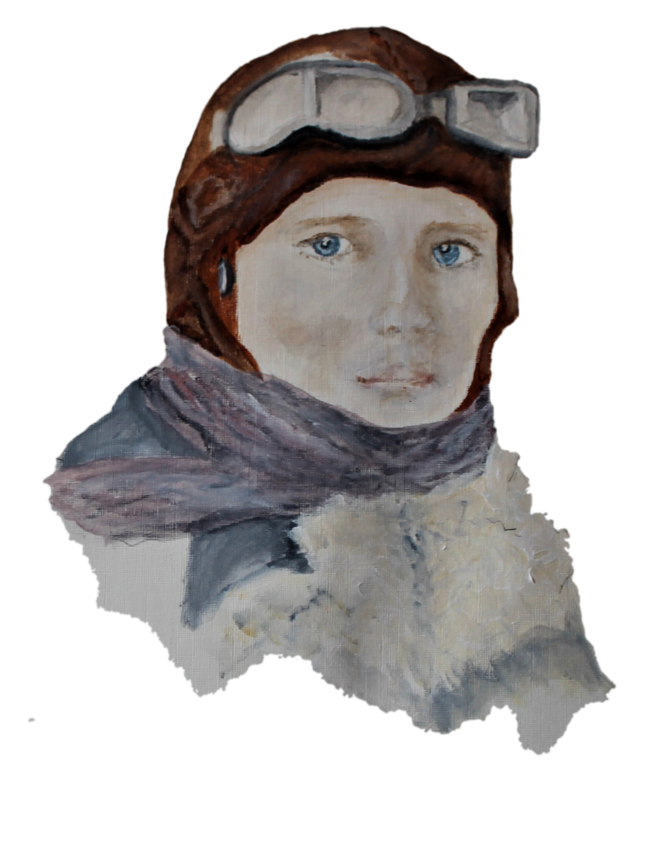
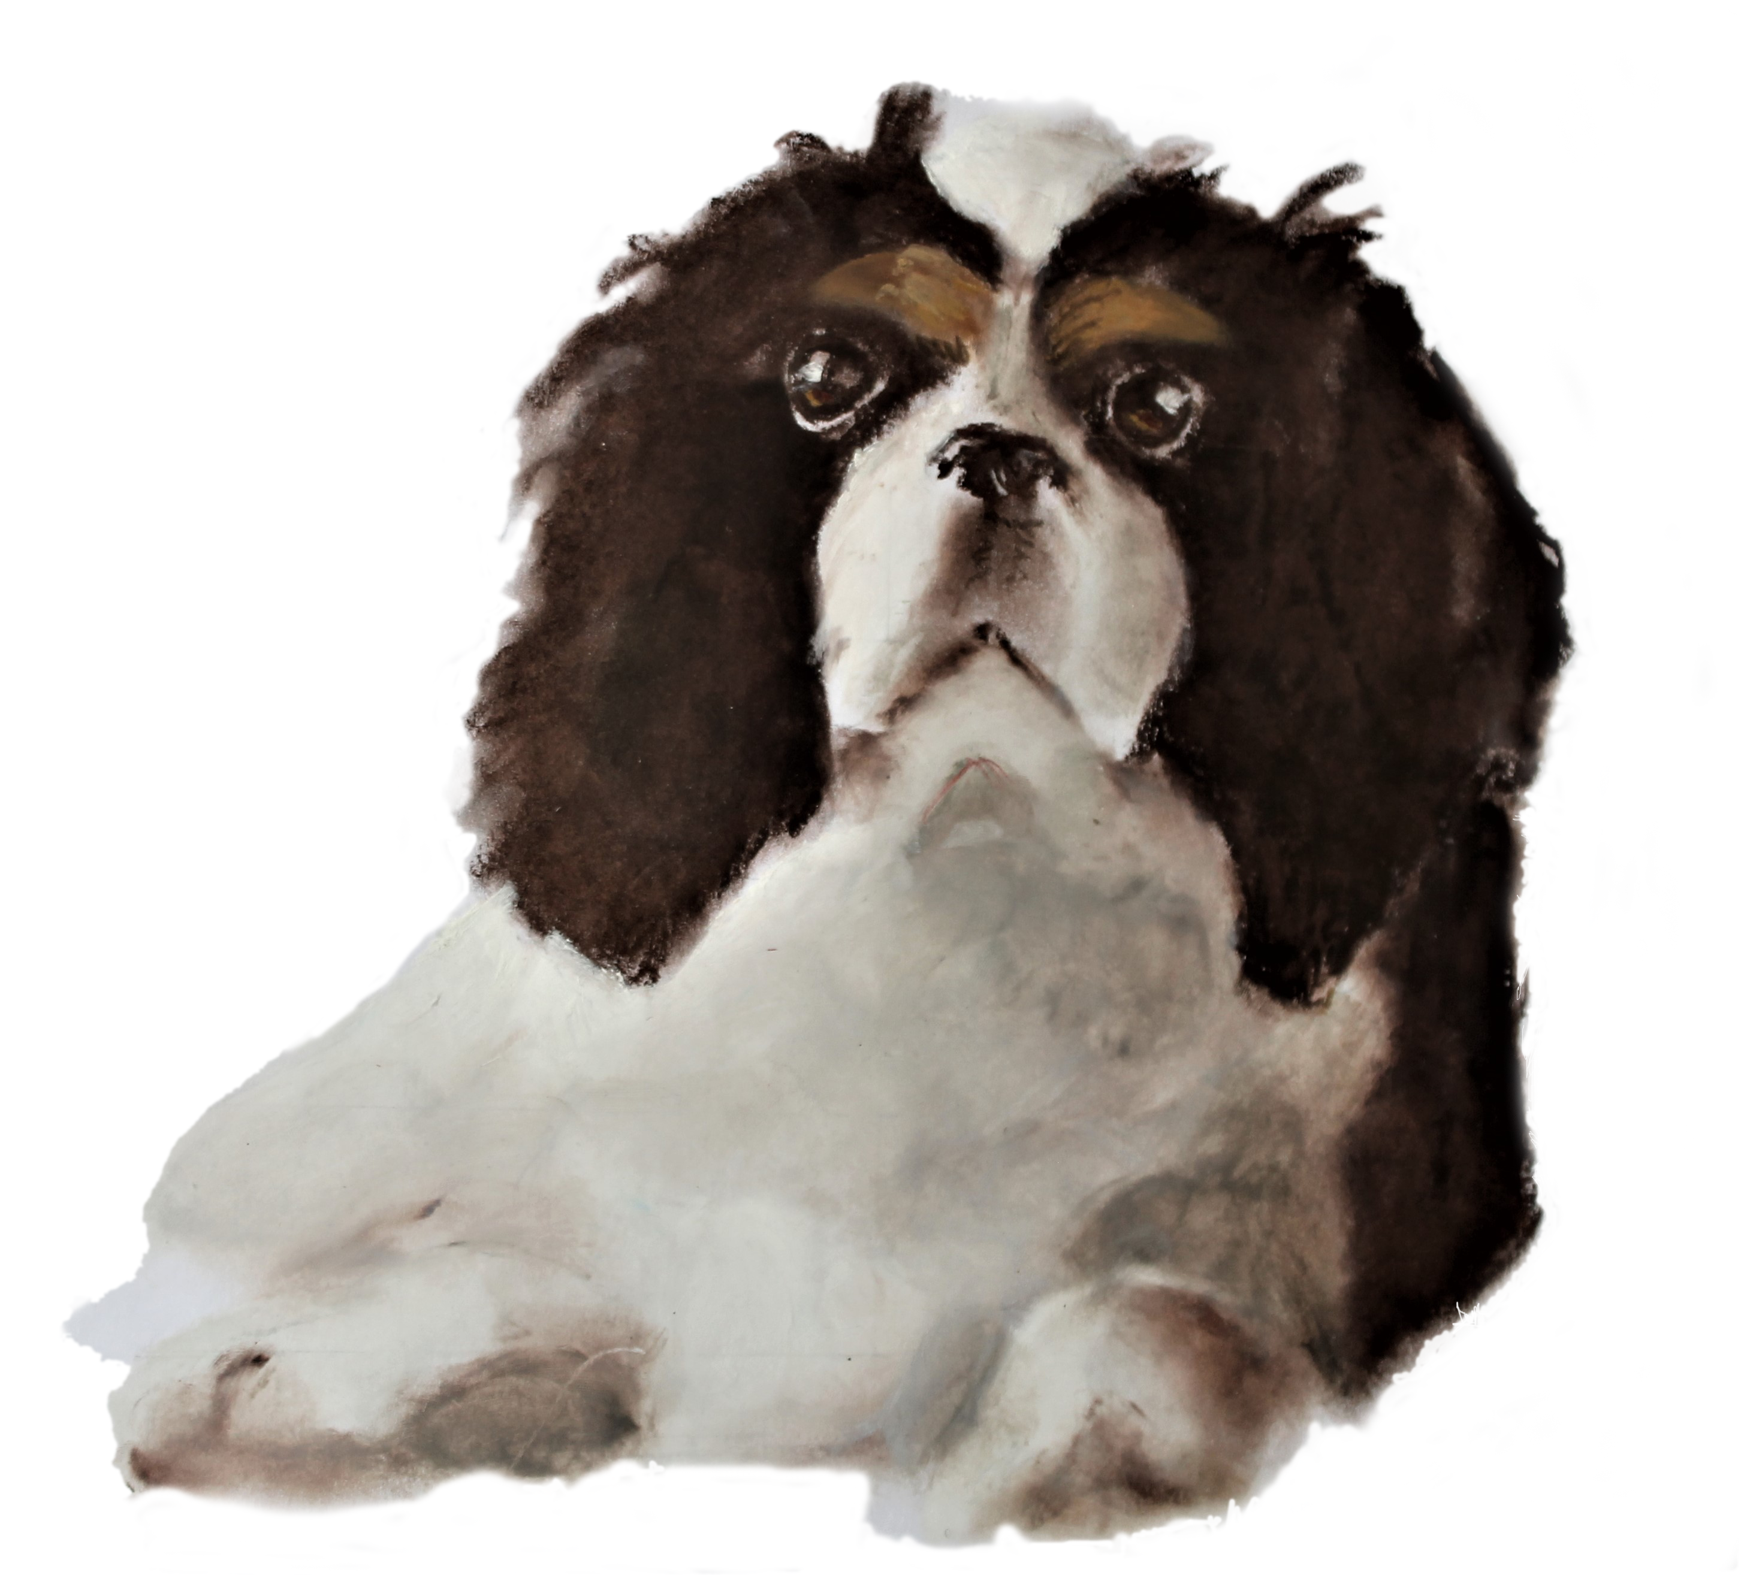
The Four Main Characters:
Victoria Broth Oi Albert
Oops... Nearly forgot Dash!

Slide 4
Author’s Note:
I chose to write Princess Victoria’s War in the THIRD PERSON so that I could follow each of the characters.
This means I can separate the characters and give them adventures of their own.
This also means that I can develop their CHARACTER ARCS more easily.

Slide 5
Victoria: fact file.
Victoria is imprisoned in Castle Darkness by her wicked cousin, Lord Hunter
She is an orphan, and has not friends, except her dog, Dash
She watches and listens and practices her sword play.

Slide 6
What does Victoria bring to the story? SPOILER ALERT: only answer questions for the parts of the book you’ve already read!
1. What is her situation at the start of the story?
[Tip: take a look at Chapter 1 P 1-5].
2. How does Victoria react when Albert and the others arrive at her turret prison?? Find examples [evidence] to support your answers.
[Tip: Take a look at Chapter 13, p 61-70]
3. How does Victoria deal with being lost in the city? [What does she do? What qualities does she show?
[Tip: take a look at Chapter 17 p 83-87 and Chapters27 -29 137-152]

Slide 7
Writing task!
At the end of the story, Victoria writes some entries in her diary, reflecting on everything that has happened.
What would the moments that would stand out for her? What would she think about them?
Write three of her diary entries.
Top TOP tip: don’t retell the story; write down her thoughts and feelings. ‘When X happened, I felt...’

Slide 8
Victoria’s character arc?
With a partner discuss the following:
What is Victoria like at the start of the story?
In what ways is she different by the end of the story?
What are the main experiences or people that caused her to change?

