Slide 1
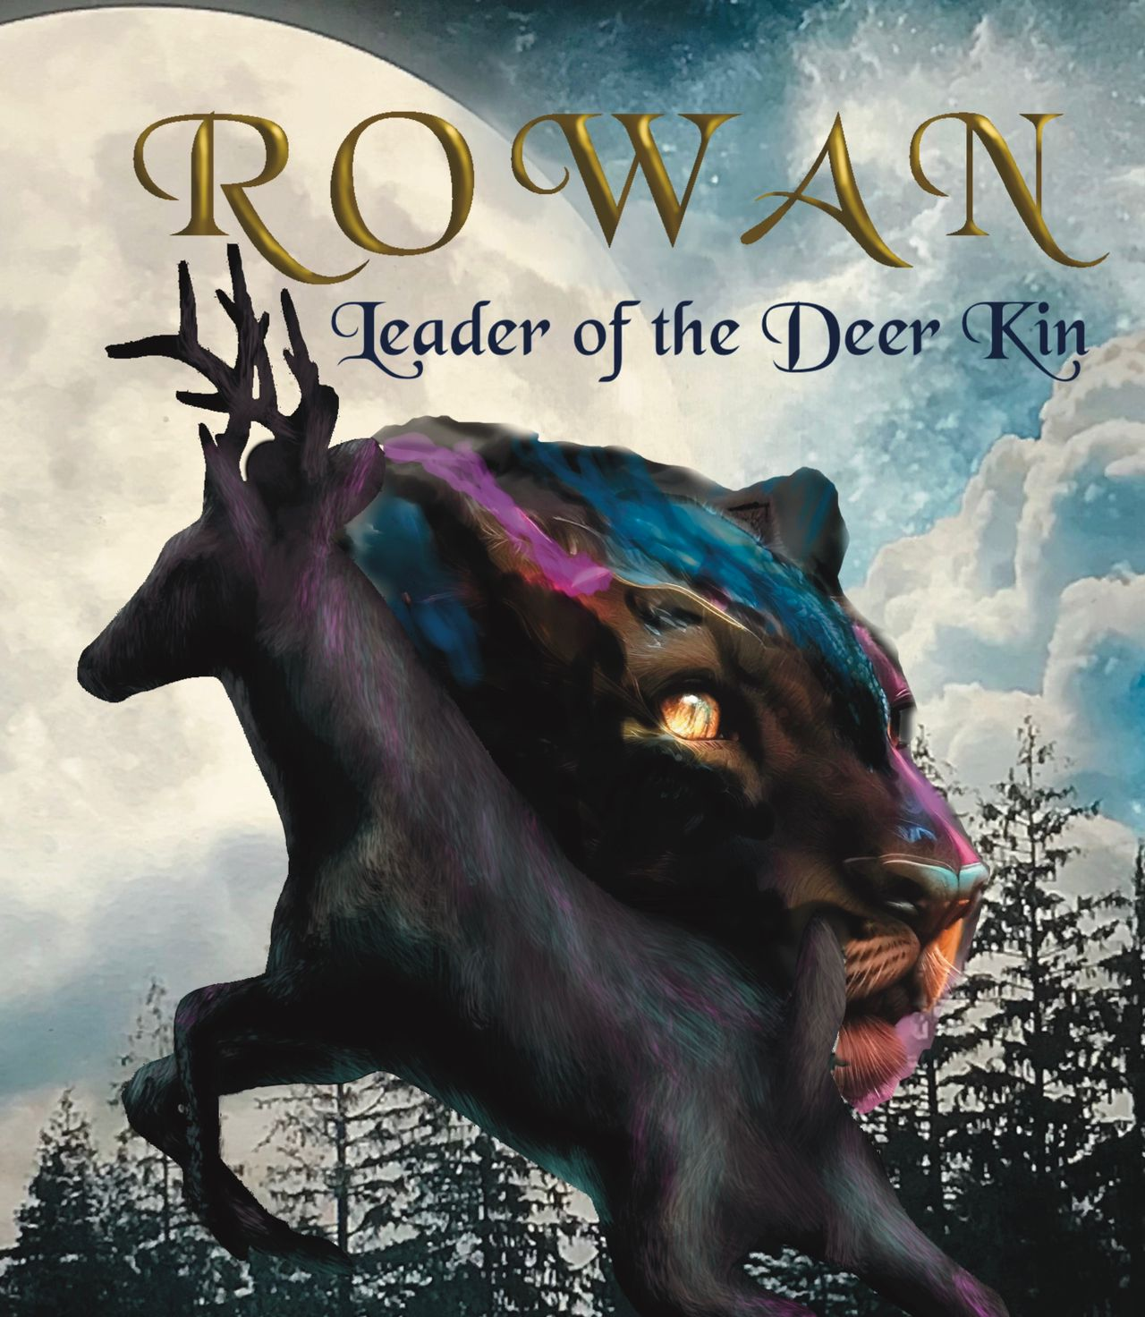
Student Mission Book 1
Sarah Green

Slide 2
Unit 1: Making the most of Chapter: The Animal Called Man Page 1
In this unit you will:
Check your understanding
Learn Key Words, [Technical Terms that impress!]
Do some writing to practise what you have learned.

Slide 3
Check your understanding!
Chapter : The Animal Called Man
What is the first thing that alerts Rowan to the approach of the men?
What are the men doing? What makes you think so?
3. What do you think the ‘Long sticks’ are that
the men are carrying?
4. What do you think ‘something in tangles’ is?
5. Why are Rowan and Bracken hiding?
6. How does Rowan know that Brack is frightened.
7. How does Mother disguise her approach?
8. What is it that scares Rowan when the men have moved away?
9. What kind of creature attacks Brack?
10. What kind of creature attacks the fox?

Slide 4
Key Words!
Make certain that you pick up technical terms as much as you can. It will help your understand more about the craft of writing... and help your results. ( Tip: examiners love it when you use a technical term.)
The book is written in the FIRST PERSON from the POV (POINT OF VIEW] of Rowan.
(So uses I /me / mine THIRD PERSON: he/she/they /his/hers /theirs
Why choose first person?
-More personal? Easier for readers to identify with?
But it can be tricky: it’s important to get the ‘voice’ right and sustain it. In terms of plot, it restricts scenes to those where the narrator is present.

Slide 5
Key Words!
Why choose third person?
You can move between characters and points of view.
You can move between scenes more easily because the main character does not always have to be present.
Be careful not to ‘hop about’ between characters too often. Some writers keep to one character for each chapter.

Slide 6
Key Words!
The GENRE of your story might be an important factor in deciding whether to choose first or third person.
E.g. a diary-based story like the Wimpy Kid series is best in the first person.
However,, a wide- ranging story where a lot of things need be explained, like Harry Potter, is best in the third person.
Note: genre: the type of story such as fantasy; science fiction; romance.

Slide 7
Key Words!
The chapter ends on a CLIFF-HANGER.
This is where we don’t know what happens so we are left in suspense.
Writers often use this technique so that their readers will want to read on.

Slide 8
Today’s Technical Terms:
First person
Third person
Genre
Cliff-hanger

Slide 9
Your Mission: become a writer!
1. Write a paragraph which could fit into a moment of suspense in a story.
Write it in the first person.
2. Now write a paragraph in the third person which could fit into a moment of suspense in a story.
3. Read what you’ve written and decide which you prefer. Make a note of your reasons.

Slide 10
Write a cliff-hanger!
Your Mission:
The chapter ends on a CLIFF-HANGER.
Write a story that also ends on a cliff-hanger.
Use this image as your starting point:
Who put the bottle in the water?
Are they in danger?
What happens?

Slide 11
Using the senses in your writing:
You can make your writing richer by using the senses.
In Rowan, Leader of the Deer Kin, the author mixes up the senses to try and build the perception of an animal.
For example, Rowan is ‘blinded by smell, suffocated by noise.’
Your Mission:
Write a paragraph in which the senses are important in describing a place.

