Slide 1
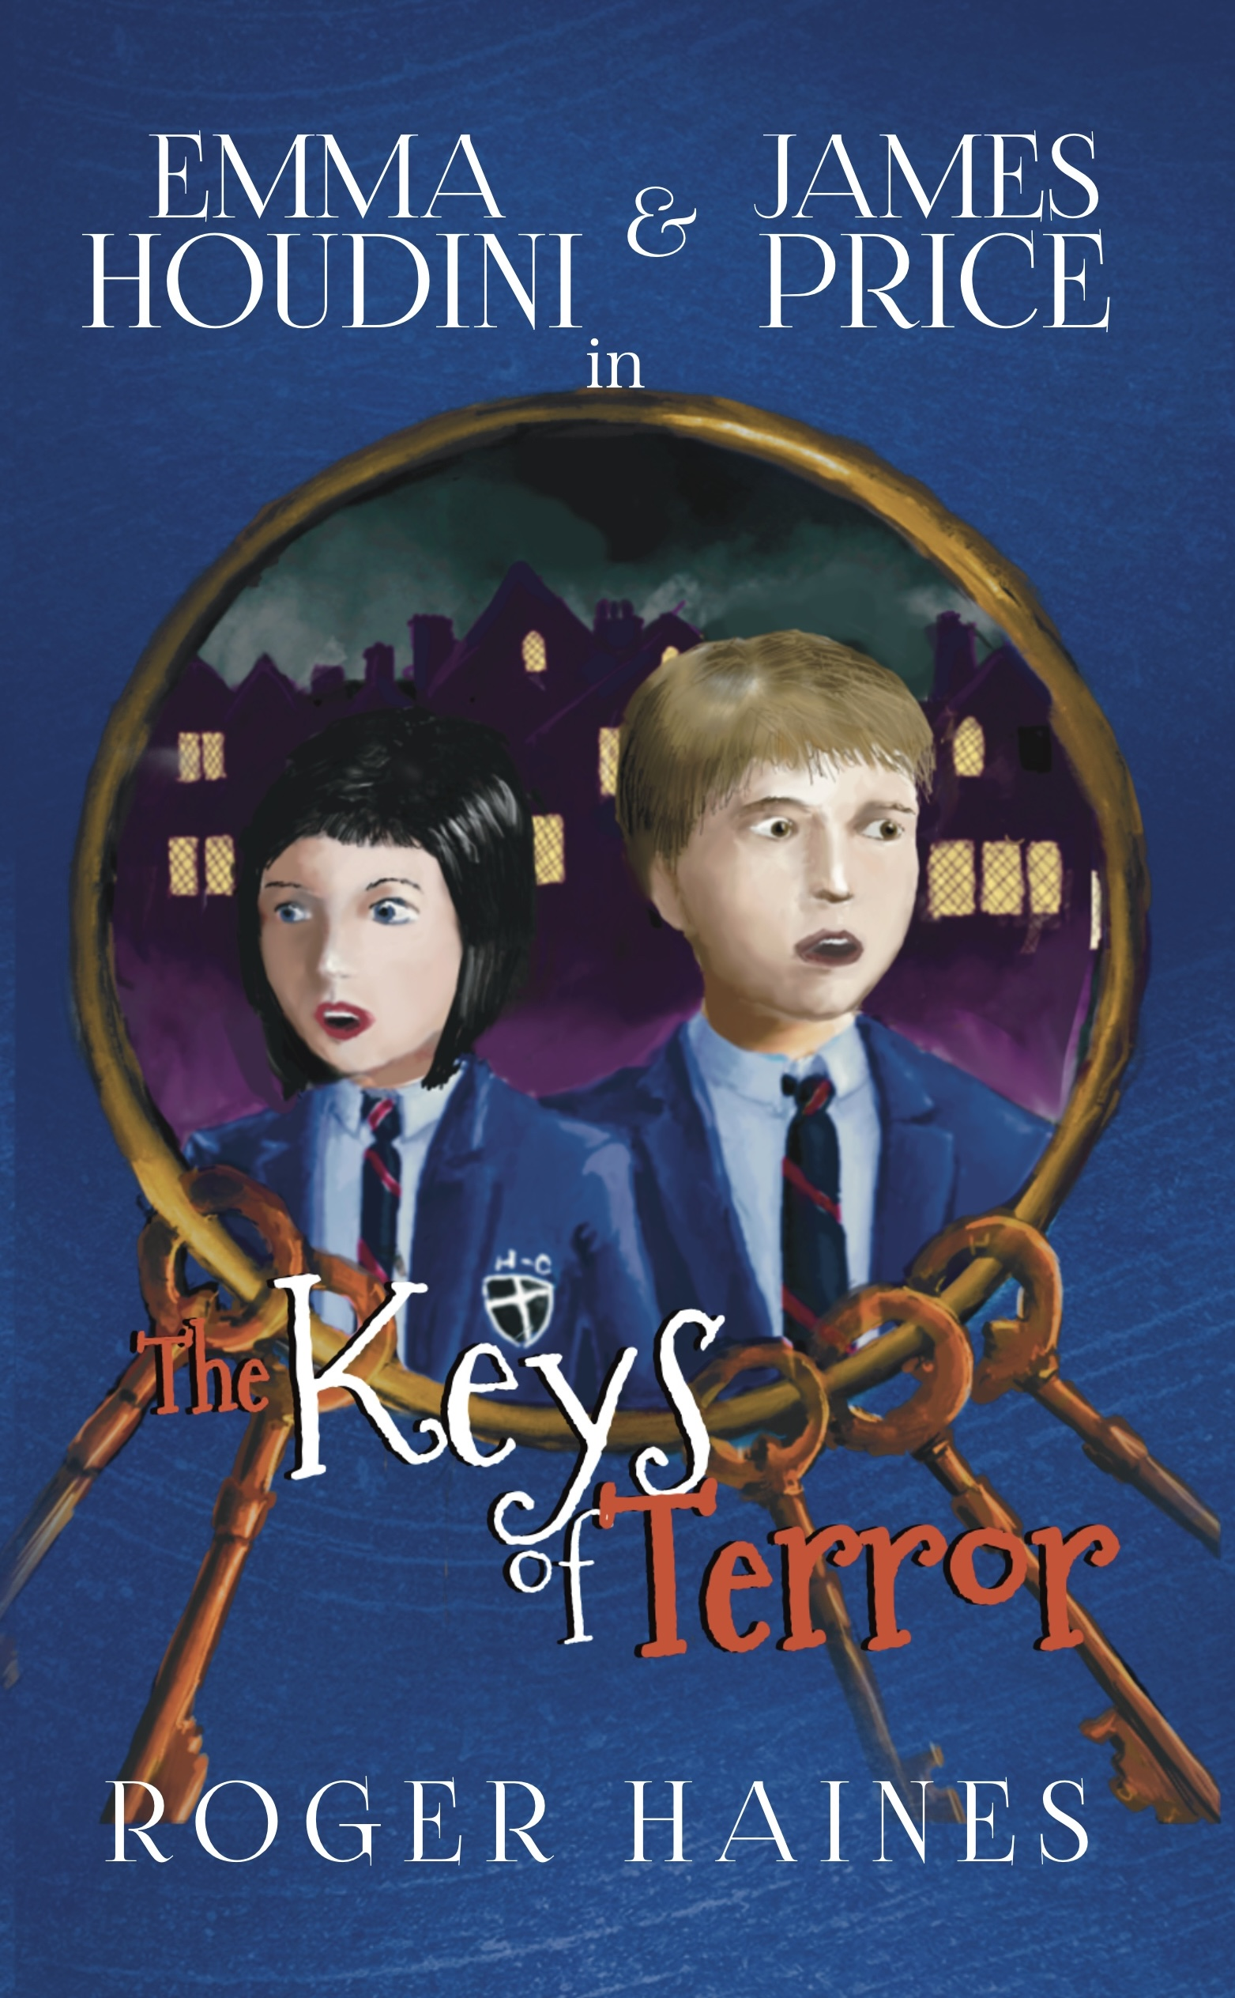
Student Mission Book 5
Roger Haines

Slide 2
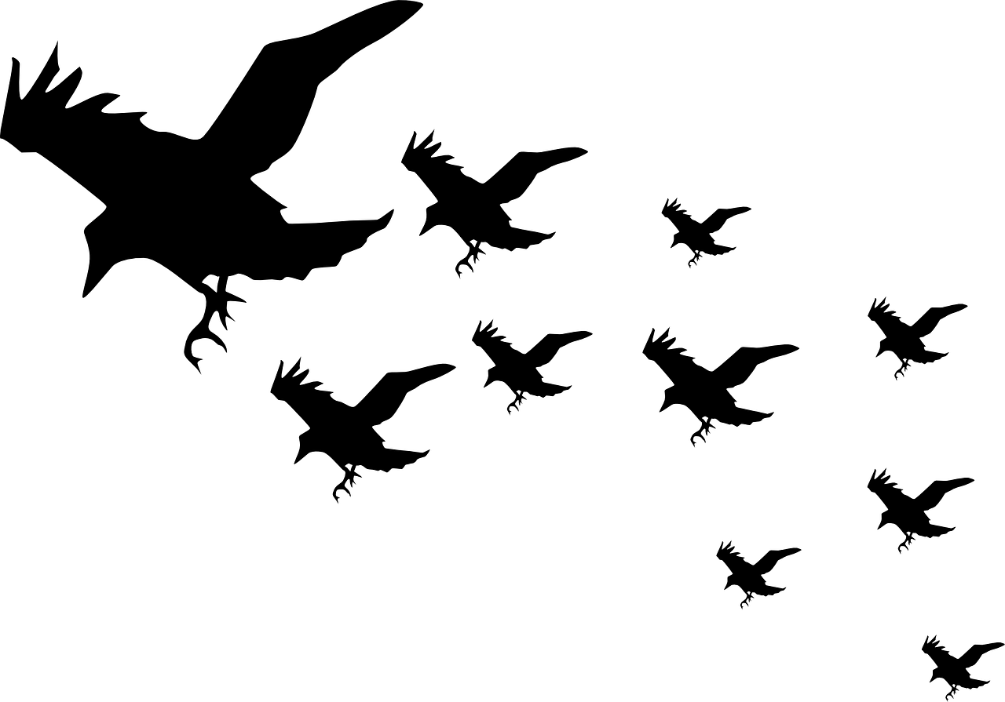
In this unit you will:
Create three important Gothic characters:
the villain;
the hero;
the victim.
Learn the function that each one has in Gothic stories.
Make detailed notes about each one.
Do some writing.

Slide 3
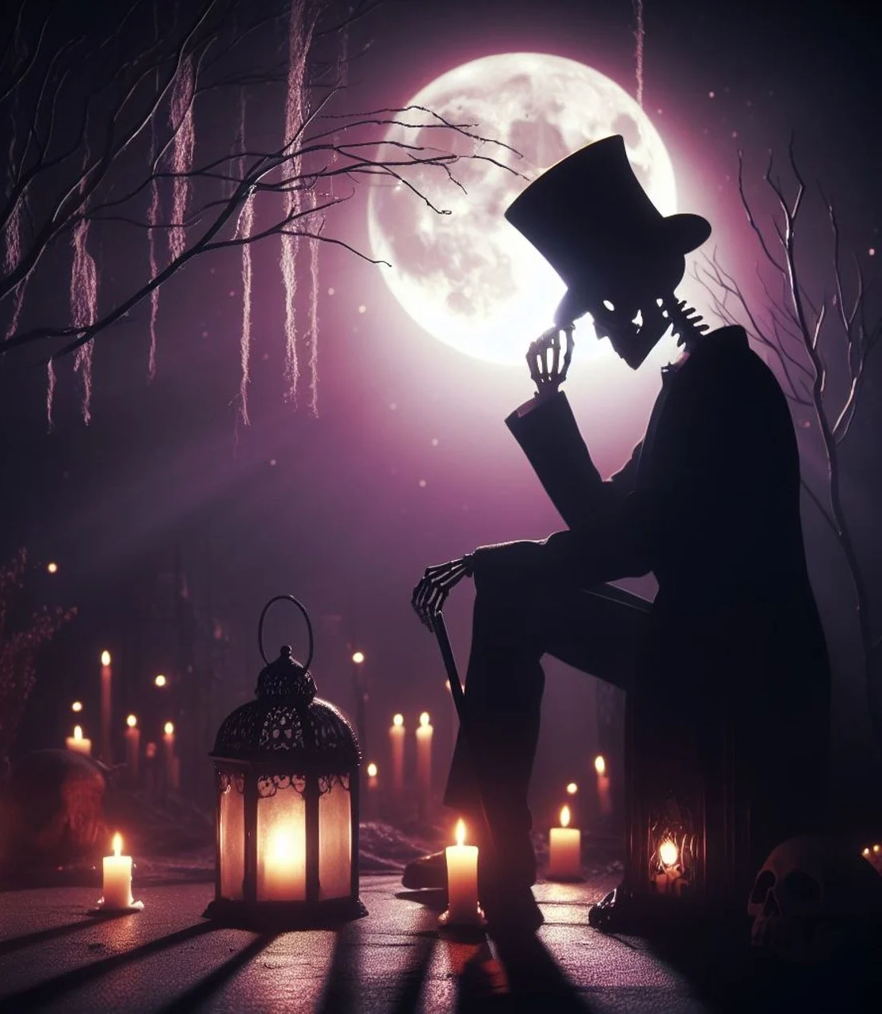
Creating Gothic Characters! Gothic stories, like their atmosphere, often involve characters that represent light and darkness, good and evil.
You will be creating a set of characters that would be suited to a Gothic story.
These characters will be:
The villain, or monster.
The hero.
The victim

Slide 4
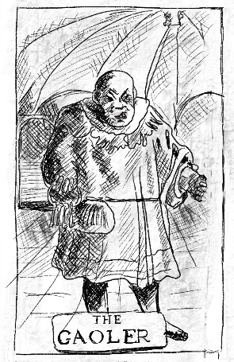
Start with the villain! Gothic stories are fascinated with the ideas of evil, darkness, the unknown and the monstrous. You should start by coming up with a really interesting, mean and moody villain.
The villain needs to:
-Present a real threat to the victim
-Be more powerful than the hero, at least to begin with
-Create a strong, horror response [Be really scary!]
-Have a reason for being evil or doing evil things.
-Some kind of weakness or limitation that the hero will have to learn about to stop them
(e.g. vampires and wooden stakes, werewolves and silver bullets).

Slide 5
Gothic Villain Planner! Make notes about your villain, using this planner:
Name:
Where they live/exist:
This villain is dangerous because…
People are frightened of this villain because…
The evil thing this villain has done/ plans to do is …
This villain’s weakness is…
Villain’s Appearance:

Slide 6
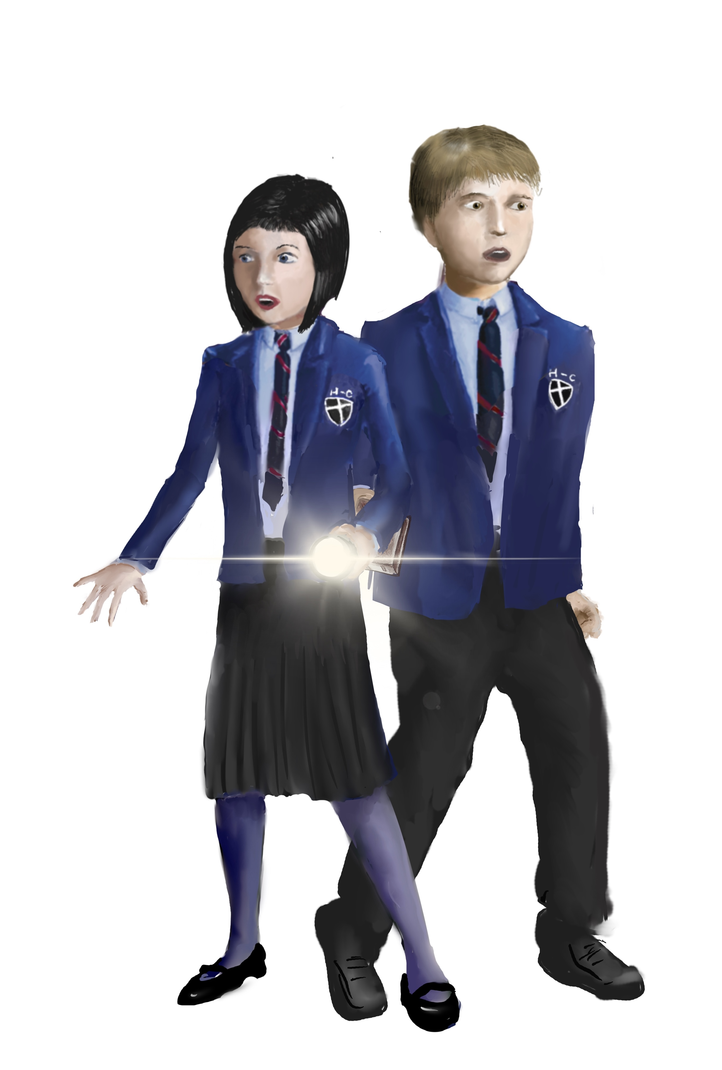
The hero The hero is the one who confronts the villain, and normally defeats them in the end.
Things to remember:
The hero needs a reason to be a hero. Usually, it’s because they are emotionally attached to the victim.
A hero shouldn’t be more powerful or as powerful, as the villain at the start of the story. The more ordinary you make them at the start, the more impressive their victory will be at the end.
The hero should develop as they meet the challenge of the villain.
The hero is the emotional link between the reader and the story. We should feel what they feel - curious, uncertain, fearful, frustrated, defeated, resolute, victorious.

Slide 7
Gothic hero planner! Make notes about your hero, using this planner:
Name:
Age:
Background
(e.g. job, family, home):
Personality
(Funny? Quiet? Outgoing? Determined?)
Abilities, skills:
Appearance:
Weaknesses:

Slide 8
Author’s Note:
In story terms, the victim mainly exists to show how evil the villain is and to give the hero a motive for getting involved.
But you don’t want the reader to notice this!
Perhaps the victim is cruelly murdered at the start...
Or is captured and needs rescuing...
The reader needs to feel an emotional reaction towards them, and a desire to see evil defeated by the hero.

Slide 9
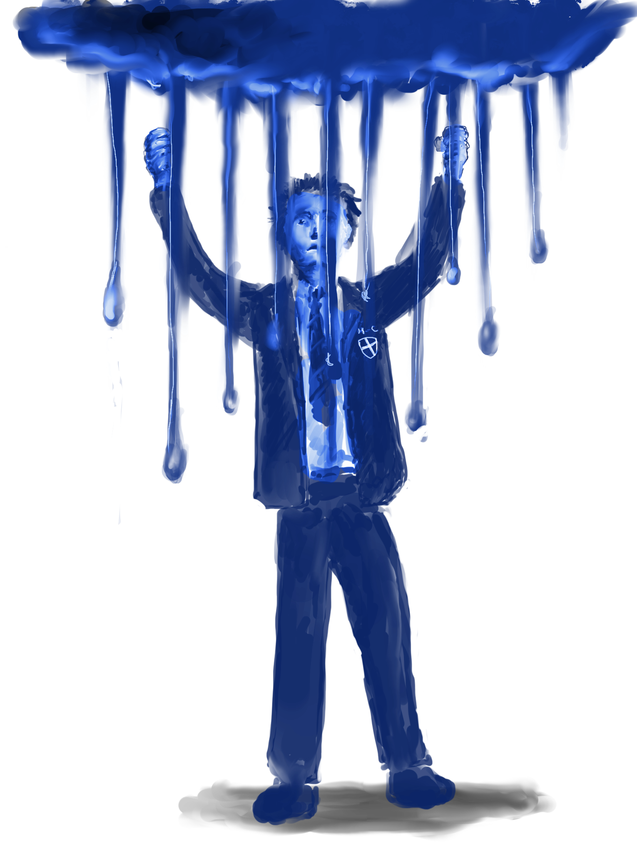
The Victim! Victims are normally presented as innocent, good and vulnerable.
The victim will normally:
Represent what the villain is trying to destroy or have power over
Be connected to the hero in some way, often a personal connection such as a family member.
Be unaware of the danger presented by the villain until it is too late.
Whether your victim lives or dies at the start of the story will change the type of story you tell:
If the victim is killed, the story will have a revenge plot where the hero’s focus will be to punish the villain for their actions.
If the victim is kidnapped, the story will have a rescue plot where the hero’s focus is on returning the victim to safety.

Slide 10
Victim planner!
Your victim normally isn’t in the story for too long, but you should still work out some basic facts about them.
Name:
Age:
Appearance
How they connect to the hero
What makes them vulnerable to the villain.
[Like a child who is always wandering on their own; or perhaps someone who is very curious...]

Slide 11
Be a Gothic writer: Write part of story in which ONE of these happens:
The hero and victim have an argument and the victim storms off. Leave it at the moment when the victim first sees or meets the villain.
OR
2. The moment when the hero realises that the villain has kidnapped or killed the victim... What will their thoughts be?
OR
3. The moment when the hero has to face up to the villain to rescue or avenge the victim.
Tip: remember to use your language skills and your Word Bank!

