Slide 1
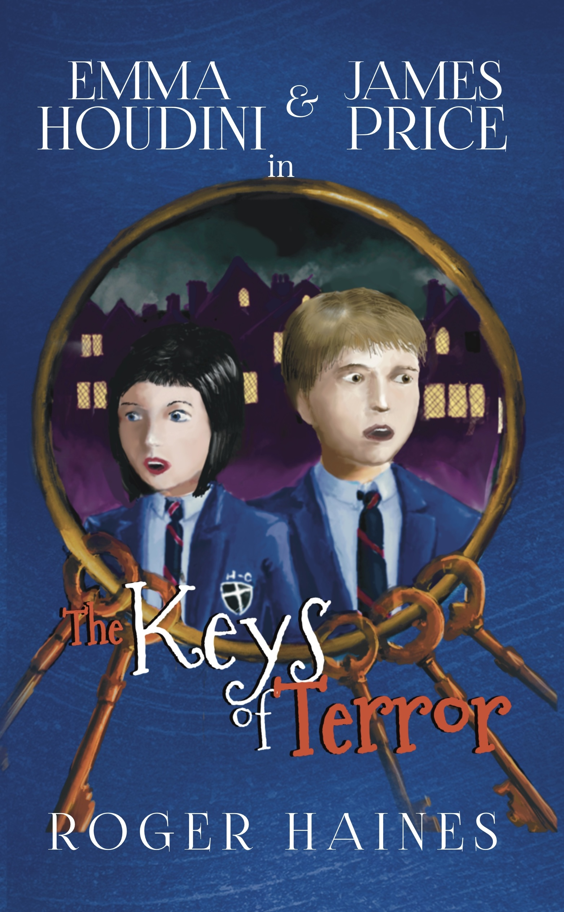
Student Mission Book 3
Roger Haines

Slide 2
In this unit you will:
Learn
Learn some techniques to give your writing more impact
Learn
Learn some technical terms to impress
Do
Do some quick checks of your understanding
Do
Do some writing of your own

Slide 3
Author’s Note!
As a writer, it’s my job to help you experience the story as vividly as possible through my use of language and structure.
I use a range of techniques to bring my readers into the story and make it live for them. Writing is a craft, and these techniques are the tools we use.

Slide 4
Writers! Learn more about Language and Structure! To help your reader get inside your story you can use:
Simile: uses like or as to make a descriptive comparison.
From Keys of Terror:
‘The noise of the keys rolled through the tunnel like a wave.’
Metaphor: talking one thing as if it is something else.
From Keys of Terror:
‘a roaring shout filled the tunnel behind them.’
[Sound talked about as if it IS a wave.]
Check your understanding:
Quick task: Describe sound in two sentences:
use a simile in the first sentence.
Use a metaphor in the second sentence.

Slide 5
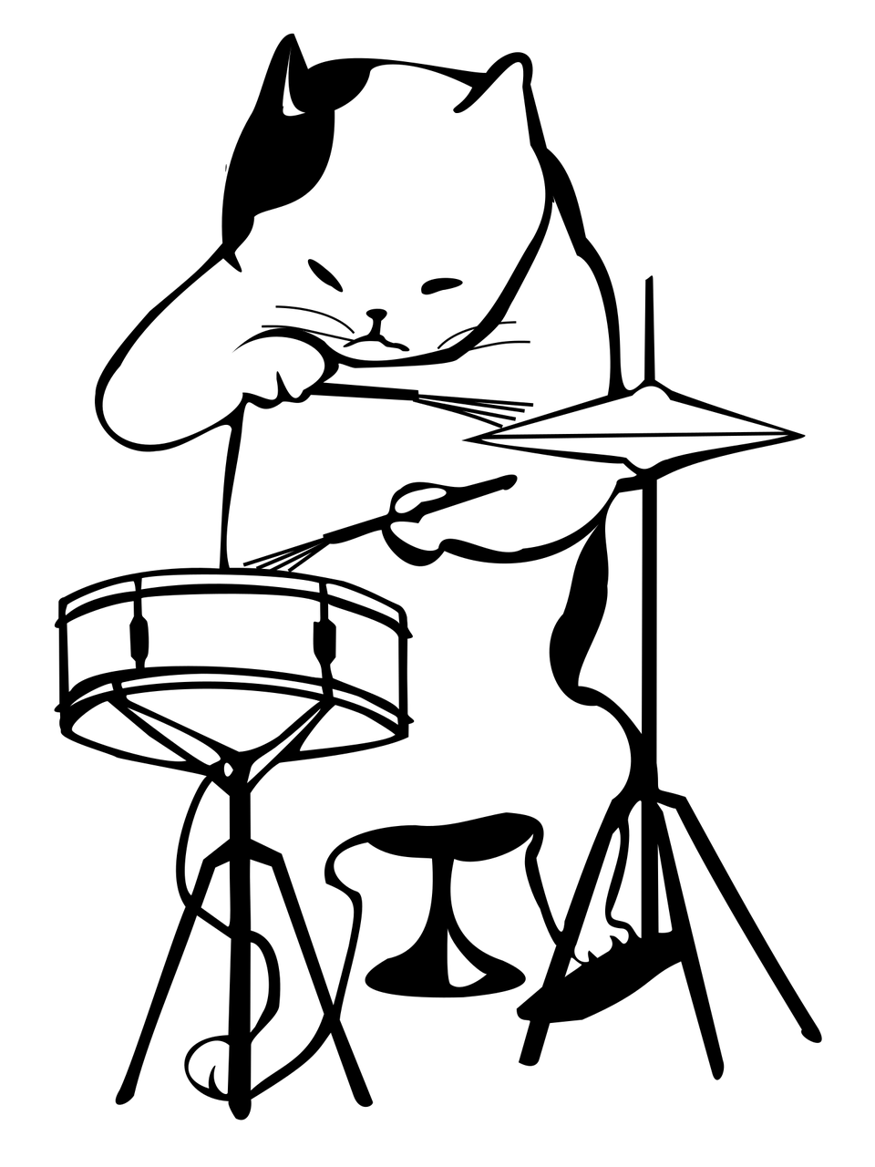
Language: riff with sounds! There are a number of ways to play with rhythm and sound in your writing. Try these techniques:
Alliteration: lots of words begin with same letter.
From Keys of Terror:
‘rasping-rumbling sound’
Onomatopoeia: when a word sounds like its meaning.
From Keys of Terror:
‘Shuffling’ ‘Rasping’ rumbling’ [That’s a good riff, putting two techniques together!]
Quick task :
Add some alliteration and onomatopoeia to your Word Bank.

Slide 6
Language: riff with sounds! There are other ways to play with rhythm and sound in your writing. Try these top three techniques:
Vary the pattern of your sentence structure:
1. Add subordinate clauses – [Parts inside of a sentence used to add layers of detail. ]
This makes complex sentences
[Complex sentences can be used to build tension, as the reader works
through the sentence to find out what happens next.]
2. Use short, simple sentences to keep the pace moving quickly.
3. Break up the description with direct speech (dialogue) to add drama.
The next slide shows you how! Check it out!

Slide 7
Check it out: Notice how the varied sentence structure works to create the rhythm in this extract from Keys of Terror
[1] As if to prove him right, a roaring shout filled the tunnel behind them, a horrible, rasping-rumbling sound that James never imagined any individual could make. [2]Then came the familiar singing voice.
[3]“Here comes the Jailer, shaking his keys!”
This helps to keep the reader interested!

Slide 8
Your turn to riff and show off what you can do! Challenge: write the opening of a Gothic story. See if you can use some of these techniques.
Simile
Metaphor
Alliteration
Onomatopoeia
Varied sentences
Dialogue
And... Oh yeah, your Word Bank!

