Slide 1
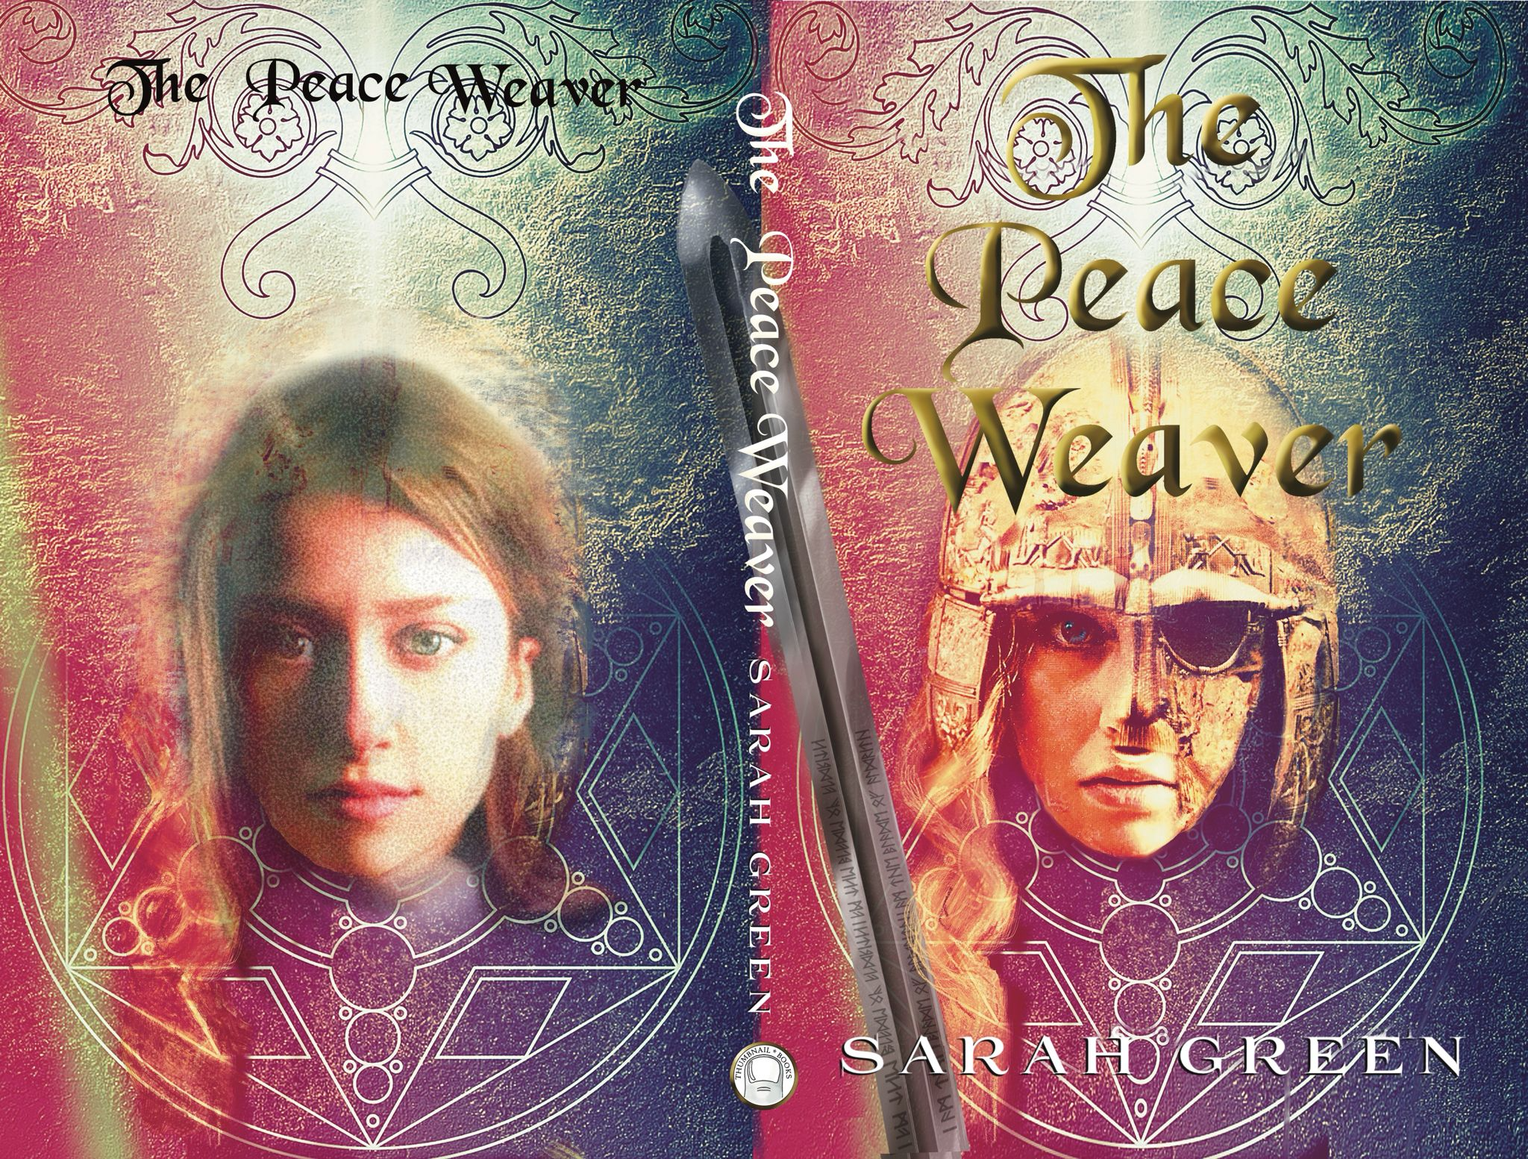
Student Mission Book 5
Sarah Green

Slide 2
In this unit you will:
Begin
Begin to take a closer look at Wren
Check
Check your understanding
Learn
Learn some key terms
Think about
Think about the narrator’s voice
Do
Do some writing of your own

Slide 3
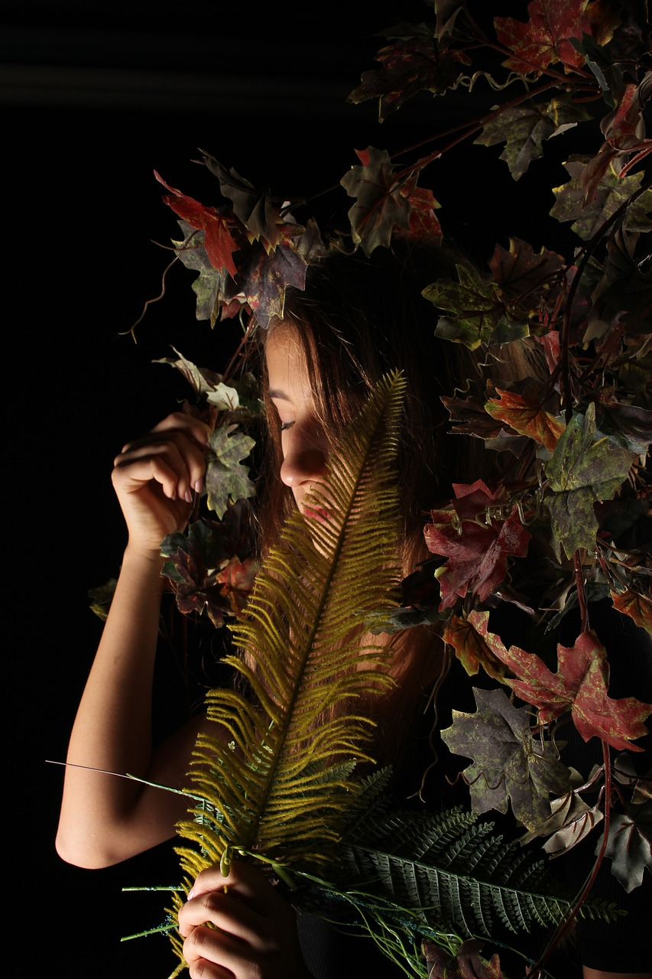
Wren: fact file:
Wren is a Welsh girl living in Saxon city.
Her father is a goldsmith but also possibly a wizard.
Her mother is skilled in plant lore and ancient wisdom
Wren sometimes has moments of ‘Sight’ when she can glimpse the future.

Slide 4
Check your understanding Remember this?
Make certain that you pick up technical terms . It will help you understand more about the craft of writing... and help your results.
( Tip: examiners love it when you use a technical term.)
The book is written in the FIRST PERSON from the POV (POINT OF VIEW] of Wren.
(Uses I /me / mine [ THIRD PERSON: he/she/they /his/hers /theirs]
Why choose first person?
-More personal? Easier for readers to identify with?
But it can be tricky: it’s important to get the ‘voice’ right and sustain it.
In terms of plot, it restricts scenes to those where the narrator is present.

Slide 5
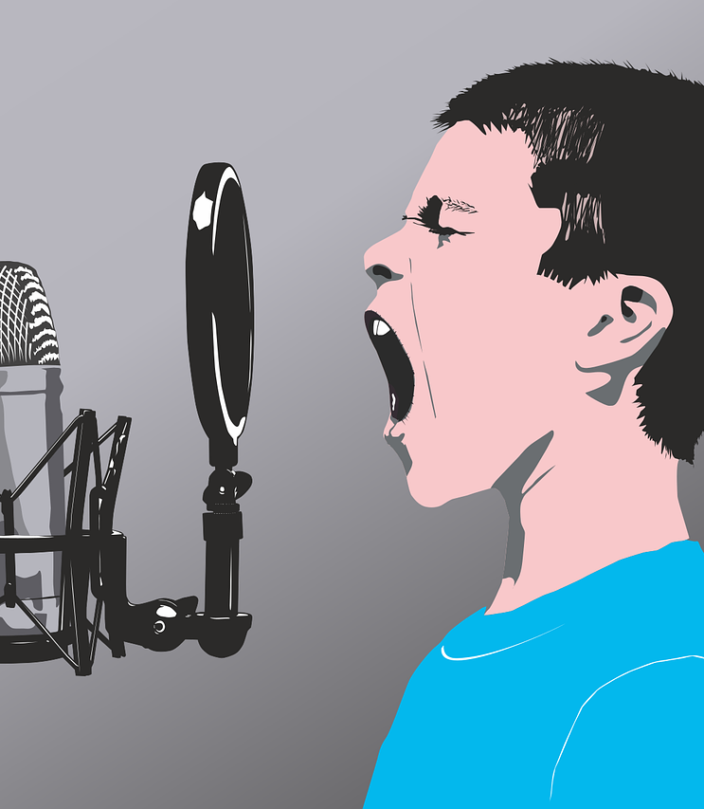
Another key word: REGISTER.
[Not the morning roll call in class! ]
We all have a variety of ways in which we talk. A ‘wardrobe’ of tones of voice, or registers.
The register you use depends on who you are talking to, and the situation.
You will have a different register for:
-Talking to your mates in the yard
-Talking to your teacher
-Talking to the head when you’re in trouble
Talking to a toddler...
The list is endless!

Slide 6
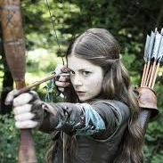
Using first person: getting the ‘voice’ right:
Every sentence you write in a first-person narrative must sound as though it really is the voice of your character.
To live as believable person, Wren needs different tones or REGISTERS in the way she speaks.
‘I kicked the dye pot over and I’m not sorry!’ [a bit childish]
‘Show yourselves, brave Cymri, or are you afraid?’ [Brave]
‘Get me rosemary, rue, honey and hyssop if you have it. And set a pan of water to heat.’ [Wise and confident.]

Slide 7
Narrative voice: building a relationship with the reader.
Every sentence you write in a first-person narrative must sound as though it really is the voice of your character with varied registers, but always personal and honest as if they are confiding in a close friend.
‘I was the girl that worked the gold. Did that make me bad magic?’
‘The wet wool stank, and I suppose I did too.’
‘I ever loved being so high in the sky like the eagles that soared overhead.’

Slide 8
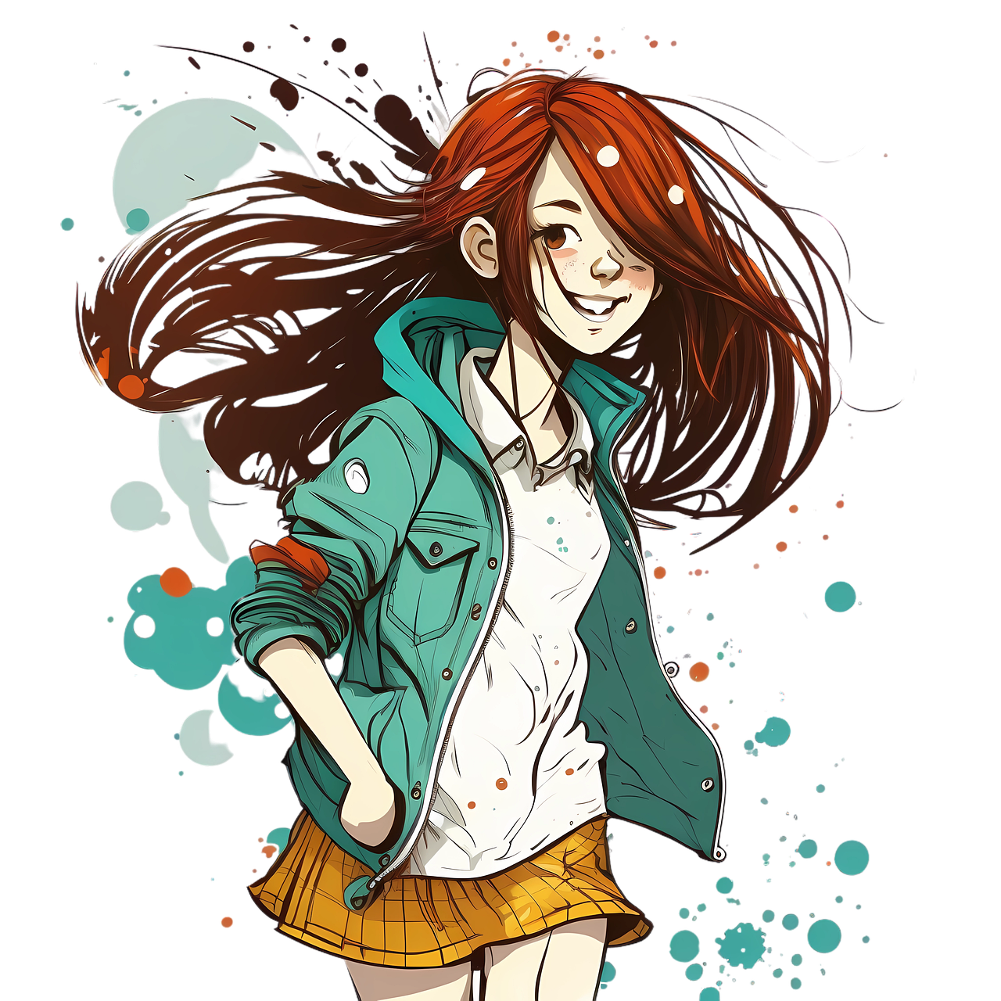
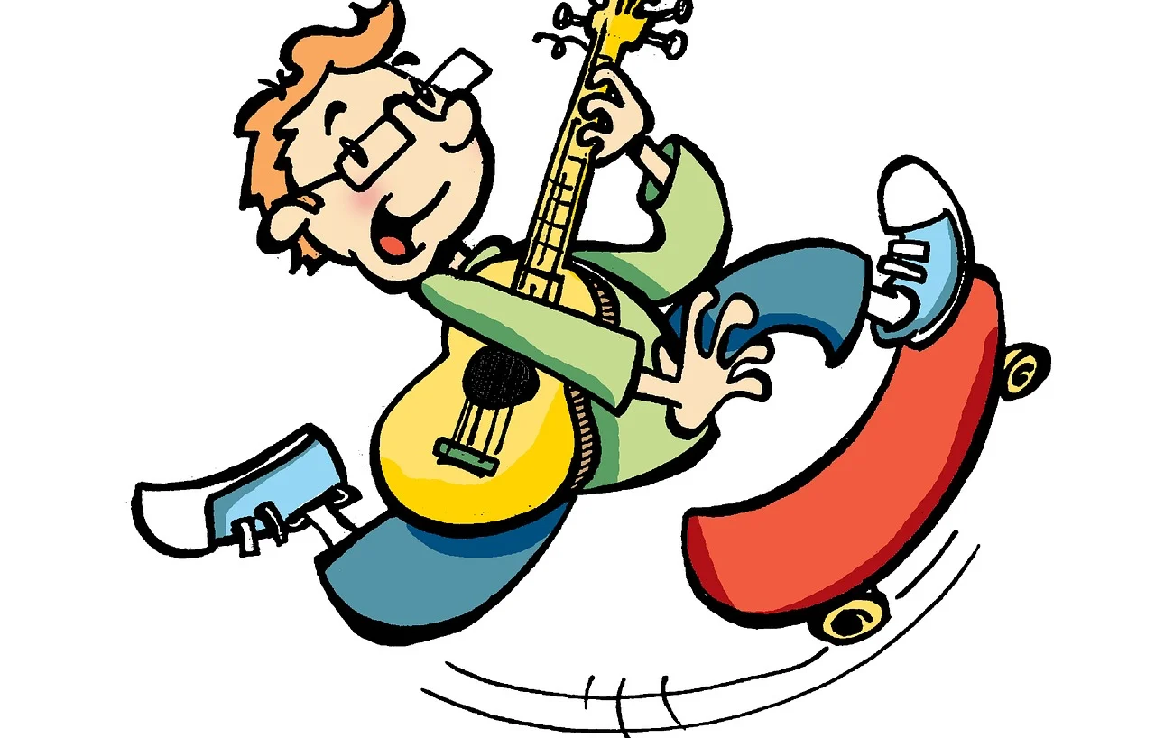
Be a writer!
Challenge!
Write a story in the first person: ‘A day in the life of...’
This could be a diary entry, perhaps.
Who is this person? What are they like? What problems do they have?
Give your narrator a range of registers as they talk to different people during their day.
Create a tone that sounds as though they are chatting to a mate.
[That will help create the relationship with the reader.]

