Slide 1
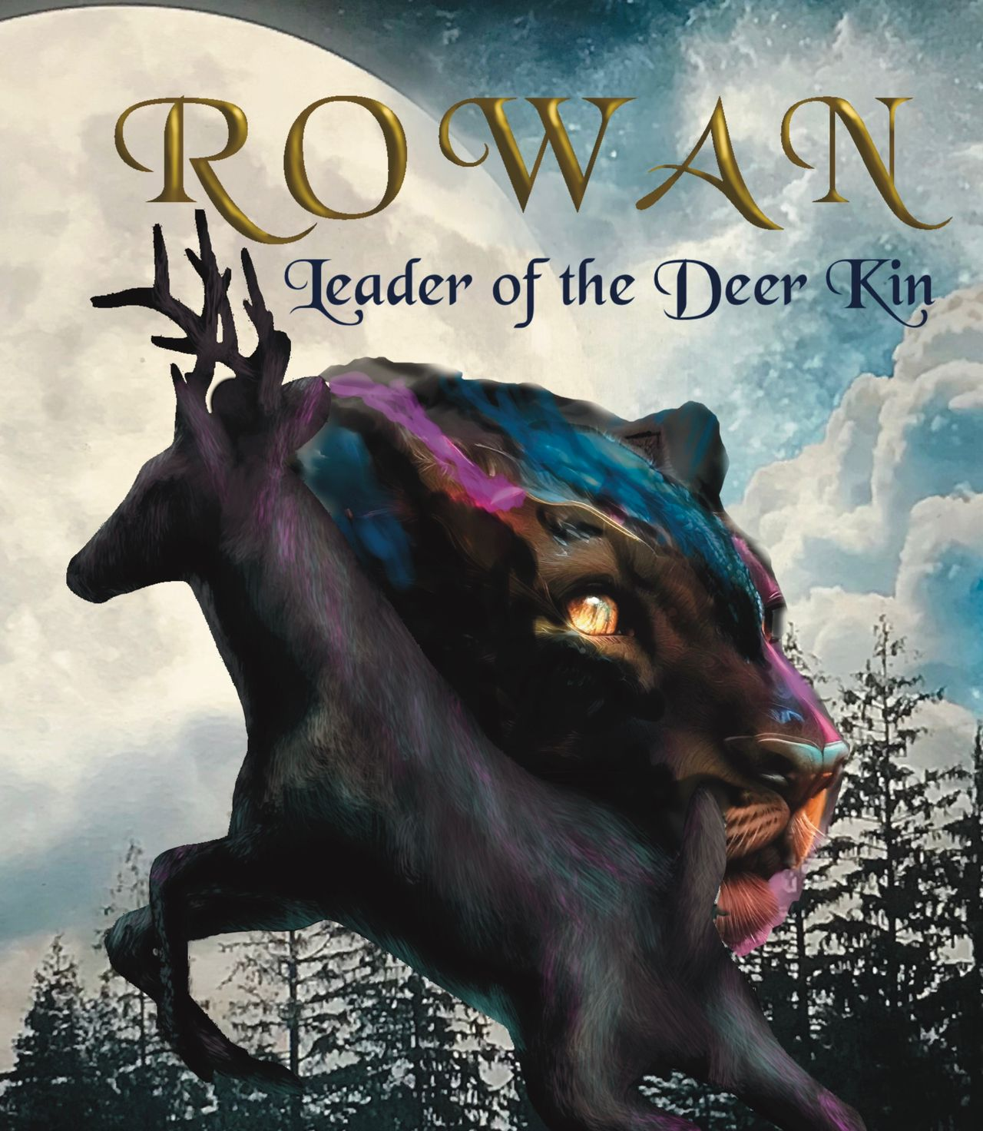
Student Mission Book 7
Sarah Green

Slide 2
In this unit you will:
Read about the settings of the book
Draw a fantasy map for a story of your own
Write part of the story or the blurb for the story

Slide 3
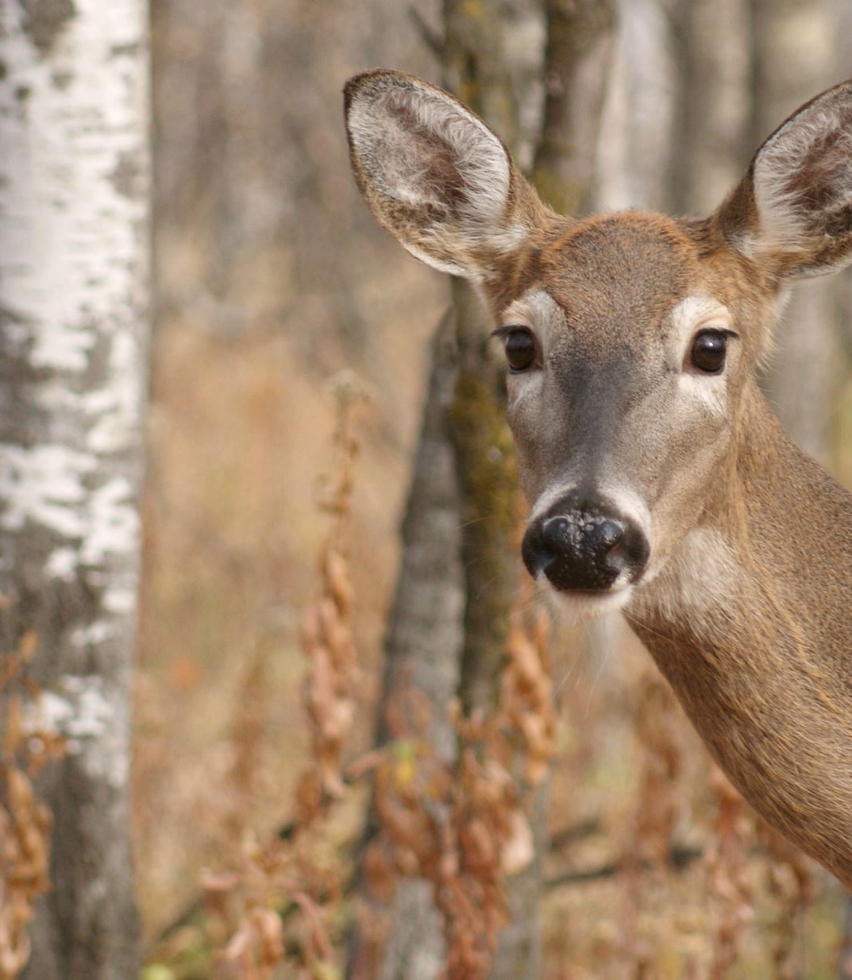
Author’s Note: the settings.
Rowan leads his clan on a long journey.
The places in the book do exist but in reality, they are much further apart than they are in the story.
No roe deer could travel the true distances between these places! but
I wanted to use them for their imaginative power.
Using real-life settings helped me immensely in setting my roe deer in their landscape.
I hope I can be forgiven for the liberties I have taken!
Author’s Tip: draw on your own experiences but apply imagination!
Task: learn more: read 248 -250 in the book

Slide 4
The Map of the story. [You can find this in the front of the book]

Slide 5
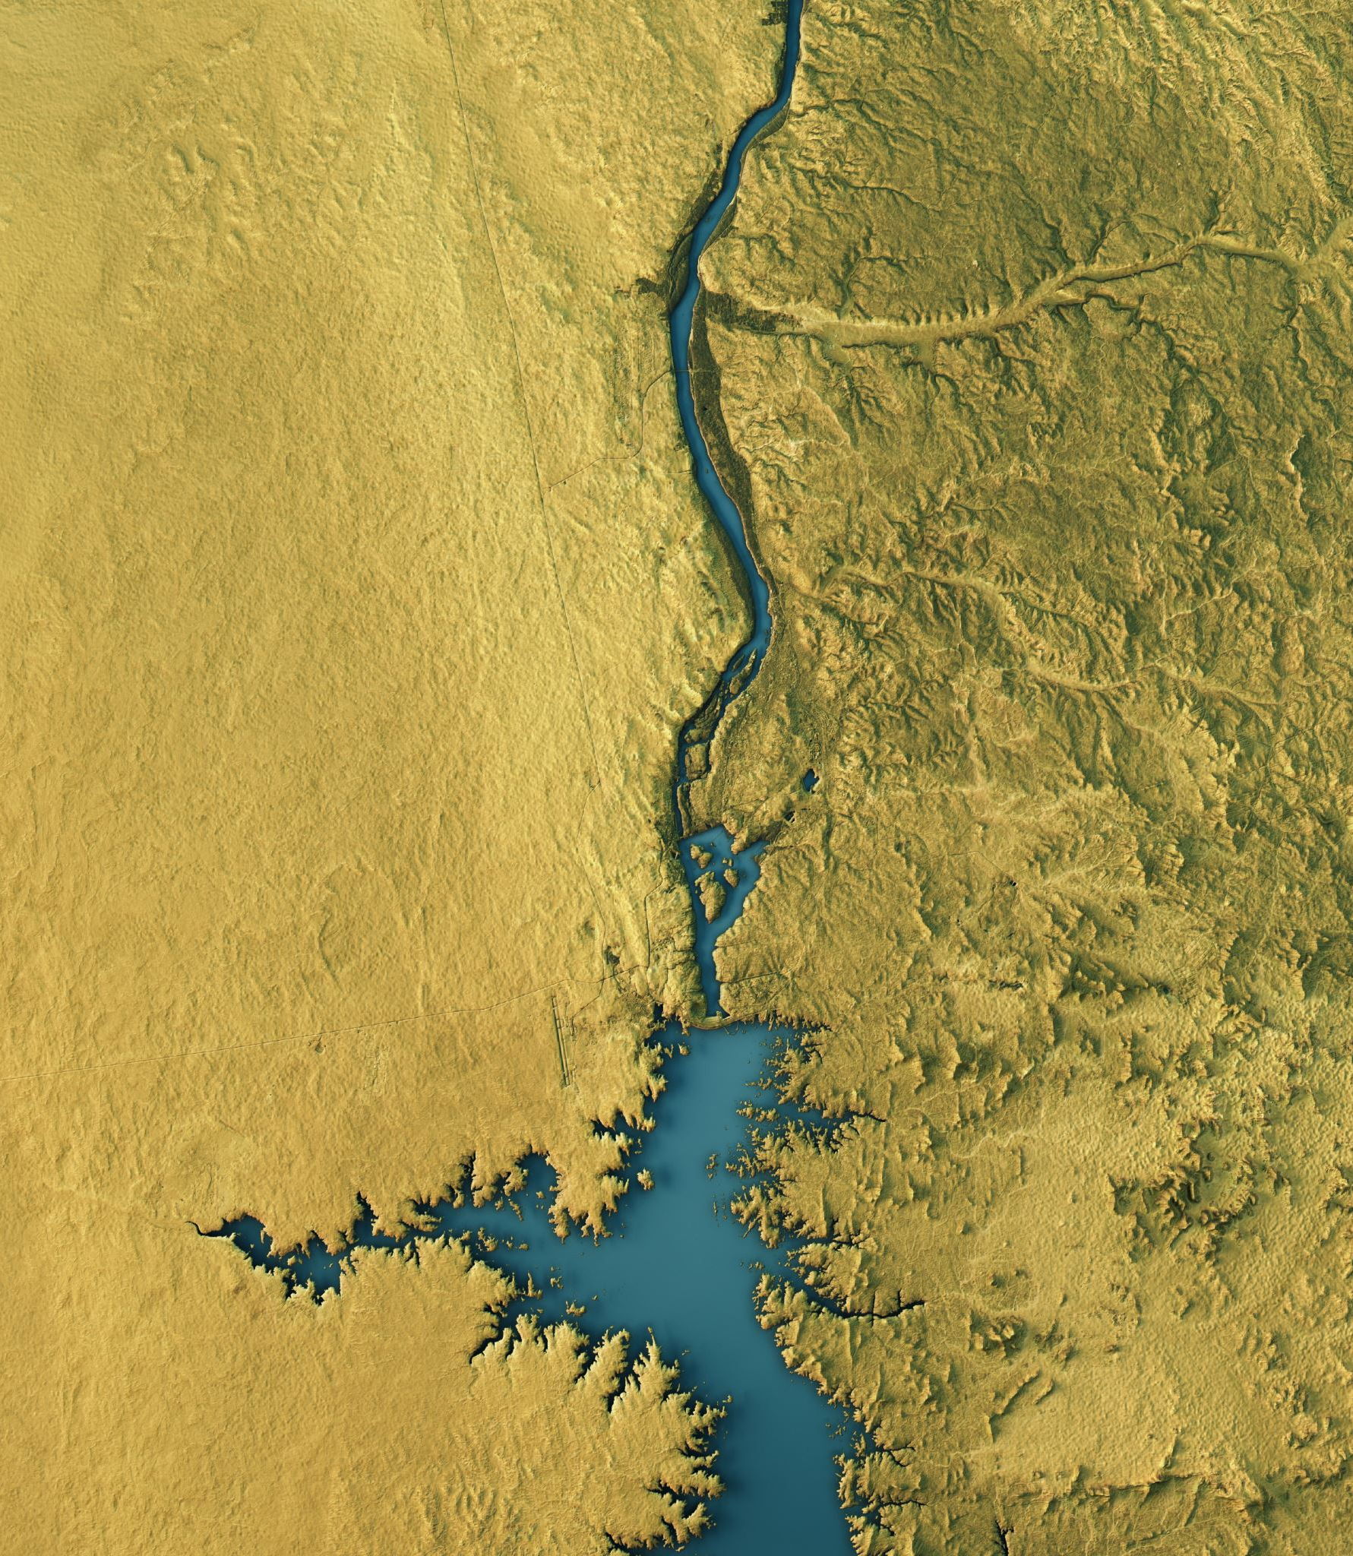
Map
Create a fantasy map for a story of your own.
Make the settings exciting and challenging!
[Like me, you don’t need to be great at drawing. Just design some simple symbols for trees, rivers, railways etc. [Whatever you need for your story.]
Tip: lots of writers draw the map of an island to make things easier.
Include different terrain like mountains, caves, swamps, trees and some buildings like castles, huts etc.

Slide 6
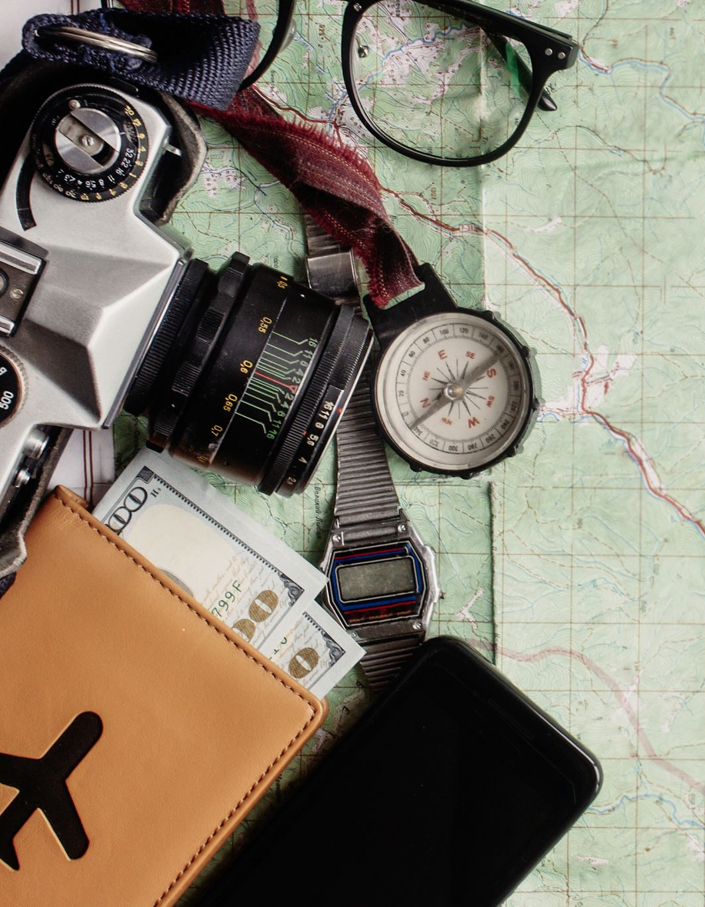
Write!
Imagine that you have written the book that your map belongs to.
EITHER:
Write part of your story in your favourite setting from your map.
OR
Write the blurb that tells us a little about the story.
Your aim here is to say just enough to tempt someone to read it!
Tip: don’t give too much away!
Something like...
Tiernan must find the lost secret of his people. His quest will take him across the Desert of Despair and into the Eagle Mountains...

