Slide 1
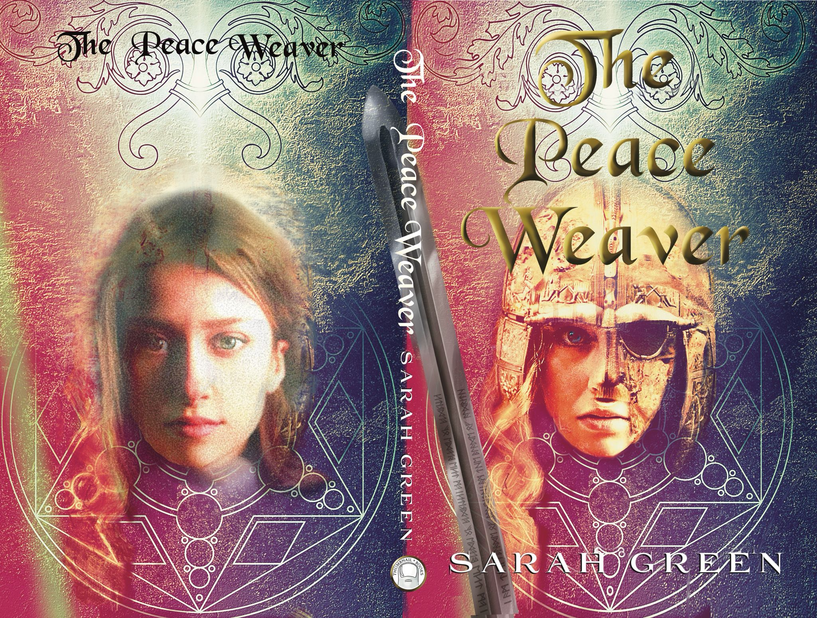
Student Mission Book 3
Sarah Green

Slide 2
In this unit you will:
Check what you have learned so far.
Learn some key words that impress.
Develop your understanding
Do some thinking planning and writing.
Do some writing of your own.

Slide 3
Check your understanding. Remember these Key Words? Tip: Technical terms impress examiners!
Story Structure:
Most stories are structured like this:
Set-up >
Development>
Payoff

Slide 4
Some new key words! In the set up we meet two main characters:
Firstly, the Hero
Key word: PROTAGONIST [use this term to impress!]
The hero is the character we are most interested in.
It’s their story we are following.

Slide 5
And the other main character?
The villain, of course!
Key word: the ANTAGONIST [use this term to impress]
The villain tests the hero
They make things happen.
No villain..? No hero!

Slide 6
More about the protagonist: THE ESSENTIAL CHARACTER ARC
Author’s Note: Don’t make your hero too perfect.
Give them a flaw or personal issue. E.g they might lack confidence
As they meet the challenges caused by the antagonist [villain] they will need to change
We call this change the CHARACTER ARC
It’s an essential ingredient in any story
PS. Villains can’t and don’t change. That’s why they’re the villain!

Slide 7
Who do you think the protagonist is?
Author’s Note:
We meet Wren first, but I think there’s a clue in the title. Aldrith is The Peace Weaver. The antagonist is focused on her and that tells us a lot. This is her story. Wren is the narrator, telling the story.
But what is your opinion?
Note:
It’s possible to identify with more than one character and really share their journey too. Enjoy!

Slide 8
Key Words [Technical Terms]
Set up development payoff
Inciting incident
Protagonist
Character arc
Antagonist

Slide 9
Pulling it all together! The Peace Weaver
Check your understanding. Remember this?:
The set-up [across the first four chapters]:
- key characters: Wren; Trajan, leader of the wolf-men and Aldrith.
-situation : Trajan is clearly unpleasant, and we are told he wants to rule the High Realm.
Inciting incident:
-The girls meet, and a friendship begins.
-This will prove to be life-changing for both of them.
Development:
more characters; some twists and turns in the events of the story.
Pay-off: we see matters settled between the girls and Trajan.
The essential Character Arc:
-Aldrith will learn how to be a leader.
- [And of course, Wren develops too, learning more about her powers.]

Slide 10
Pulling it all together! Thinking!
Begin by doing some thinking! Jot down some notes about for a story of your own:
Set up?
What sort of place? Your street? The countryside? Another planet?]
What sort of era? [The past? Today? The future?]
Protagonist?
Think of a name. Draw a sketch or write a few notes about them. [Male? Female? Tall? Small?] Give them a problem...
Antagonist:
Have fun thinking of a name! Draw a sketch or make some notes about them. Why are they causing trouble?
Inciting incident?
What might happen to kick the story off?
Developments:
What else might happen?
Payoff:
How might the story end?
Try to think about some different possibilities.
Top tip:
This is a thinking stage. Jot down ideas. Draw pictures if that helps.
Enjoy!

Slide 11
Pulling it all together! Plan! Write!
Now that you’ve done some thinking , write a plan for a story:
Write some details under these headings, telling us about your ideas:
The Set up:
At the start of the story...
The protagonist is...
The antagonist is....
The inciting incident:
The story kicks off when this happens...
Some developments in the story are...
The pay -off...
At the end, this happens....
Super -power mission:
Write part of your story.
Tip: the inciting incident could be a good choice for writing about in detail.

