Slide 1
Student Mission Book 11
Sarah Green
Roger Haines

Slide 2
In this unit you will:
Take a closer look at flying machines
Check your understanding
Design a fantasy flying machine of your own.
Do some writing of your own.

Slide 3
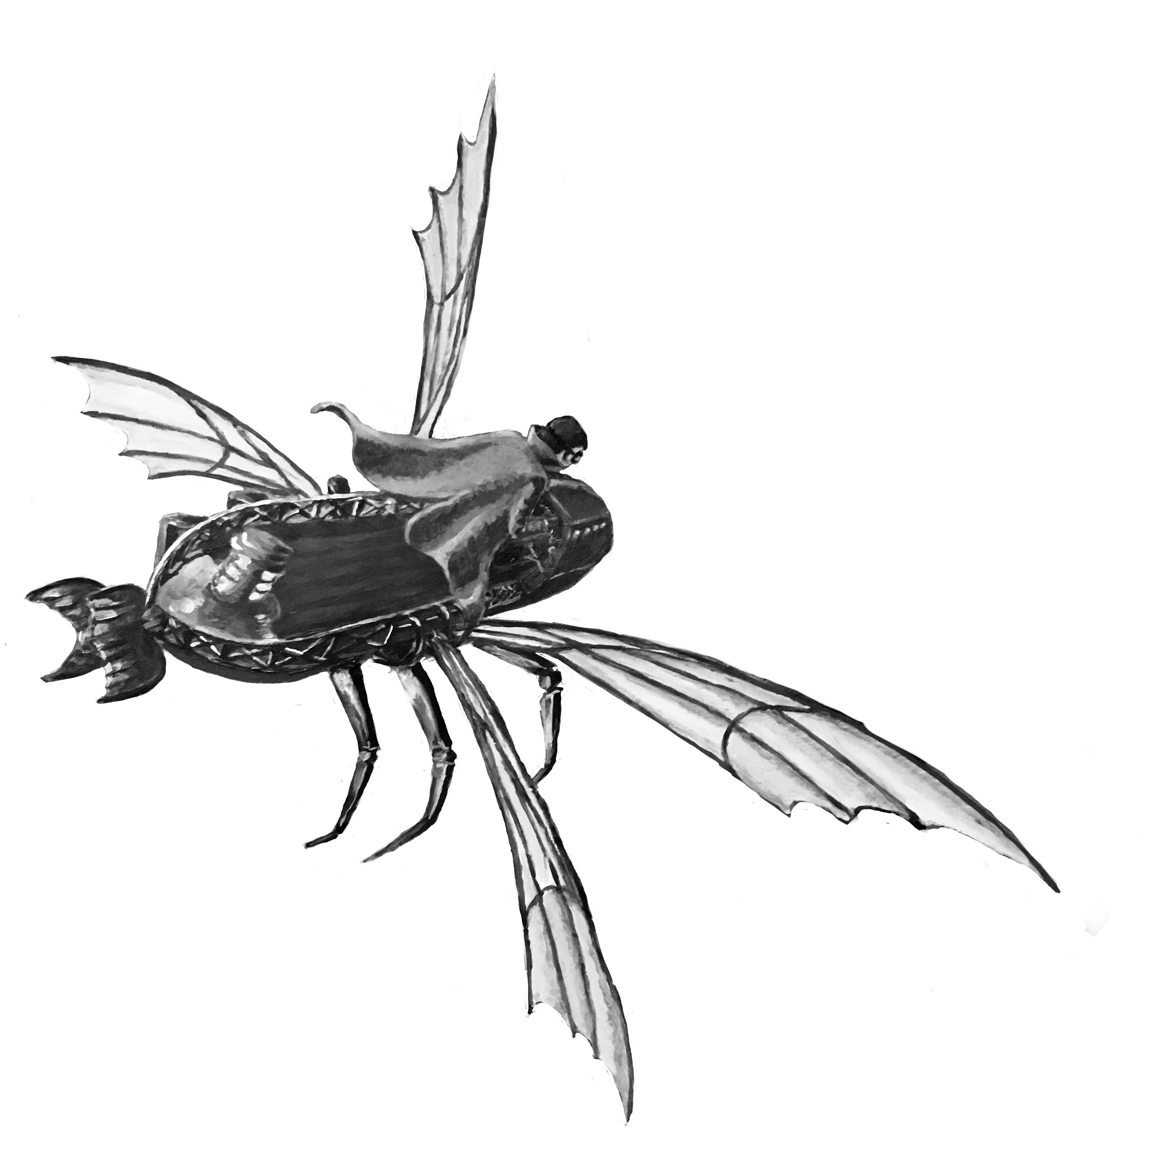
Check your understanding!
How many wings does the ornithopter have?
2. How is it powered?
3. What’s it like in the air? [Eg. Quick? Slow? Heavy? ]
4. Is the ornithopter the only man-made flying thing in the book?
5 . Why would it be dangerous for Hunter to get his hands on the ornithopter?

Slide 4
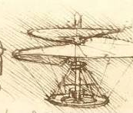
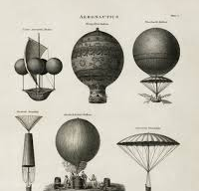
Research, detective!
If you can get access to computers that would be helpful. Or take a trip to the library!
You aim is to find out some key facts about the history of flying machines:
1. See what you can find out about Leonardo Da Vinci’ s drawings of flying machines.
2. Who invented the first air balloon?
3. Who invented the first airplane?

Slide 5
This is a diagram for the ornithopter. You can get a closer look on P311 of the book. Read Chapter 9 p 41-45 for some description of the machine.

Slide 6
Be an inventor!
Now design:
a fantasy flying machine of your own!
Let you imagination run riot!
BUT YOU CANNOT USE ANY ENGINE THAT USES FOSSIL FUELS. You will need to think how it could be powered but remember this is a fantasy machine so
[NO PETROL OR DIESEL]
Draw a diagram of your machine with labels to show how it works and what the different parts are made of. Think about how parts can be recycled.

Slide 7
Writing Task!
Either produce a leaflet entitled
‘Early Flying Machines’
Or
Produce a sales leaflet for your product, pointing out all its key selling points.

