Slide 1
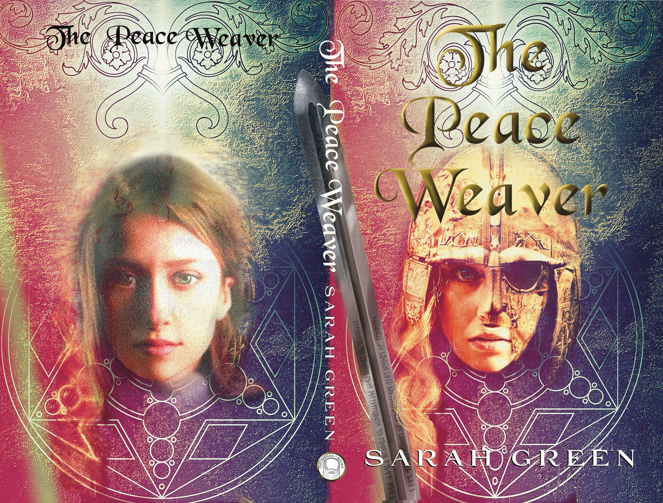
Student Mission
Book 10
Sarah Green

Slide 2
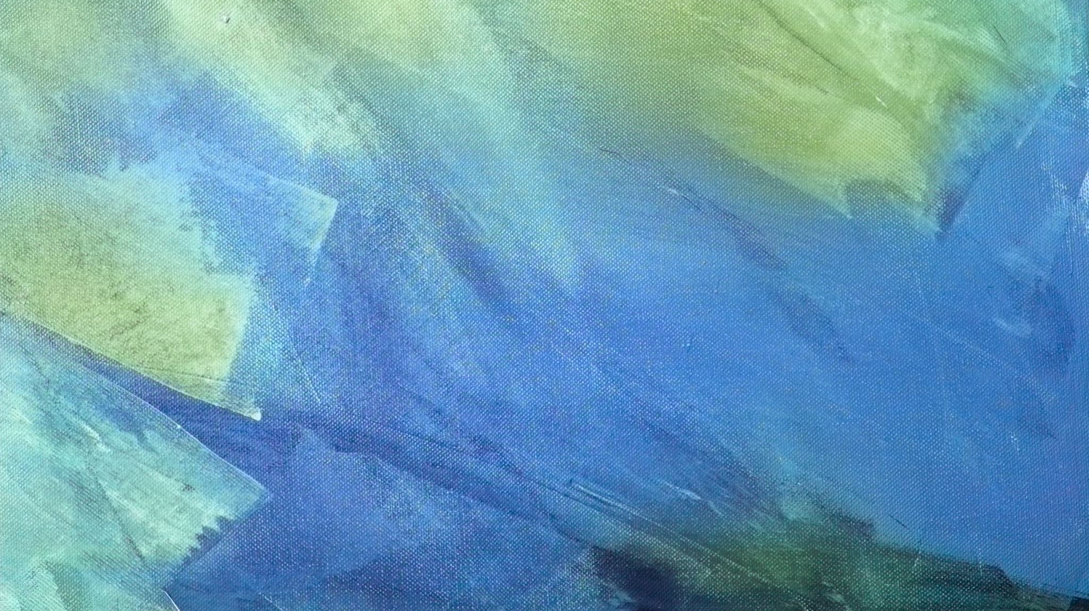
In this unit you will:
Learn
Learn a key word: subtext
Understand
Understand its importance
Discover
Discover at different ways to create subtext
Look
Look at examples from the book
Do
Do some writing of your own

Slide 3

Key Term: the subtext.
Think of a text as if it is an iceberg.
Some things are very easy to see: the tip of the iceberg, above the water.
But most of the iceberg lies beneath the surface.
In literature that is the SUBTEXT
Look beneath the surface and you will find... Hidden emotions, themes, implied meanings and comments.

Slide 4
A closer look: subtext:

Slide 5

Turning fact into fiction?
If you write fiction, you want to deliver more than bare facts.
A good writer works on the subtext:
-Adds emotion
-Interprets how someone felt
-Adds meaning
-Uses the facts to explore themes
-Builds a story that comments

Slide 6


Working on the subtext: Dialogue
Dialogue is a great way to create the subtext because people often say a lot less than they mean.
These two lines of dialogue come from a very emotional moment in the book when Wren must go into the city alone to contact the resistant fighters. She and Aldrith might never see each other again.
‘I would come with you, but...’
‘...you must lead the attack. We’ll be ready at dawn.’
There is a lot left unsaid here, but the subtext is highly emotional, charged with courage, love and anxiety for each other.

Slide 7
Working on the subtext: setting
In this extract we can see Wren’s home.
Note: a skep is a basket.
‘I could not sleep and lay looking at the curved roof of the house place. It was like living in a bee skep. The embers in the hearth were low, so the place was furred in darkness, with touches of gold like a bumble bee.’
Task: Pick out words and phrases that make this setting seem homely and gentle. Think about the sounds of the words as well as the meaning.

Slide 8
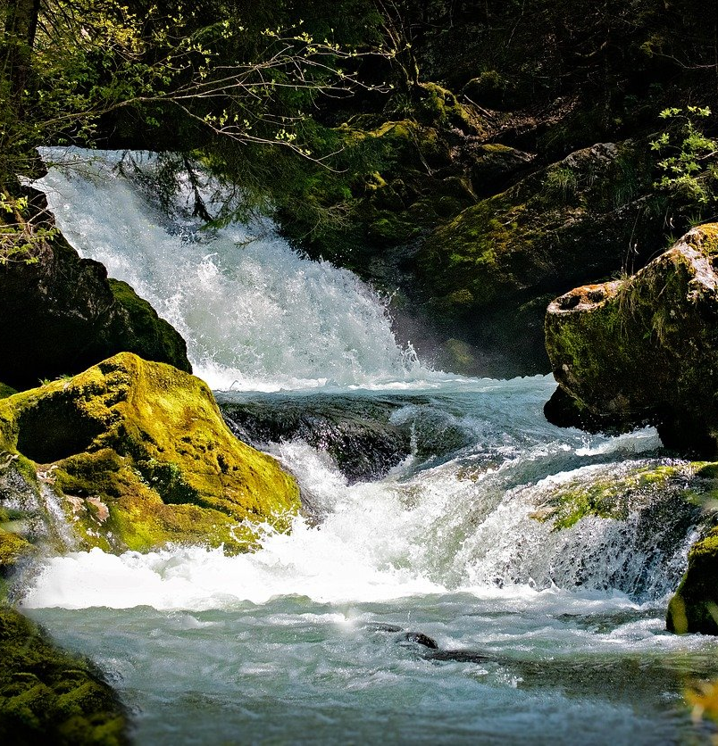
Working on the subtext:
Description
This is a description of the area need Wren’s home:
‘An unruly stream tumbled down from a spring just above our home-place, and I had long known how it had carved a hidden ravine through the dykes and hedges that only the wild things and I ever visited.’
The subtext here is all about Wren wanting to escape from the dreariness of her everyday life.
Pick out any words and phrases that are working to help create that subtext.

Slide 9
A very important reader skill: interpreting the Subtext :
Tip: It’s all about emotion.
Subtext is about what the reader feels
Interpreting subtext: it’s all about what you feel is going on beneath the surface.
Tip: there are no wrong answers here! This is about personal response to the subtext. That’s interpretation. [Examiners love it!]

Slide 10
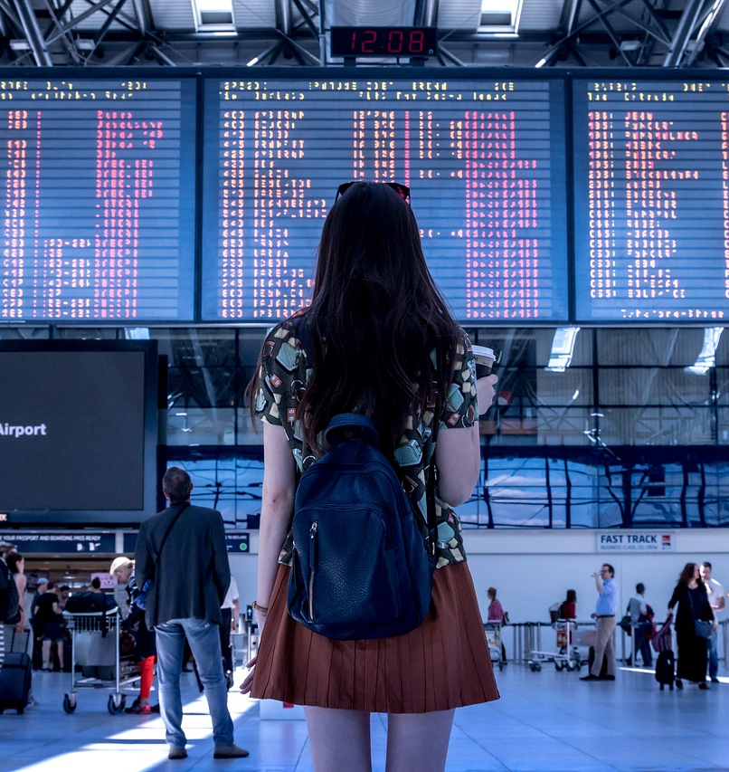
Writing task:
Writing task: a teenager is leaving home for a year to go back-packing. This is the scene where they are saying goodbye to their parents at the airport.
Describe the setting [lots of people; announcements of flights to foreign destinations; information boards]
Include some dialogue as they wait for their flight to be called.
The parents give their son or daughter a small gift to take with them ‘for luck’ [=symbolic object]
Think about the underlying themes here: love; fear for the teenager; desire for independence.

