Slide 1
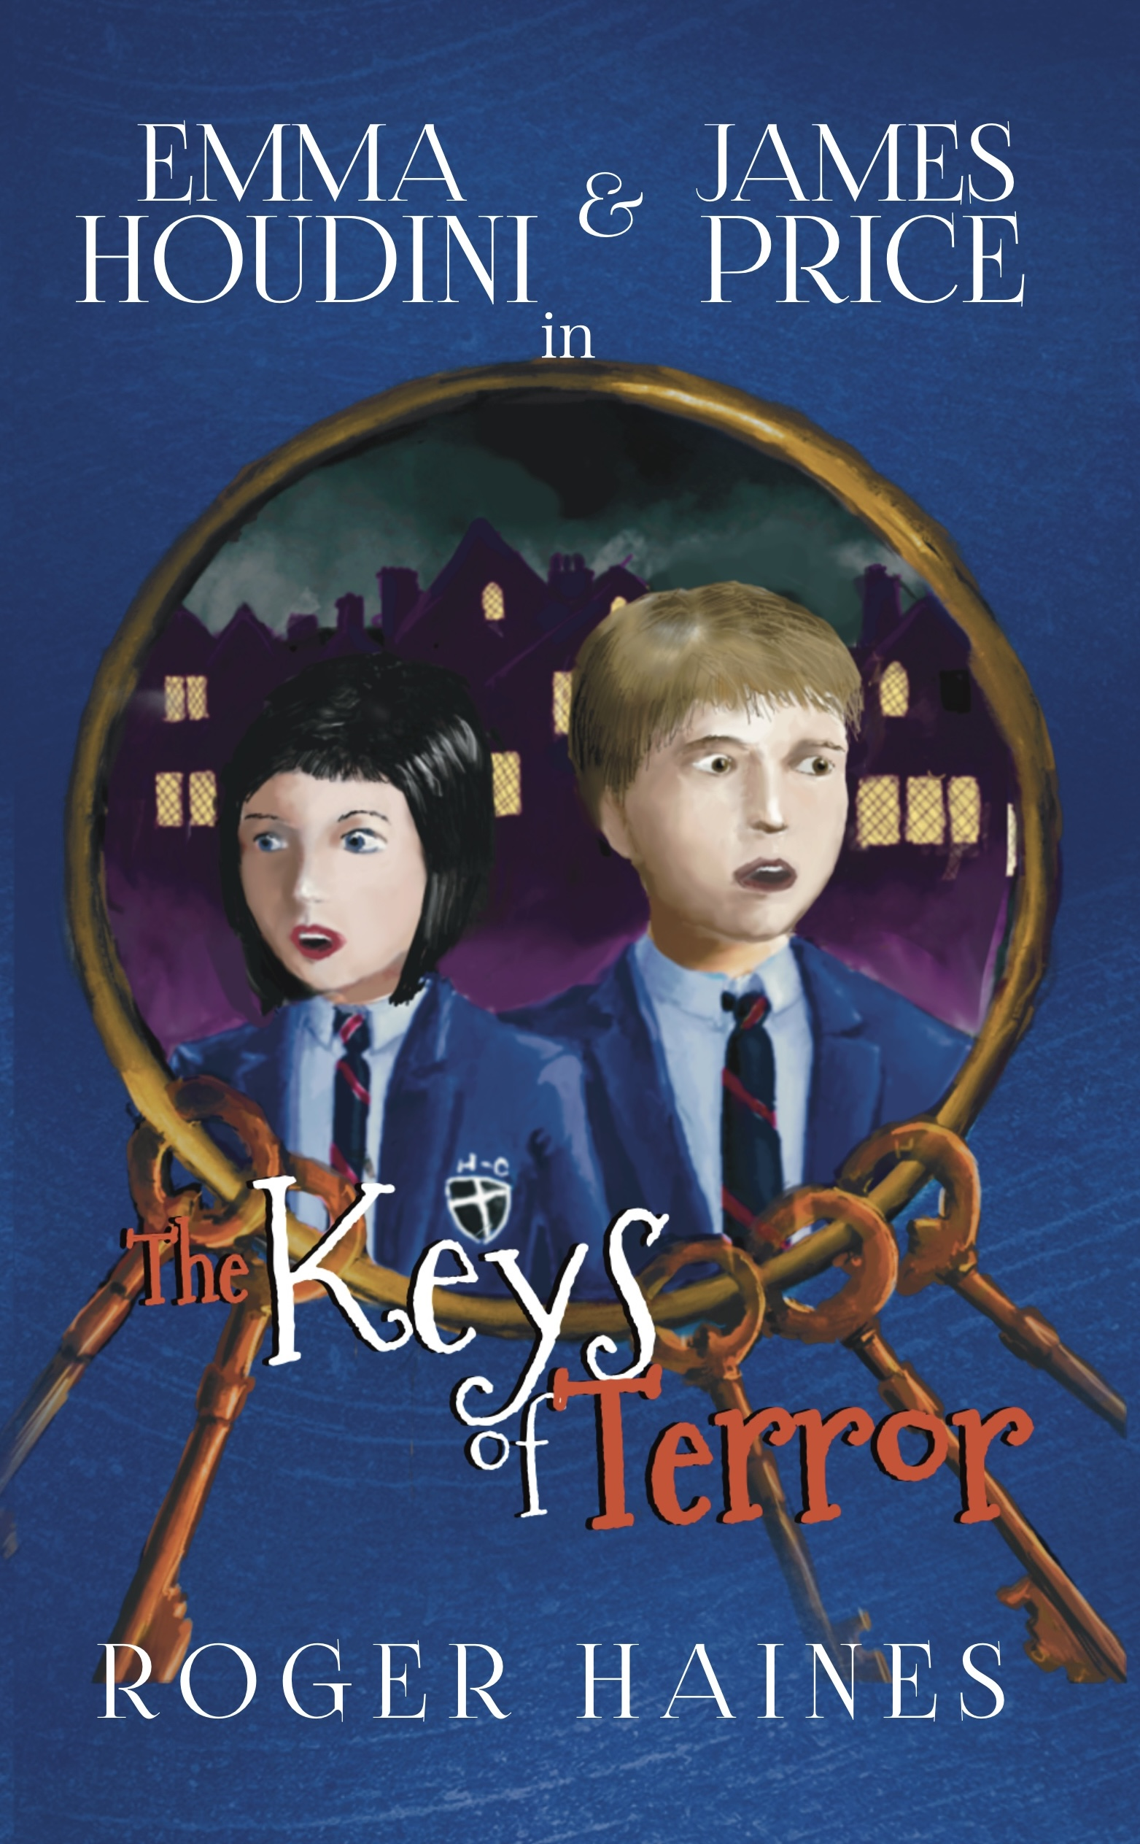
Student Mission Book 6
Roger Haines

Slide 2
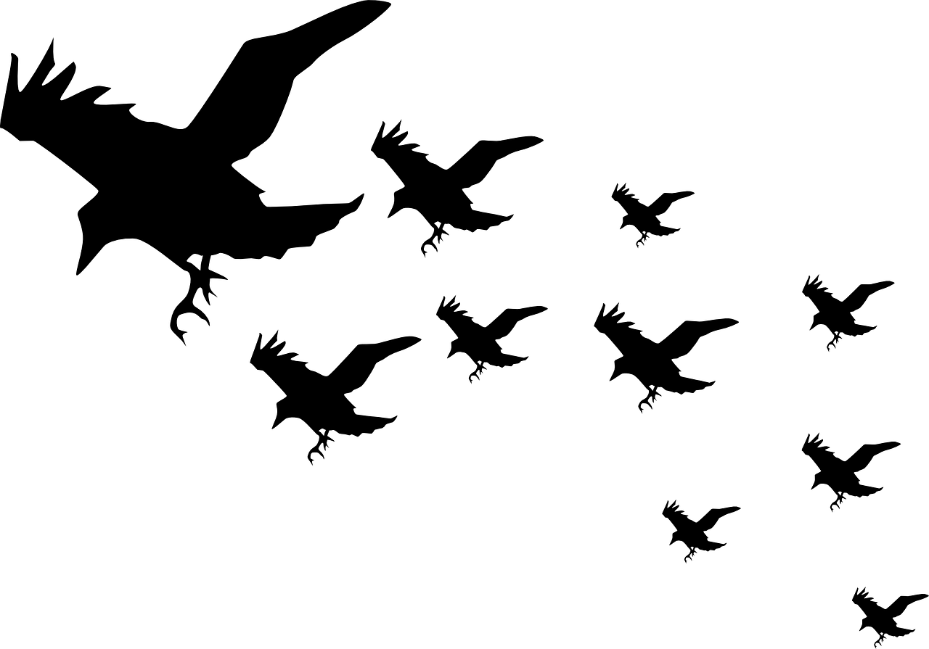
In this unit you will:
Learn about story structure
Look at a detailed example from Keys of Terror
Apply what you have learned and plan a short story
Write the story

Slide 3
The writer’s craft: How to plan your story
INTRODUCTION
[SET-UP]: genre, main characters, setting
INCITING INCIDENT: the event that sets off the conflict and drama (caused by the villain)
RISING ACTION: the build up of events and growing tension towards the crisis (or climax)
CRISIS (CLIMAX): the dramatic moment of change, where everything seems to go wrong for the hero
FALLING ACTION: The hero recovers and takes control, pushing forward to the final confrontation
RESOLUTION: the villain is defeated, the hero returns

Slide 4
This diagram is called Freytag’s Pyramid. It shows the shape of a story.

Slide 5
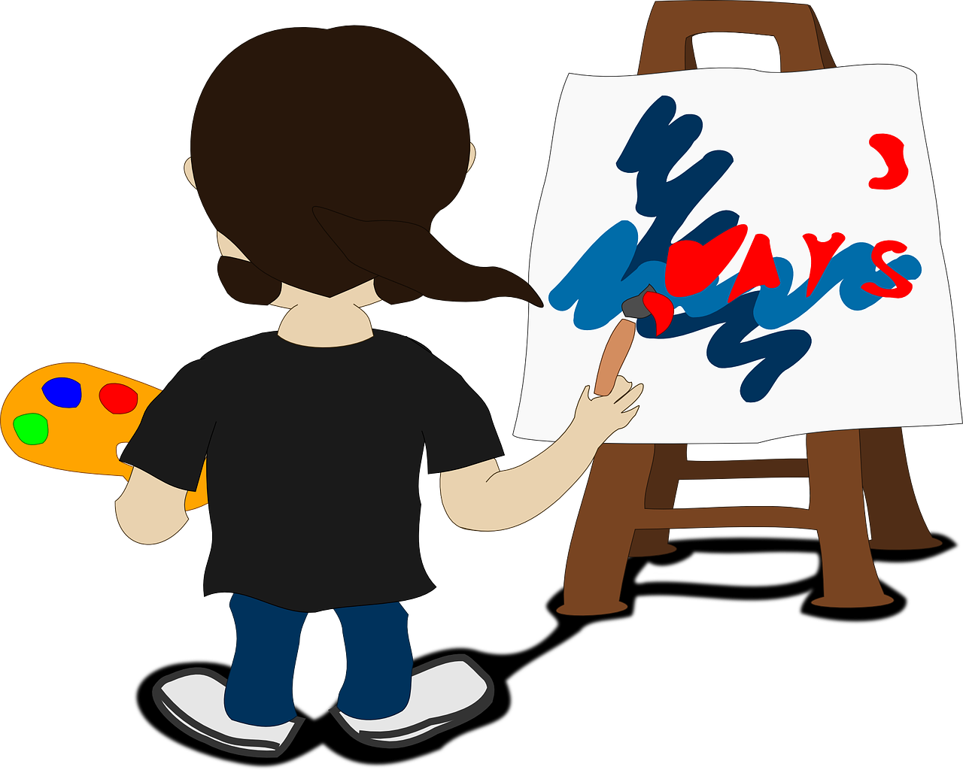
Let’s look at an example:
Read the sheet ‘Six Steps to Story’
It shows how the author planned the opening section of the novel, using the pyramid to help him.
It includes the pyramid diagram with some pictures and notes.
Top tip:
You might find it helpful to sketch your own diagram with some drawings and notes when you plan your story.

Slide 6
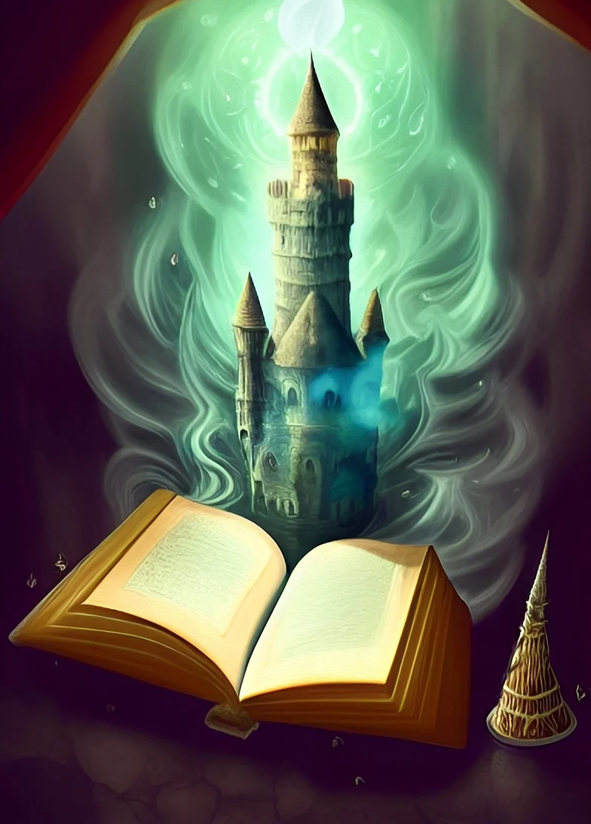
Let’s unpack all that! Six steps to a great story!
Step 1: INTRODUCTION
Start your story by establishing:
The SETTING: Place? Era? [1.e present, past or future?] Weather?
IMPORTANT CHARACTERS: the hero, victim and villain - at least mentioned or present in some way
THE GENRE - we should know it’s a Gothic story from the location and/or characters.
Now draft your introduction.
Tip: Keep it brief; this is not the full story, just the launch pad!

Slide 7
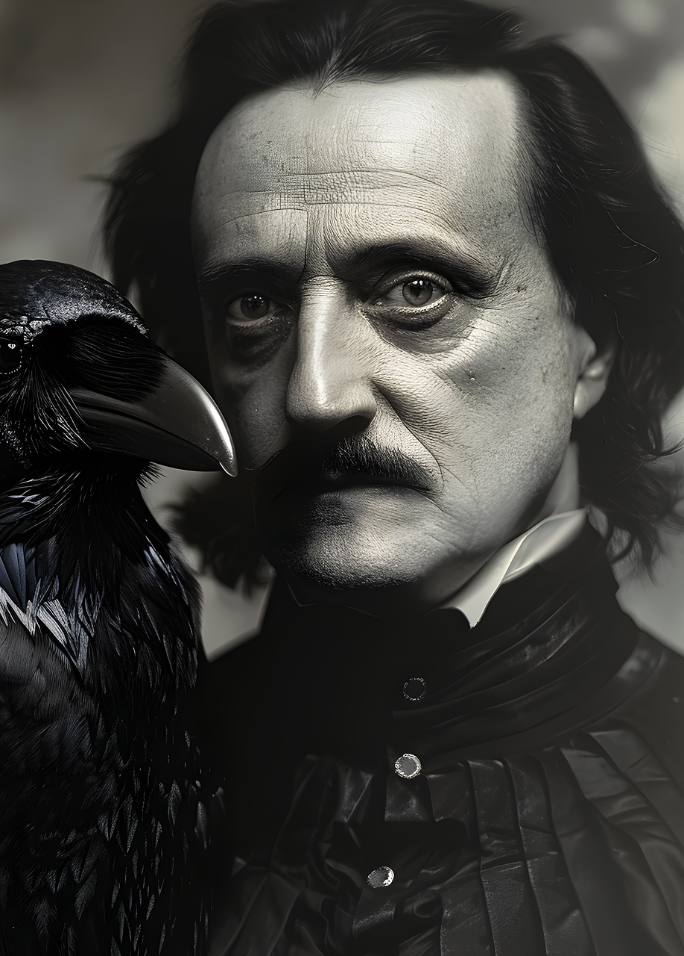
Step 2: the inciting incident!
This is the event that sets the story in motion.
We’ll keep this one easy:
The villain kidnaps the victim.
The hero discovers the victim is missing and feels anger...
but also frustration- for now, they lack the power to defeat the villain and rescue the victim.
Draft your inciting incident!

Slide 8
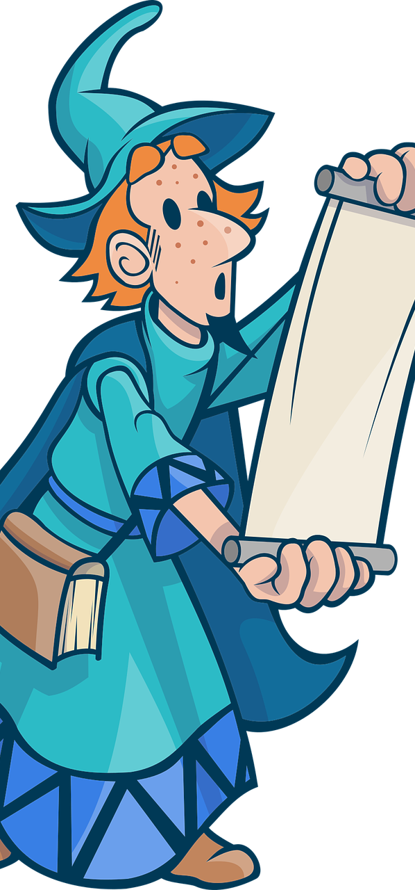
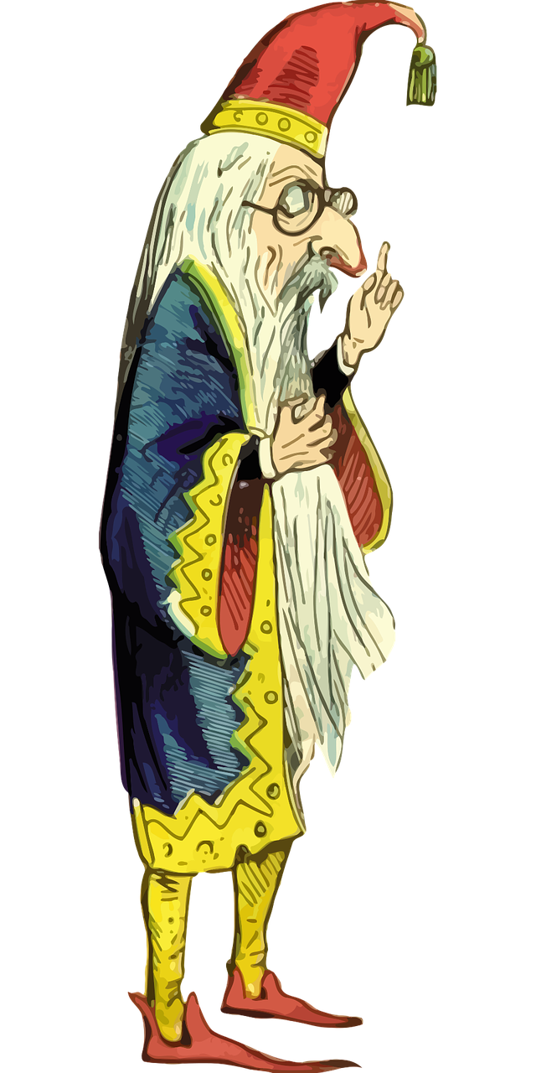
Step 3: The Rising Action!
The rising action is where the hero powers up!
In Gothic stories, this is almost always about gaining knowledge.
But there’s also an emotional component: the hero is fearful but grows in courage.
They discover qualities, skills and abilities they didn’t know they had.
How does your hero gain the knowledge they need? [A person? An ancient book?]
Now write the rising action of your story!

Slide 9
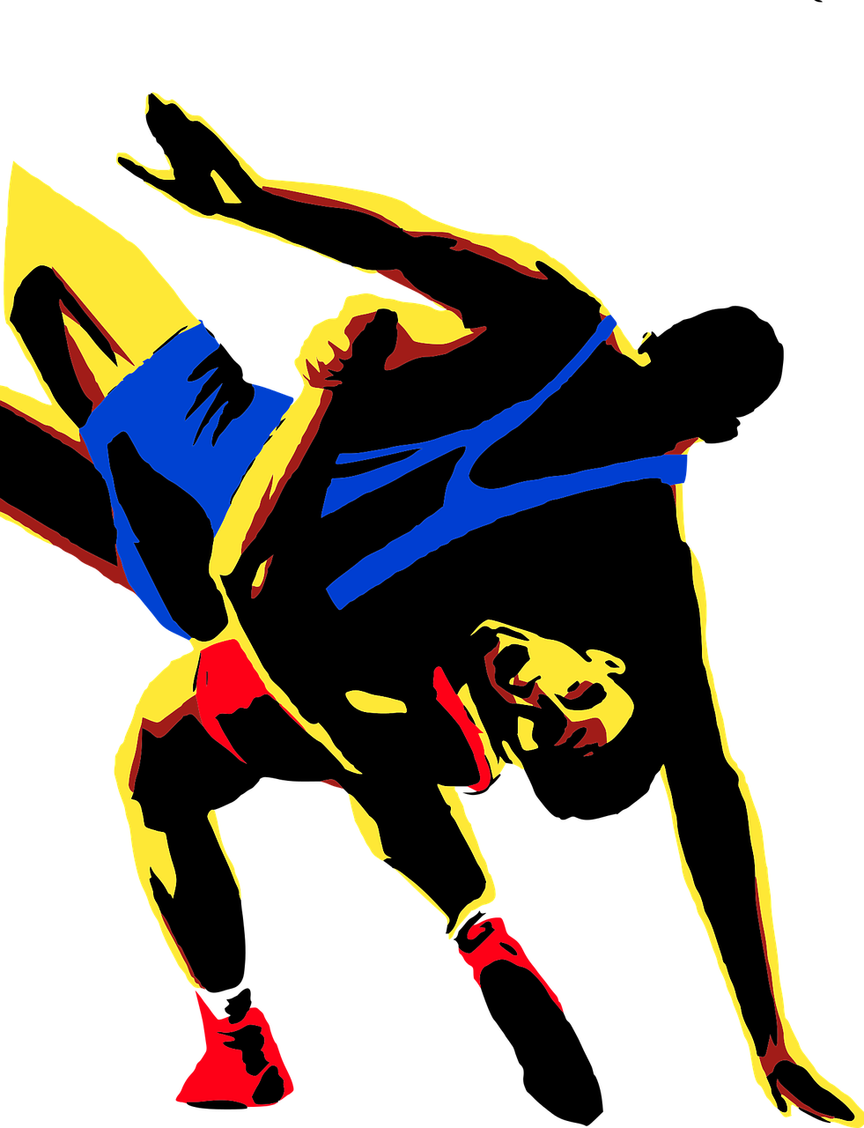
Step 4 : the crisis /climax!
The Crisis (or Climax)- this is the moment when the main character has their biggest moment of change. It could be physical or mental but always emotional.
For example: now equipped with the knowledge, skills or equipment, our hero confronts the villain, nervous but believing that they now have the power to defeat the villain.
They were wrong.
But even though the villain has won for now, the hero has made an important discovery. The experience has changed everything they used to think, and now they have what they need for the final confrontation.
Do some thinking. Make some notes.
Now draft you’re the crisis moment of your story.

Slide 10
Step 5: falling action! Called that because it’s moving away from the crisis...
If the Crisis was the highest point of tension in the story, this is where the tension is released, pushing your hero towards the final confrontation.
Our hero has had their moment of realisation.
They now know a truth that was hidden to them before.
They confront the villain again - and right up to the last moment, it look like the villain has won!
But in a last second twist, the changed hero turns the tables.
Think, make notes, draft this lovely part of your story!

Slide 11
Step 6: Resolution!
The villain is defeated.
the victims have been rescued and the danger is over.
But there’s also time for reflection:
The hero has changed, and we need to see the emotional effect of this.

