Slide 1
Student Mission Book 8
Sarah Green
Roger Haines

Slide 2
In this unit you will:
Take a closer look at characters in the book
Check your understanding
Discuss character arcs
Do some writing of your own.

Slide 3
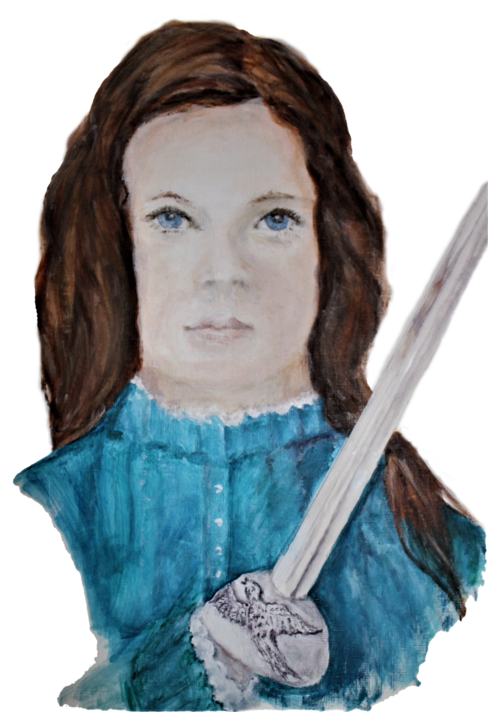
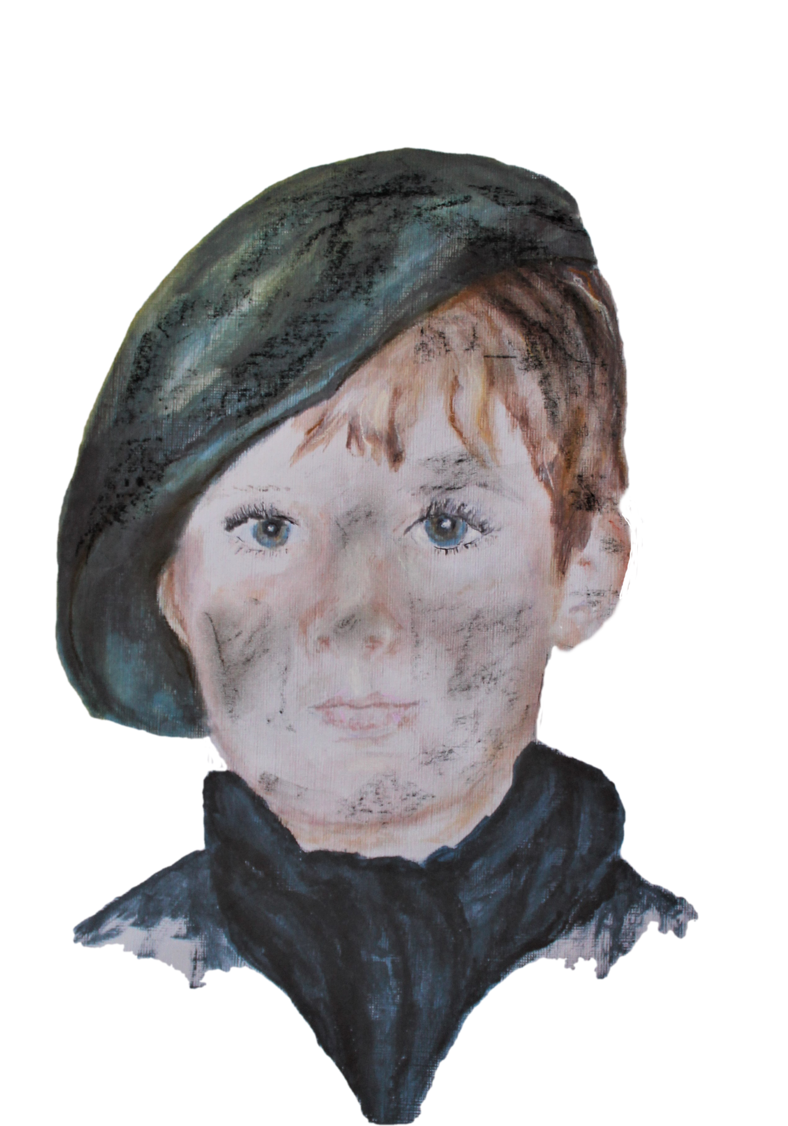
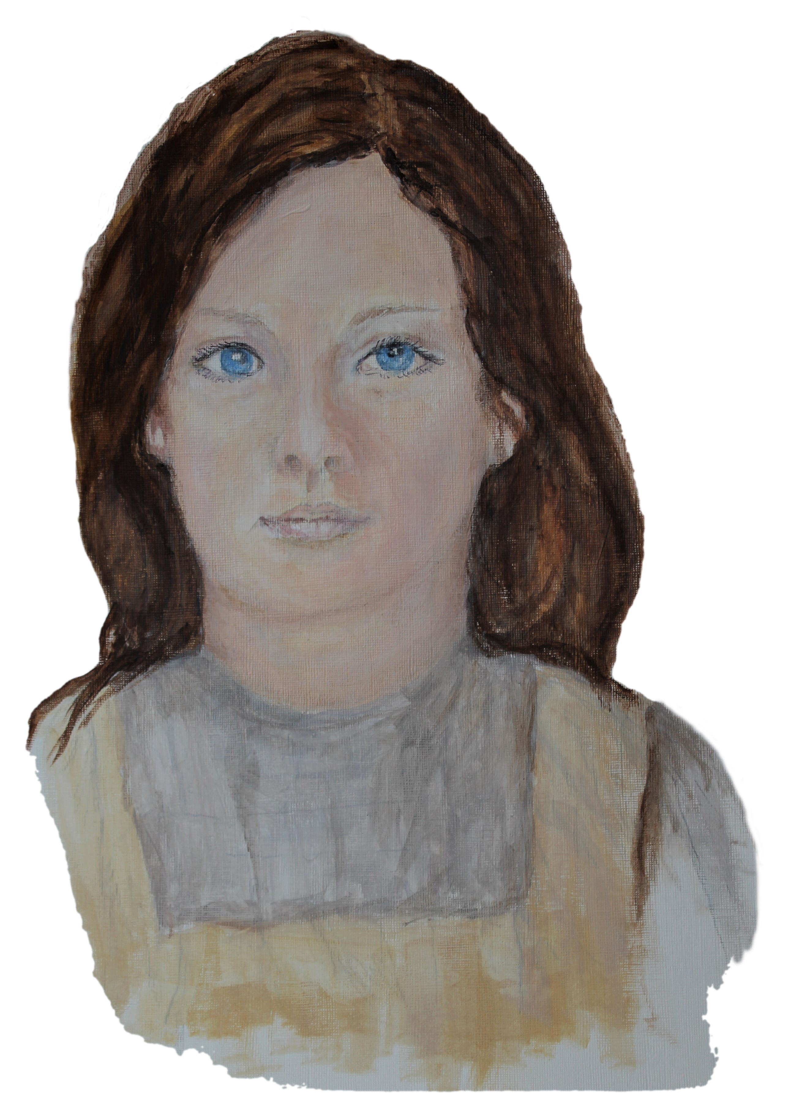
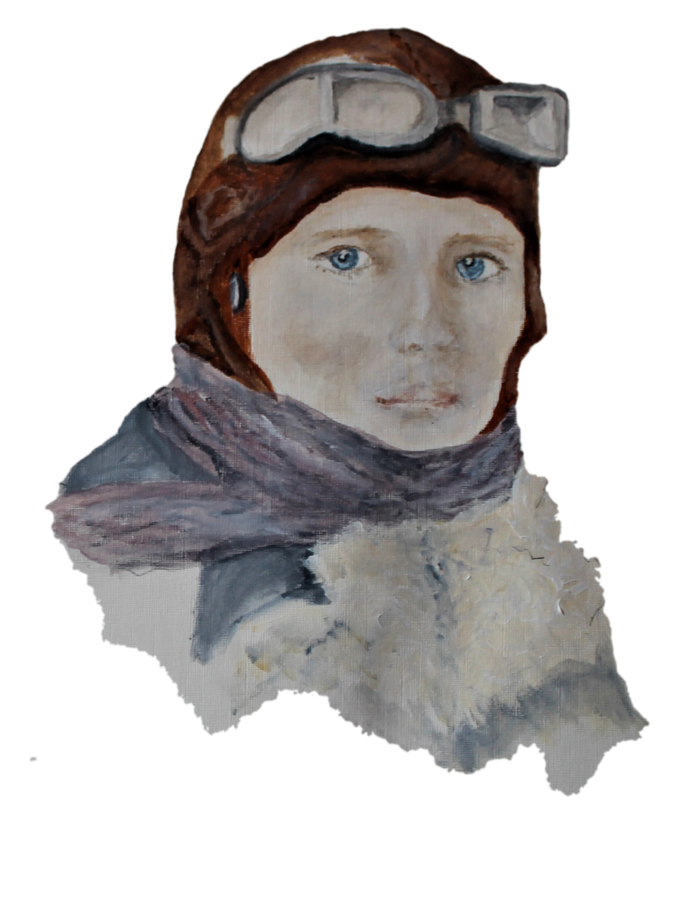
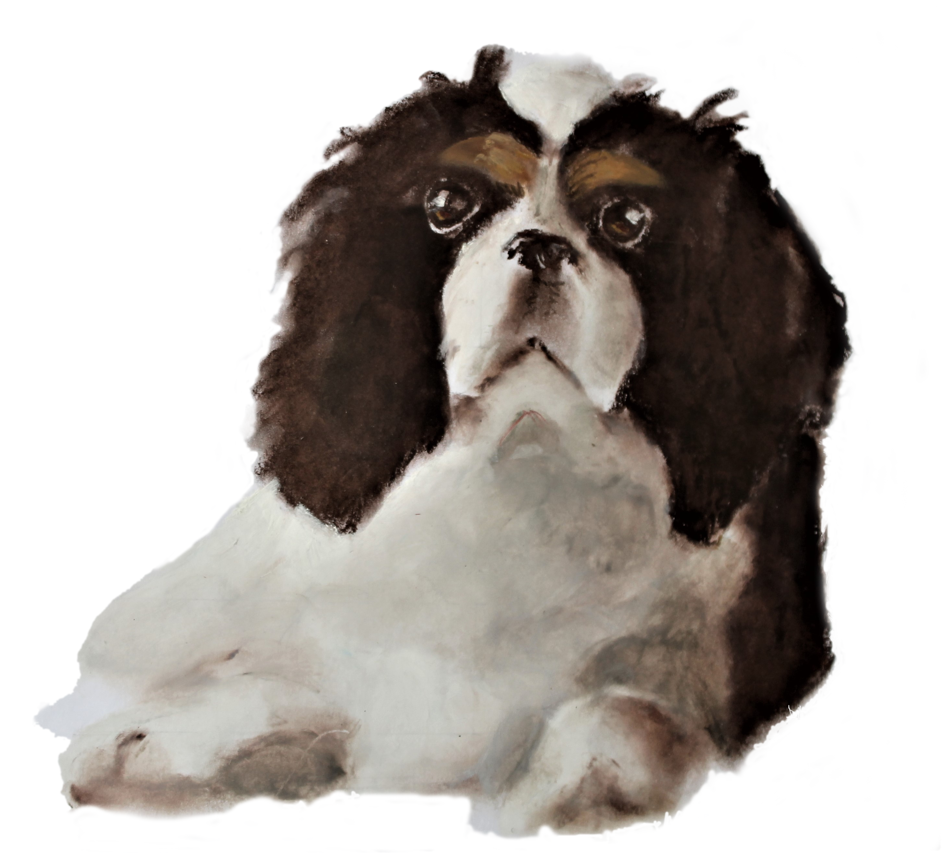
The Four Main Characters:
Victoria Broth Oi Albert
Oops... Nearly forgot Dash!

Slide 4
Author’s Note:
I chose to write Princess Victoria’s War in the THIRD PERSON so that I could follow each of the characters.
This means I can separate the characters and give them adventures of their own.
This also means that I can develop their CHARACTER ARCS more easily.

Slide 5
Albert: fact file.
Albert is Victoria’s cousin
He has designed his own flying machine
He belongs to a secret society, led by Black Rod.

Slide 6
What does Albert bring to the story? SPOILER ALERT: only answer questions for the parts of the book you’ve already read!
1. Find examples of how Albert uses his flying machine to help the others.
[Tip: take a look at Chapter 8 P 36-40] ; Chapter 14, p66-70].
2. What is Albert’s connection with Blunden’s Yard? Find examples [evidence] to support your answers.
[Tip: Take a look at Chapters 31and 32 p 158-167]
3. Why is Albert important to the ending of the story?
[Tip: take a look at Chapter 57-p299-303]

Slide 7
Writing task!
Albert and Victoria are talking about all that has happened.
What would the moments that would stand out for them? What would they think about them?
Write their conversation.
[Tip: try to capture their joky way of talking to each other.]

Slide 8
Albert’s character arc? Albert’s arc is more difficult to see than the others because he is always joking, usually to hide his feelings.
With a partner discuss the following:
What is Albert like at the start of the story?
Do you think he does change by the end of the story?
For example, how does he show his true feelings for Victoria?
What are Albert’s main character traits?
Find examples to support your thinking

