Slide 1
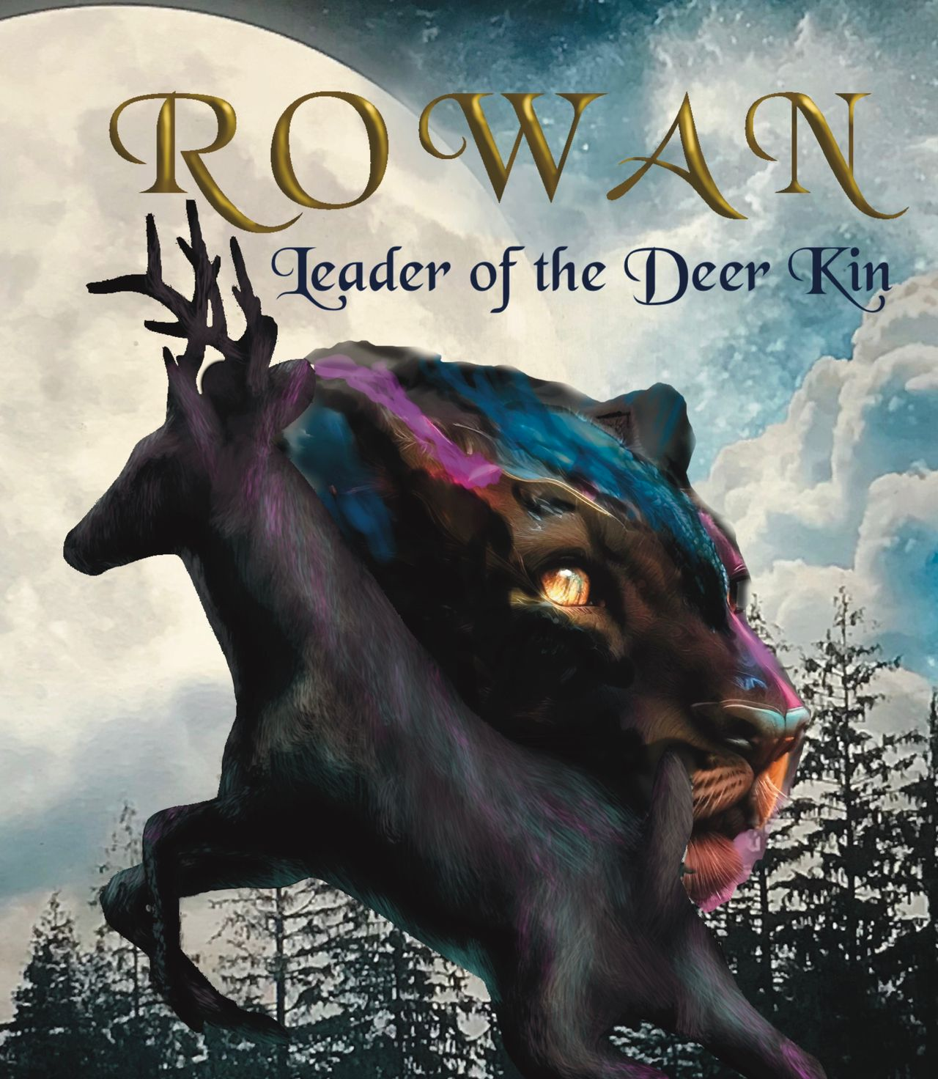
Student Mission Book 3
Sarah Green

Slide 2
World Building

Slide 3
In this unit you will:
Improve your understanding of world-building
Physical
Cultural
Spiritual
Check your understanding
Write part of a story

Slide 4
Author’s Note:
Every story has to be set in a time and place. This is world-building.
-If the setting is modern, that may be a little easier, but we still need to create a sense of that world... the smell of coffee... the sound of traffic...
-But some story-worlds can be created from imagination. For example, science fiction, fantasy. Some story worlds require research. For example, historical stories.
-I researched very carefully the life of roe deer, what they eat, the kind of terrain they prefer but I also brought an element of fantasy to the story.

Slide 5
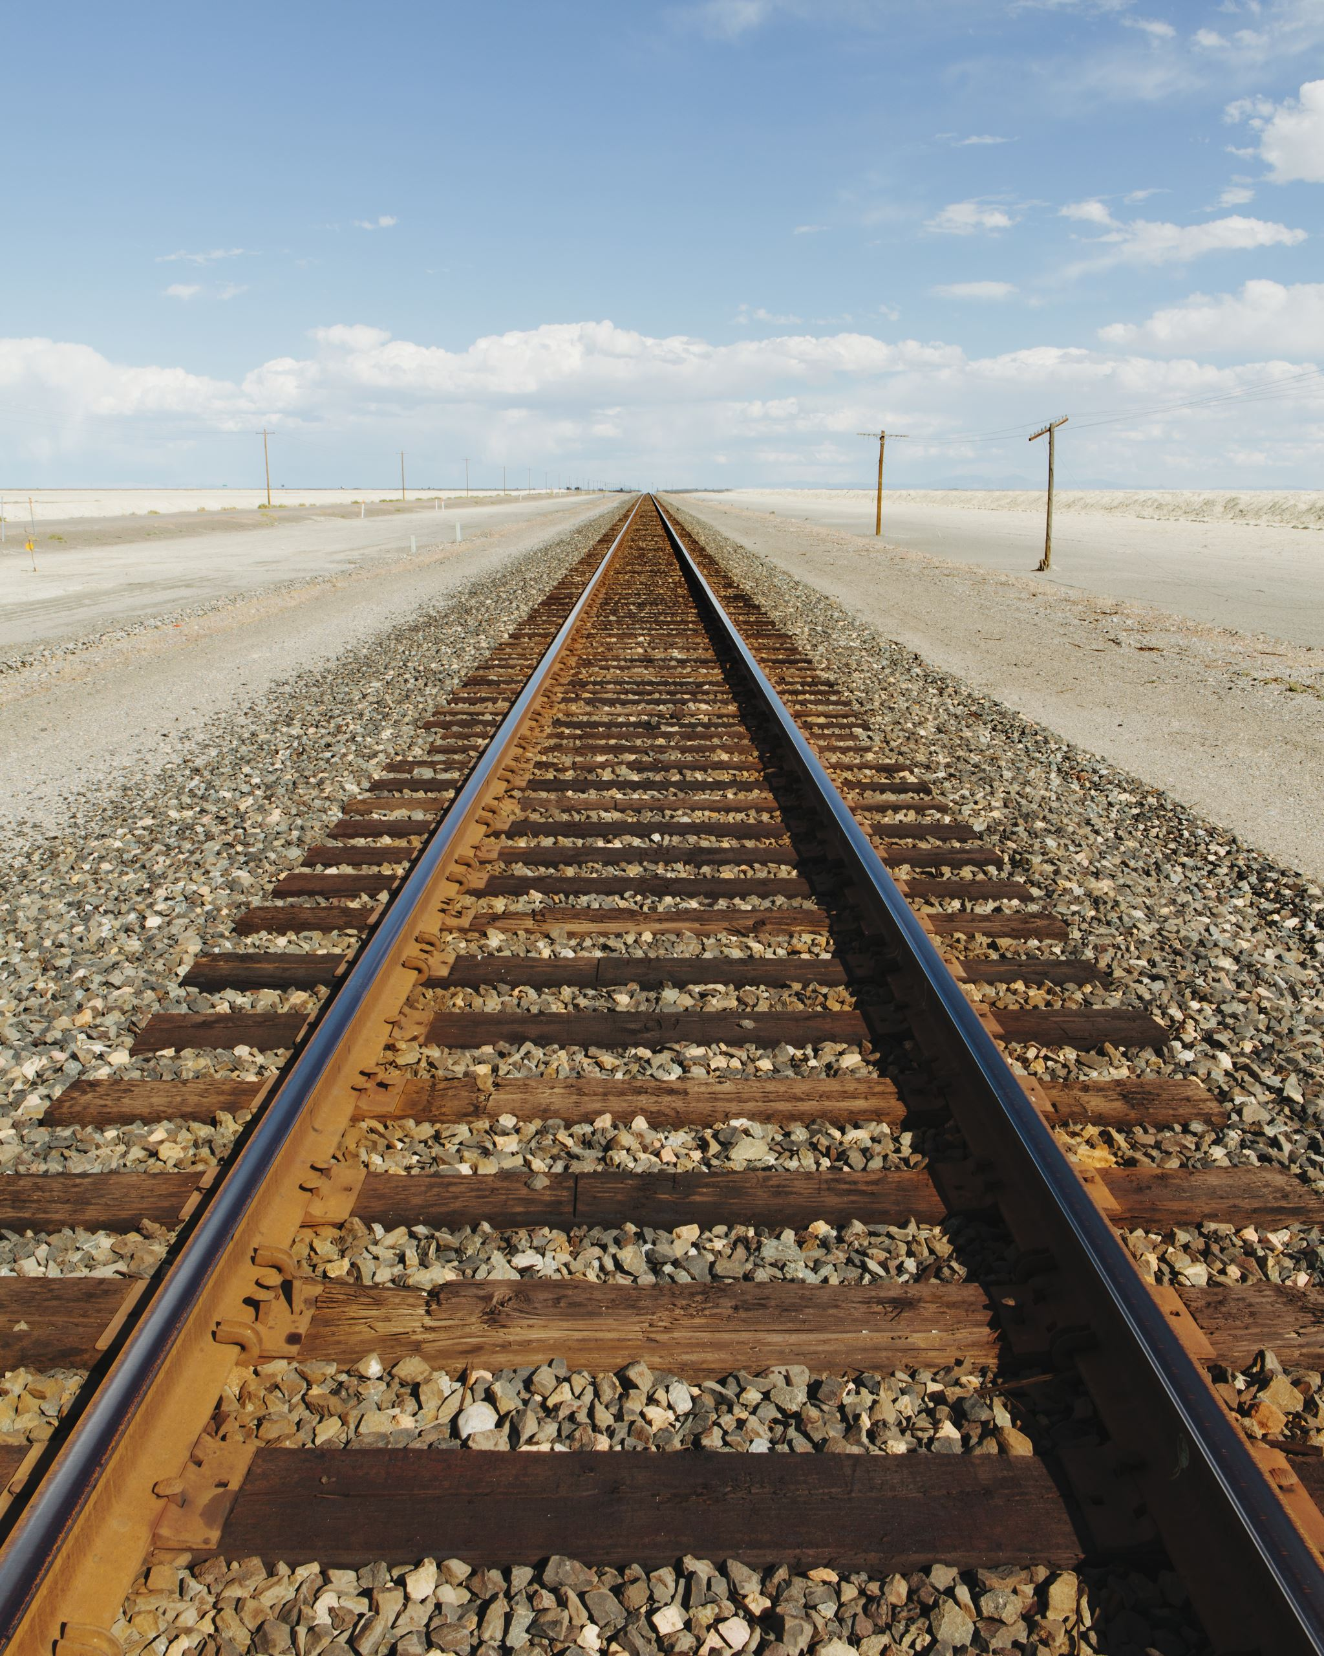
World Building: Add emotion to physical details
Read these lines from P 134 in the book
‘The ground was entirely covered by shiny man-lines, just
like the ones running through the tunnel. They seemed to run in
every direction, dead and pale like polished bones. The air
tasted bitter.’
With a partner:
-pick put the details that tell you what the deer can see.
-Rowan says the railway lines are ‘dead and pale like polished
bones.’ What does that tell you about his feelings?
-Pick out a phrase that uses the senses.

Slide 6
Author’s Note
This is a story written in the first person.
That took me into thinking about the culture and yes, spiritual beliefs of the deer.
For example, Research told me that roe deer are often seen alone. Being hidden is clearly one of their survival techniques.
I interpreted this as Stillness, a state of mindfulness where the deer seek to be one with the earth.

Slide 7
World Building: Include the cultural beliefs of your characters. Check your understanding! Read or re-read the Chapter on Page 44 : The Word of the Duir. This chapter tells us a lot about the beliefs of the deer.
What are the men doing? What makes you think so?
What are they wearing? What makes you think so?
How does Rowan and the other deer respond when they see the men?
How does this make them feel.
5. What is the Duir?
6. Why is it important to the deer?
7. What does ‘taboo’ mean?
8. What effect does the Duir have on Rowan?.

Slide 8
World building How do your characters think about the world? Read the handout about the moment when the deer arrive in the churchyard. This is an alien place for the deer, but they have some insights into its spiritual nature as they struggle to understand.
Speaking and listening task.
With a partner discuss :
-How does the reader know it’s a churchyard?
-What are the deer’s thoughts about man?
Writing Task:
Mission: choose one of the following:
Either
Write part of story when someone arrives on a strange planet.
Or
Write part of a story when someone travels in time and unexpectedly arrives in a puzzling place in history.

Slide 9
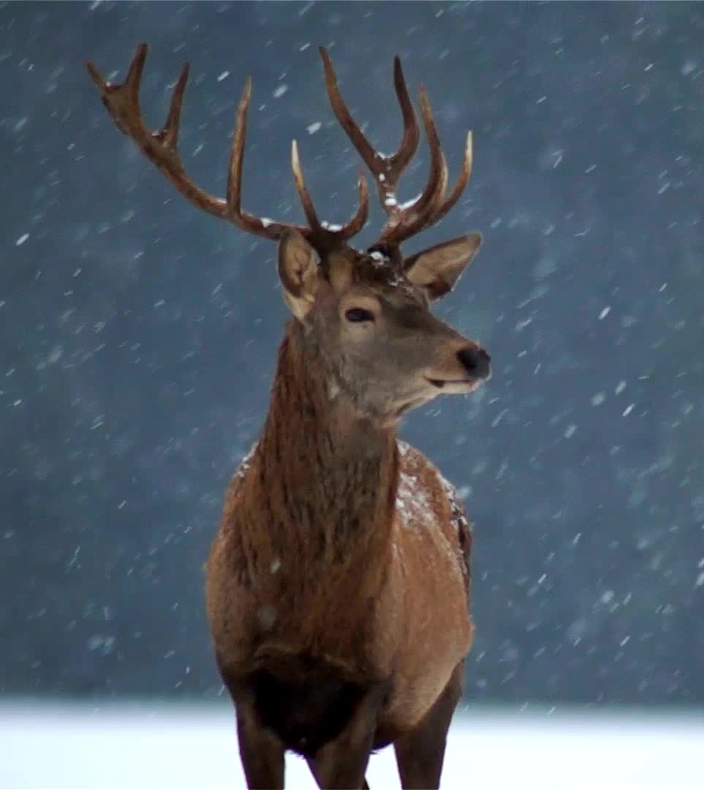
World Building Add in myths
Mission task: write a deer myth of your own to explain one of the following:
A thunderstorm
Trees and why some shed their leaves, and some don’t.
Snow or rain.
The seasons.
Super-power mission:
Research some of the story myths of First Nation people from either Canada or America.

