Slide 1
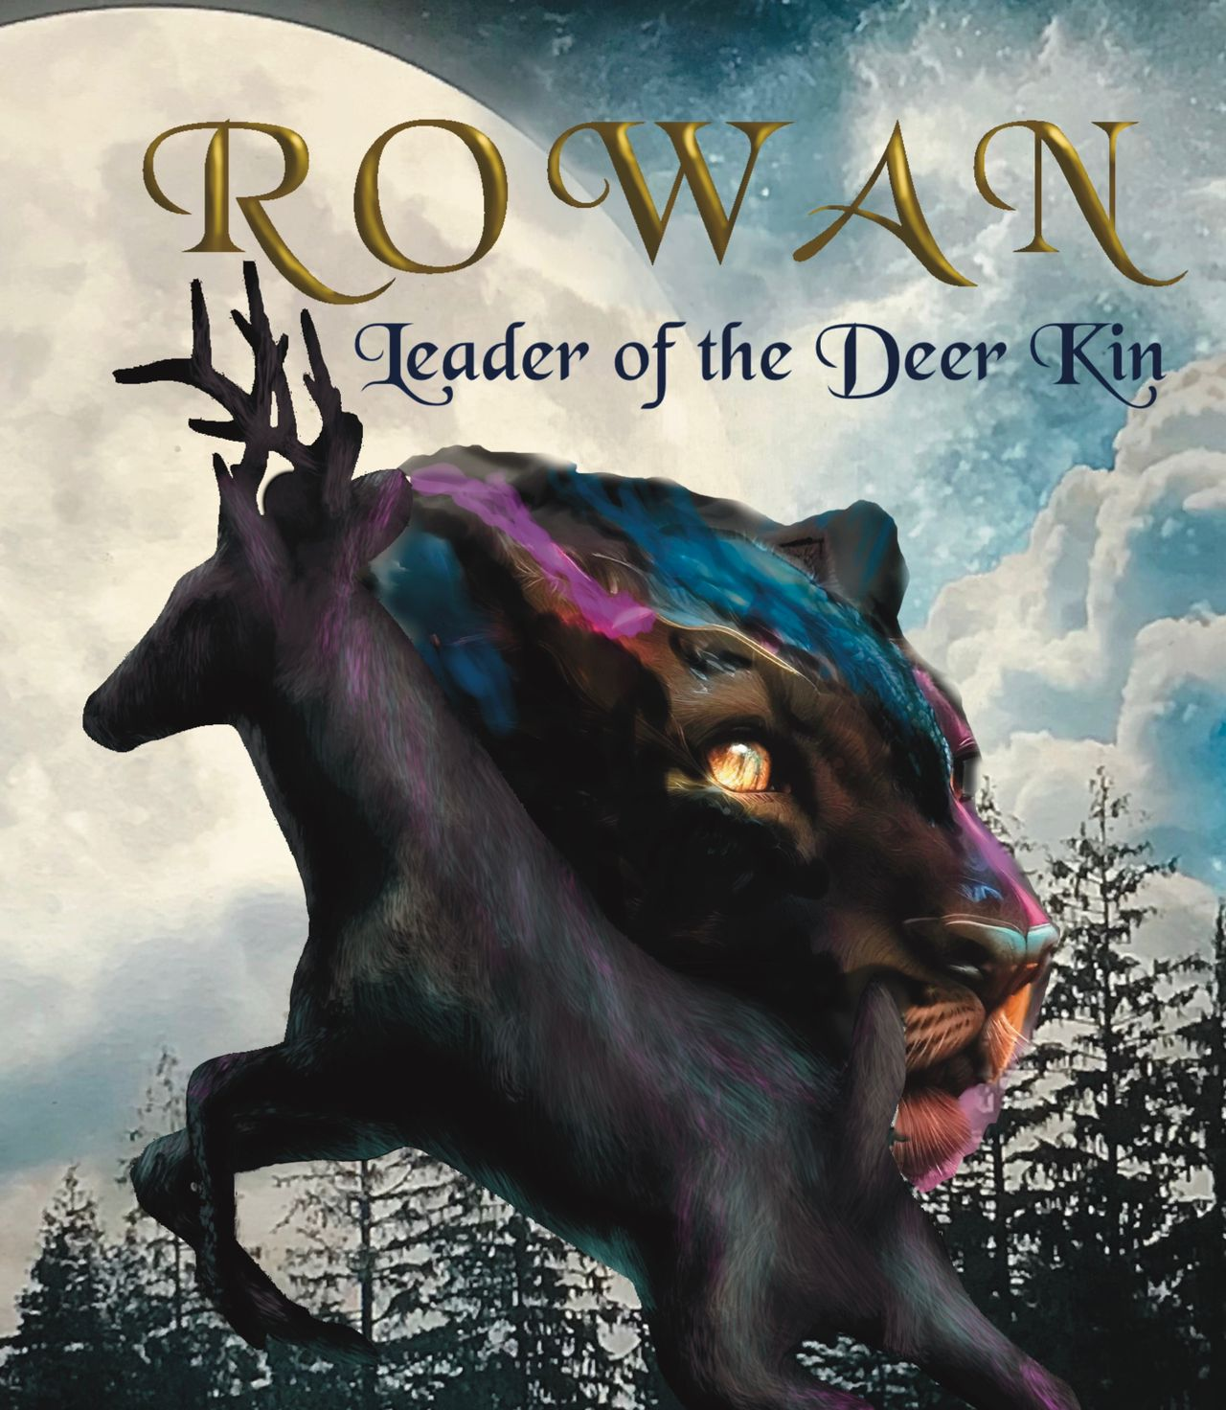
Student Book 9
Sarah Green

Slide 2
In this unit you will:
Read some extracts from the book
Research the facts
Design a leaflet about the environment
Be given a big challenge

Slide 3
The Environment
When you write about wildlife in the first person, it really makes you think about the impact that man is having on the environment.
And when you map an epic journey across the British landscape it does focus the mind!
The roe deer live in the ‘fringes’ of human existence and man is eroding their territory more and more.
Our environment is a theme that runs throughout the book.
Now read the extracts on the next two slides.

Slide 4
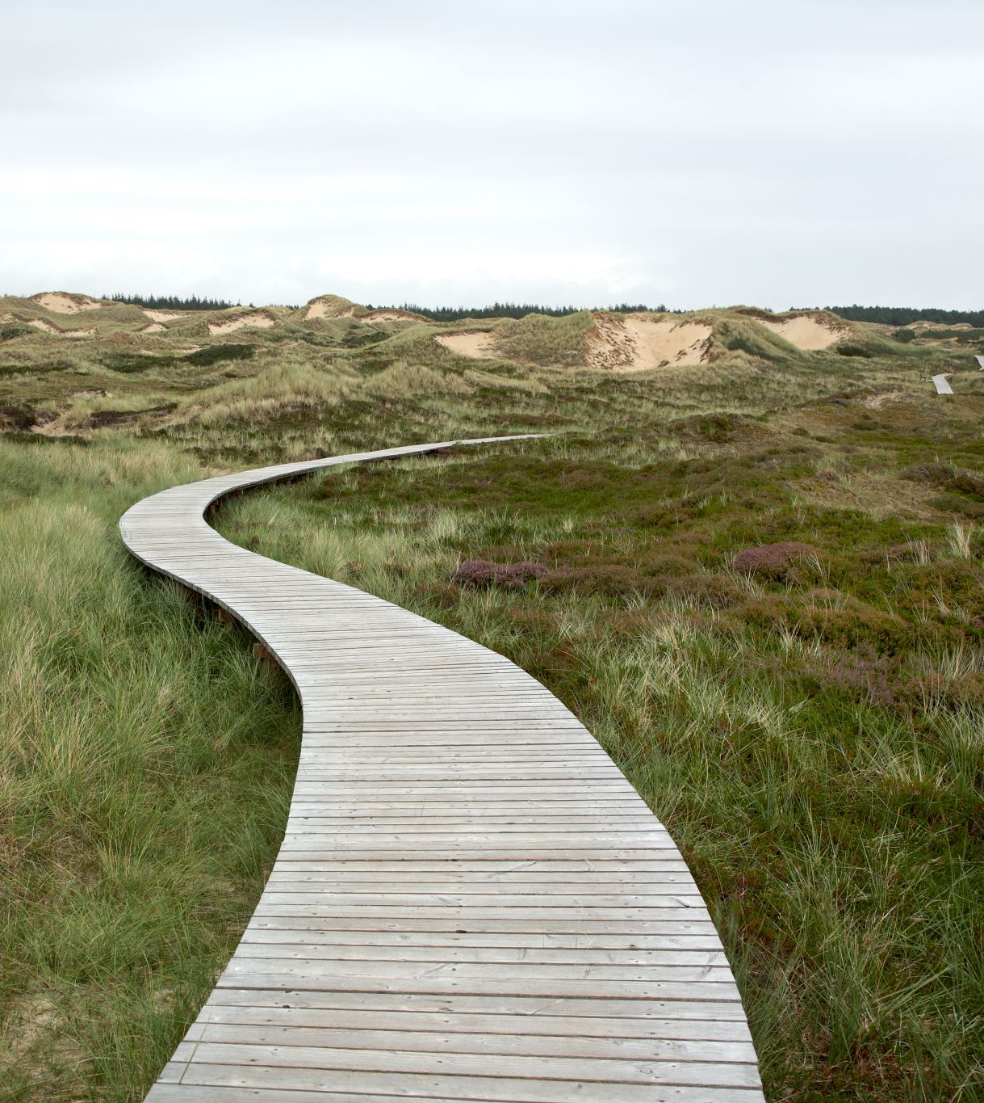
Far to the east, we could see men and
huge moving things that were tearing into the
earth and moving it around like giant moles.
Stretching away into the distance they’d made a
wide river of raw earth going up and down the hills.
“Like Molde-Warp,” said Flax.
“What’s Molde Warp?” said Brack.
“The giant snake that inhabits the underworld,
Los Duir. He lies waiting in the dark to snatch
the unwary, like a stinking fly-trap,” said Flax.
“And now it’s above ground! “
“Another curse!” muttered Redshank.

Slide 5
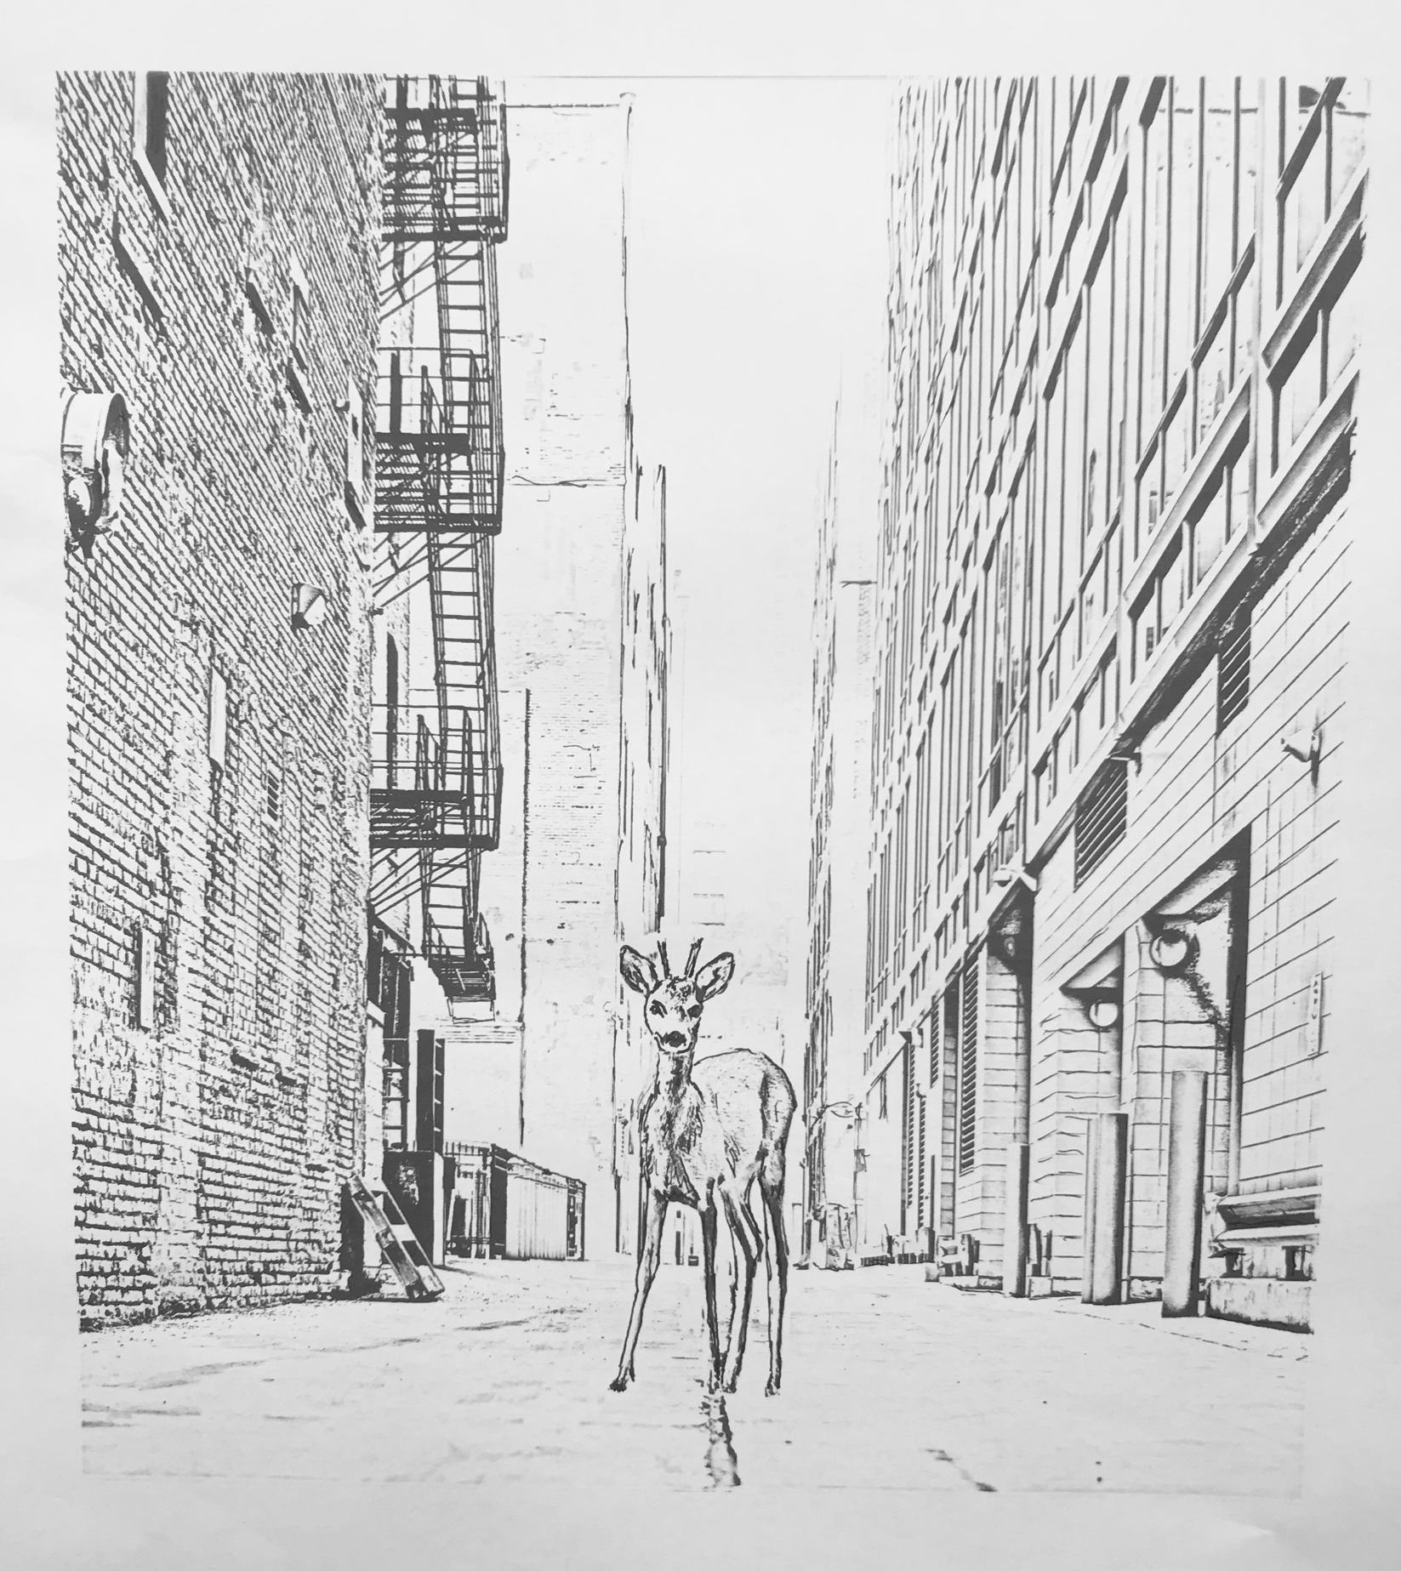
The deer are in the city...
I led the way through the sinister ravines which ran through the hive. They were dark
and shadowed and there was nothing living to
be smelt. All the time I was aware that the cat
could be following…or had the noise-monster
killed her? I did not know. The ground was
covered in the dark, hard stuff. I remembered
Hawthorn’s words. “They cut the earth open and
cover it with their black stuff and it becomes hard and bitter...”

Slide 6
The environment needs you!
Design a leaflet to make people think about the environment.
Begin with some research: find 3 facts about the environment.
These could be shocking, or they could be good news.
Now design a leaflet around those facts.
Tip: Use images; big fonts; strong colours. Keep the message simple... and memorable!

Slide 7
Find your voice!
So where does all this lead us? I hope that the book makes us think a little bit more about what we are doing to the environment.
Stories have the power to make us think, to help us understand an issue a little more. If you care about something, you can write about it and make other people think and perhaps share your feelings.
So, this Student Mission Book ends on a big challenge.
- Write a story related in some way an issue you care about. Try to give your reader some insight into whatever it is you feel strongly about.
Tip: keep it subtle. This isn’t a speech or a lecture. Let it be an engaging story but more than that, give it heart.

