Slide 1
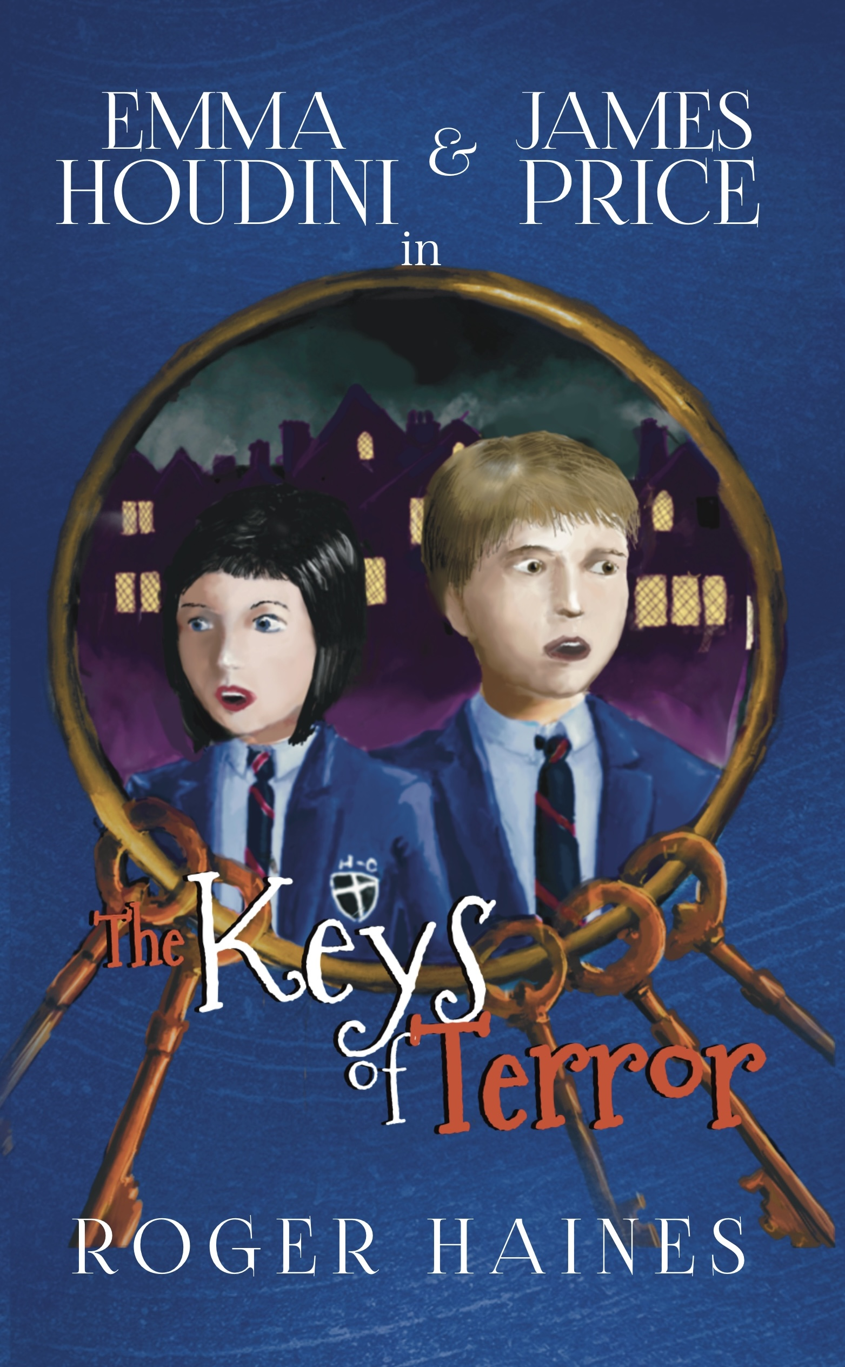
Student Mission Book 1
Roger Haines

Slide 2
In this unit you will:
Check what you know about the Gothic genre
Find detailed examples from Keys of Terror
Link what you know to other texts
Design a poster or slides to show what you know
Check your understanding of Chapter 2 which introduces the main characters, Emma Houdini and James Price.
Do some writing.

Slide 3
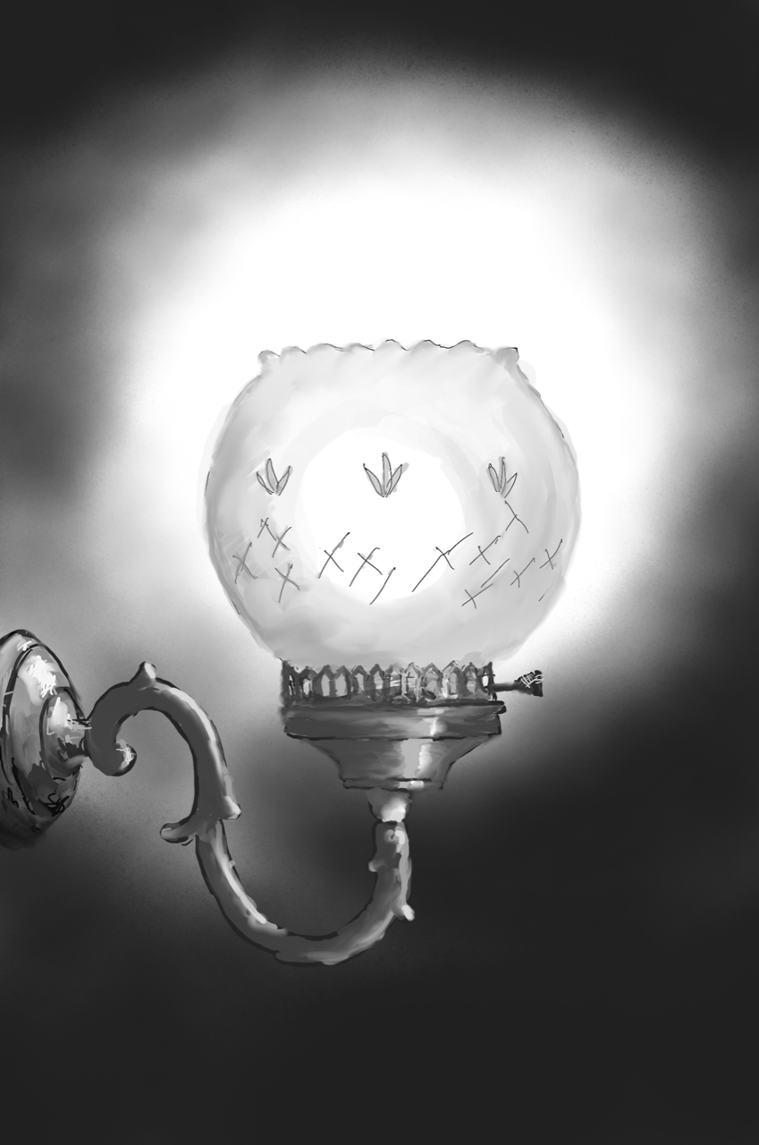
Check your understanding : the Gothic genre! Keys of Terror is set in modern times, but it uses many of the features [conventions] of the Gothic genre. Read Chapter 1.
Find examples of these gothic conventions in Chapter 1:
1. Emphasis on darkness and shadows
2. Elements of dream or fantasy
3. Ruined settings and buildings
4. Intense emotions
5. Supernatural events or creatures
6. A sense of mystery

Slide 4
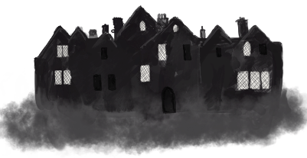
Be an expert! Link the six Gothic conventions to other texts you know. [Show off your knowledge!!]
The challenge!
Produce a poster or set of slides about the six gothic conventions on your list.
Include these examples to illustrate what you mean:
-Quotes from Keys of Terror
-Names of other gothic texts that use the conventions.
-Comments of your own:
what emotional effect is each convention trying to create in the reader...suspense... Intrigue... Fear...?

Slide 5
Check your understanding! Answer these questions on Chapter 2. The Strange Girl.
1. Why is Darren late for school?
2. In what year group are James and Darren?
3. Who is James’ little brother?
4. How do we know that James’ brother is in trouble quite often?
5. What is the name Emma Houdini says is her legal name?
6. Why do you think she prefers to be called Emma Houdini?
7. Where has Emma lived for the past five years?
8. We are told that James “wondered if it was too late to ask someone else” to show Emma around. Why do you think this is the case?
9. Who is Emma going to be living with, and where does this person live?
10. Who does Emma tell James he is related to?

Slide 6
Be a writer!
As writers we must have empathy for our characters.
Put yourself in Emma’s shoes. Imagine how she would feel after her first day at school.
Write an entry for her diary.
Or
Imagine you are James Price. What does he say to himself about the day as he walks home from school?

